Slide 1
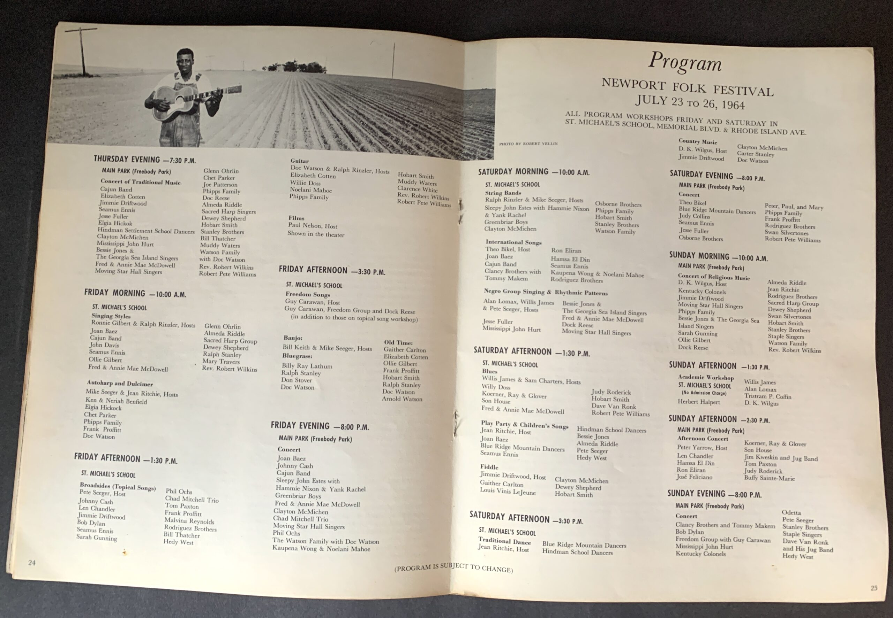
The Songs of the Historic 1964 Newport Folk Festival
https://pleasuresofpasttimes.com/popt-shop/bob-dylan-newport-folk-festival-1964-programme/

Slide 2
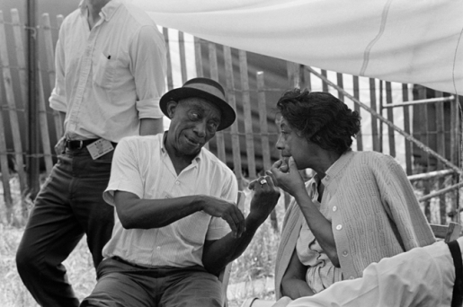
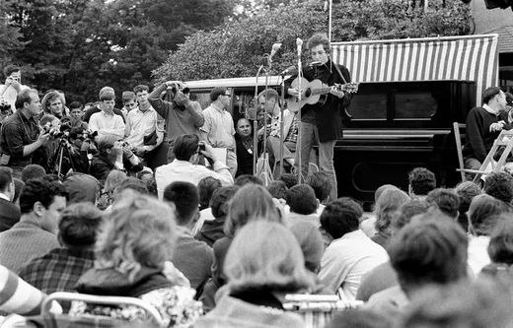
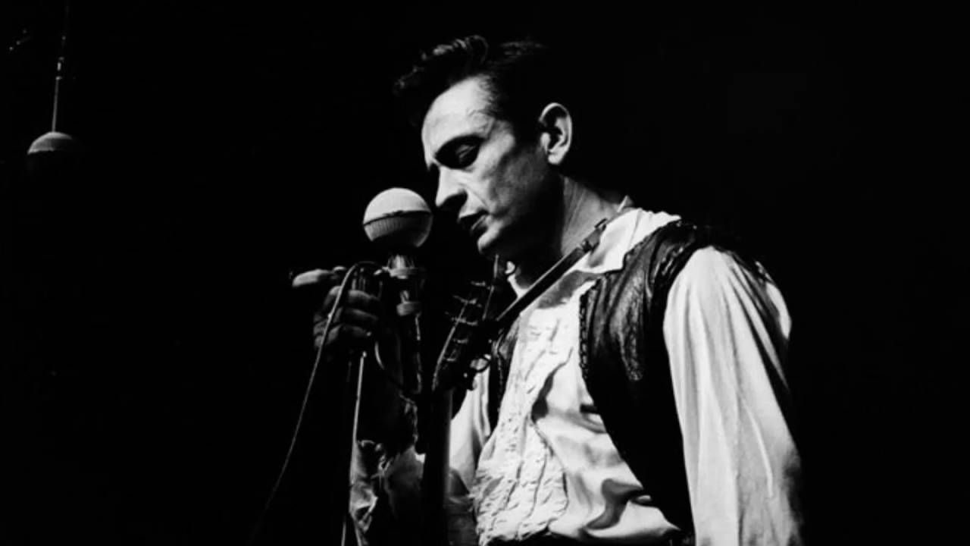
Faces of the Festival
https://www.wallofsoundgallery.com/en/mississippi-john-hurt-by-joe-alper-mississippi-john-hurt-C-newport--folk-festival-C-i3113#
https://www.pinterest.com/pin/bob-dylan-performing-at-newport-folk-festival-newport-rhode-island-1964
https://www.youtube.com/watch?v=RVjrg6-JXu4

Slide 3
The Folk Revival
1928: Library of Congress creates the Archive of American Folk Song.
1928: Bascom Lamar Lunsford hosted first Mountain Dance and Folk Festival in Asheville, North Carolina.
Folkways Records founded by Moses Asch in 1948.
1950: The Weavers' cover of Lead Belly's Goodnight Irene hits #1 on the Billboard charts for 13 weeks.
1952: Harry Smith's Anthology of American Folk Music issued by Folkways Records.
August 1955: Pete Seeger appears before the House Un-American Activities Committee. Indicted for Contempt of Congress (1957), convicted in a jury trial (1961); conviction overturned (1962).
December 1955: The Weavers historic Carnegie Hall reunion.
1956: Albert Grossman and Les Brown opened the Gate of Horn in Chicago.
1957: The original Kingston Trio formed; Tom Dooley sold 3,000,000 in 1958.
1957: Izzy Young opened the Folklore Center of MacDougal Street in Greenwich Village.
1958: The Gaslight Café opened on MacDougal St.; Club 47 opened in Cambridge.
1958-1970: Berkeley Folk Festival
1959-1960: Harry Belafonte Carnegie Hall concerts recorded live.
1961: Inaugural year of the University of Chicago Folk Festival.

Slide 4
The Early History of the Newport Folk Festival
The “Utopian” Period
Founded by George Wein in 1959, owner of Boston jazz club Storyville and founder of the Newport Jazz Festival. Albert Grossman put the line-up together.
12,000-14,000 attended in 1959 and 10,000 in 1960. The Newport City Council shut it down after the first two years. Clashes with police had led to violence and vandalism.
In 1963, the Council was persuaded to grant a licence to Wein to resume the festival. The Newport Folk Festival was incorporated as a non-profit, with a 7-member board of directors: Pete Seeger; Theodore Bikel; Bill Clifton; Clarence Cooper; Erik Darling; Jean Ritchie; and Peter Yarrow.
They designed a weekend program of afternoon workshops and evening concerts, and invited traditional musicians, established country and blues acts, aspiring singer-songwriters, and world music performers.
The non-profit also included the Newport Folk Festival Foundation. The foundation funded regional festivals and folk song societies. And they sent Ralph Rinzler. Mike Seeger, and Bob Jones out into different regions of the country to find traditional singers and players and invite them to come to perform.
From 1963-1969, every performer received $50/day to perform regardless of their stature or reputation.

Slide 5
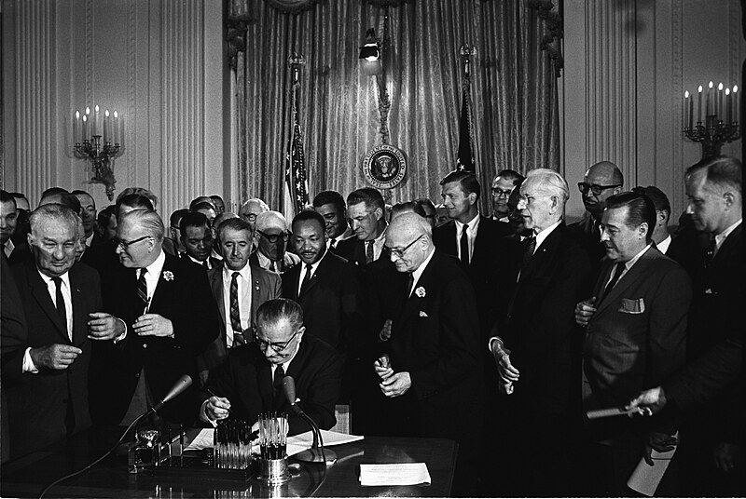
Remembering 1964: A Timeline
2/25 Cassius Clay beat Sonny Liston
3/6 Cassius Clay changed name to Muhammad Ali.
4/13 Sidney Poitier won Best Actor for Lillies of the Field.
4/20 LBJ and Khrushchev summit on nuclear weapons.
5/2 Ku Klux Klan murders in Mississippi.
5/28 PLO chartered.
6/12 Nelson Mandela sentenced to life.
6/14 Freedom Summer voter registration drive launched.
7/2 Civil Rights Act outlawed discrimination based on race, color,
religion, gender, and national origin.
7/27 5000 more US troops sent to Vietnam.
8/7 Congress passed Gulf of Tonkin Resolution.
8/27 Mary Poppins opened.
9/24 Warren Report on JFK assassination issued.
10/14 Martin Luther King won Nobel Peace Prize.
10/17 China’s first successful nuclear bomb test.
11/3 LBJ elected with 62.8% of the popular vote.
12/3 Berkeley Free Speech Movement, 800 arrested.
https://en.wikipedia.org/wiki/File:Lyndon_Johnson_signing_Civil_Rights_Act,_July_2,_1964.jpg

Slide 6
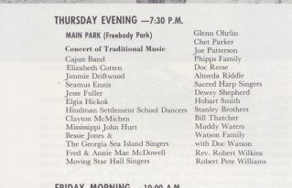
Thursday Night
Our Setlist
Tis A Gift to Be Simple (Jean Ritchie)
Freight Train (Elizabeth Cotten)
Jack O’Diamonds (Hobart Smith)
Merry Golden Tree (Almeda Riddle)
The Chickens Grow Tall (Glenn Ohrlin)
Goin Down the Road Feelin’ Bad (Doc Watson)
San Francisco Bay Blues (Jesse Fuller)

Slide 7
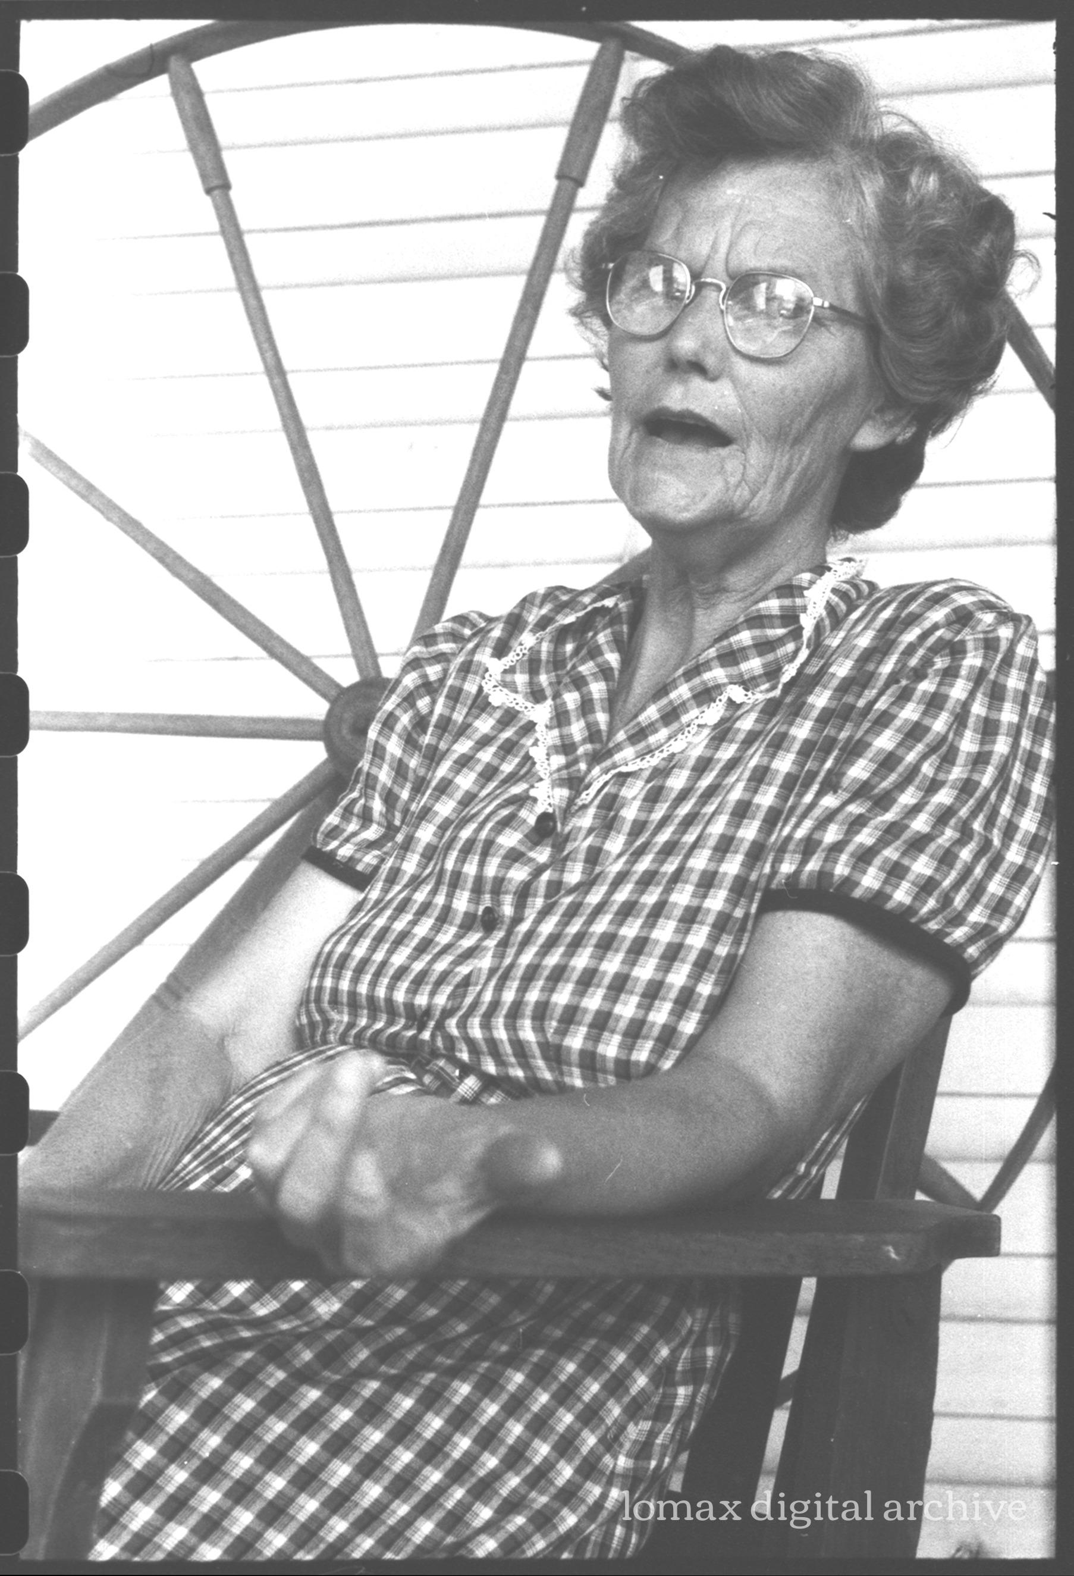
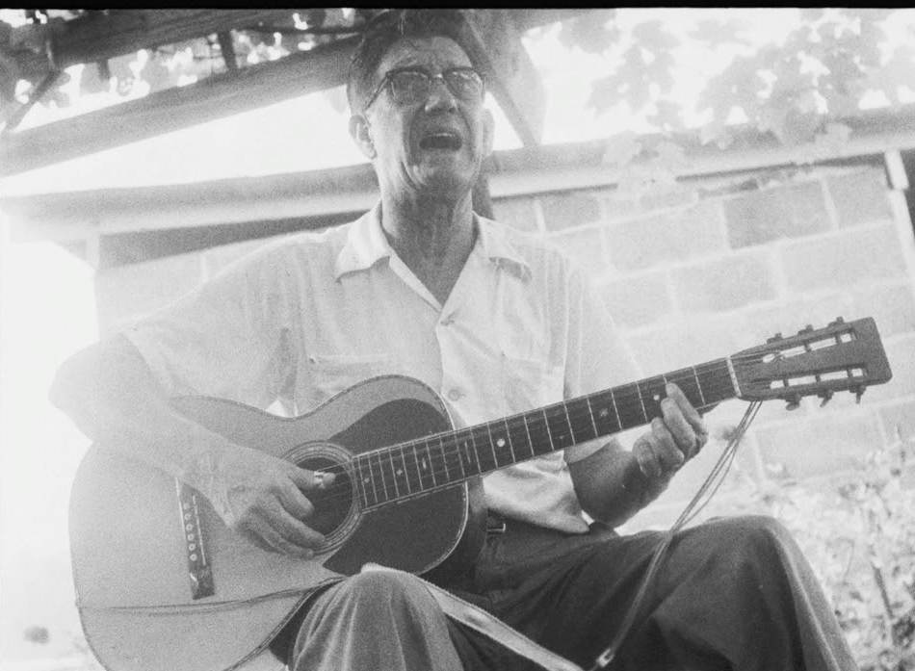
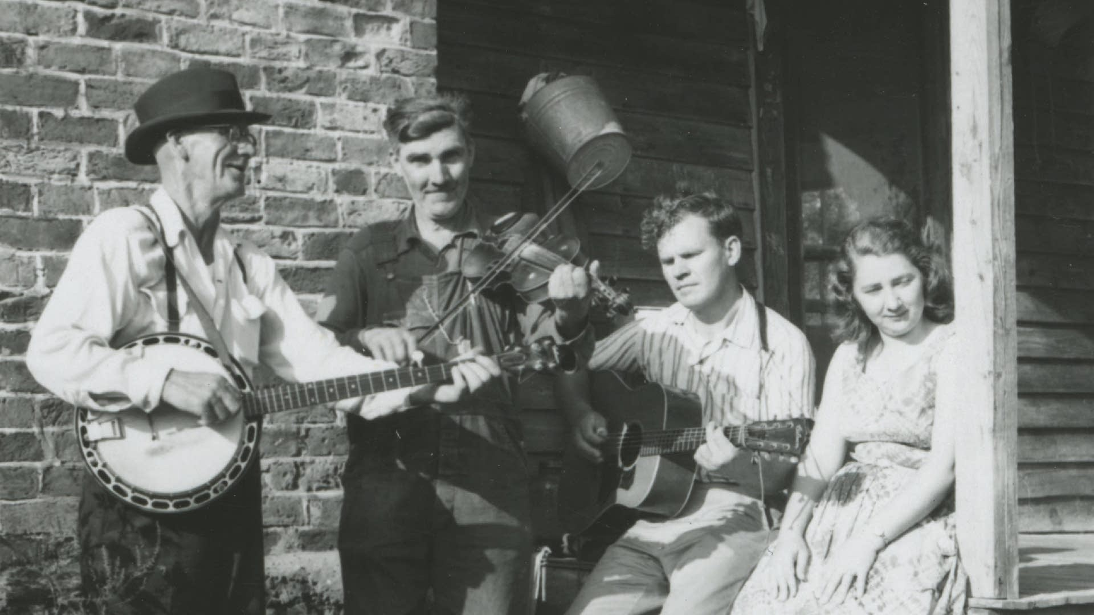
Songs of the Southern Mountains and Their Singers
Almeda Riddle
Phipps Family
Hobart Smith
The Watson Family with Doc Watson
Dewey Shepard
Stanley Brothers
https://i.ytimg.com/vi/ylDYpFXFo0U/maxresdefault.jpg
https://archive.culturalequity.org/field-work/almeda-riddle-her-home-4
https://img.apmcdn.org/ae0140a5ee8b626dbebf3a6e0d0ab74a61a4defd/uncropped/65dd43-20200528-doc-watson-and-gaither-carlton-02.jpg

Slide 8
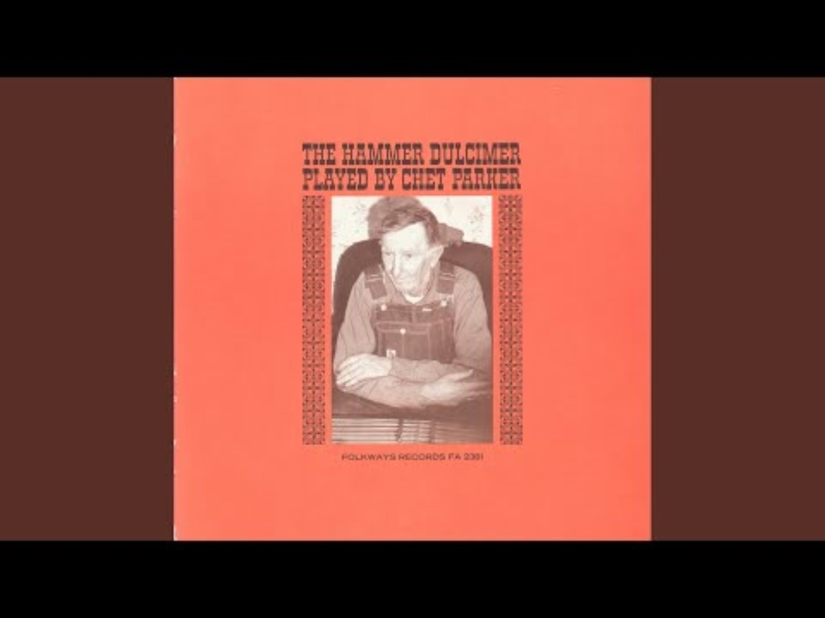
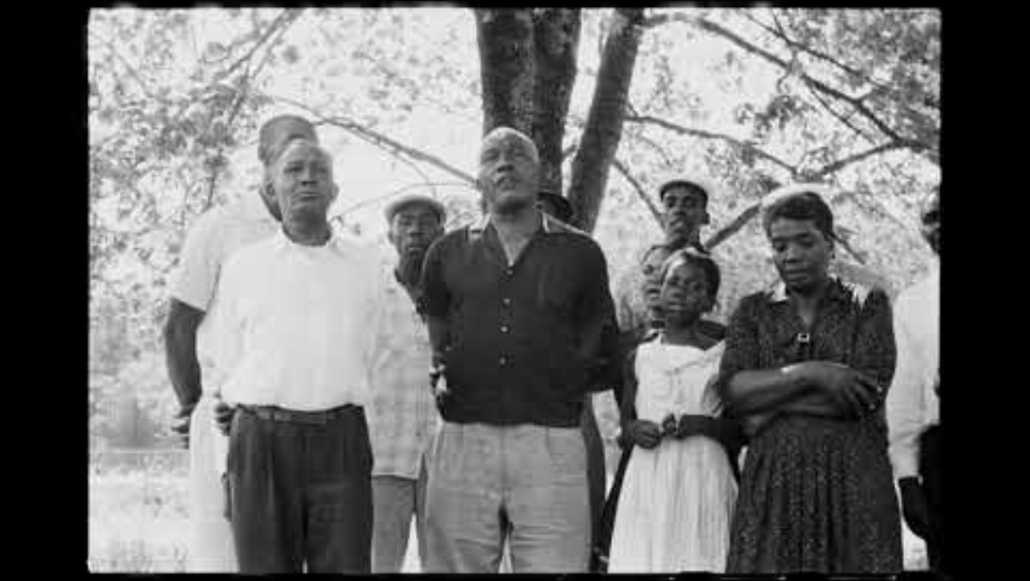
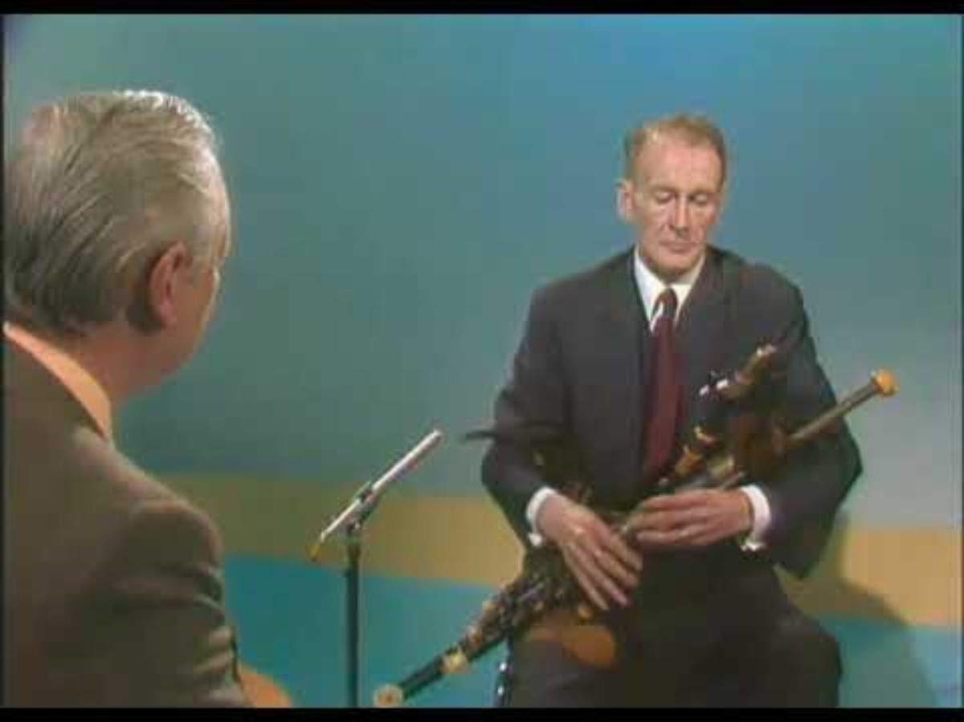
Other Traditional Music Makers
Elgia Hickok
Chet Parker
The Hindman Settlement School Dancers
Sacred Harp Singers
Bessie Jones and the Georgia Sea Island Singers
Moving Star Hall Singers
Seamus Ennis

Slide 9
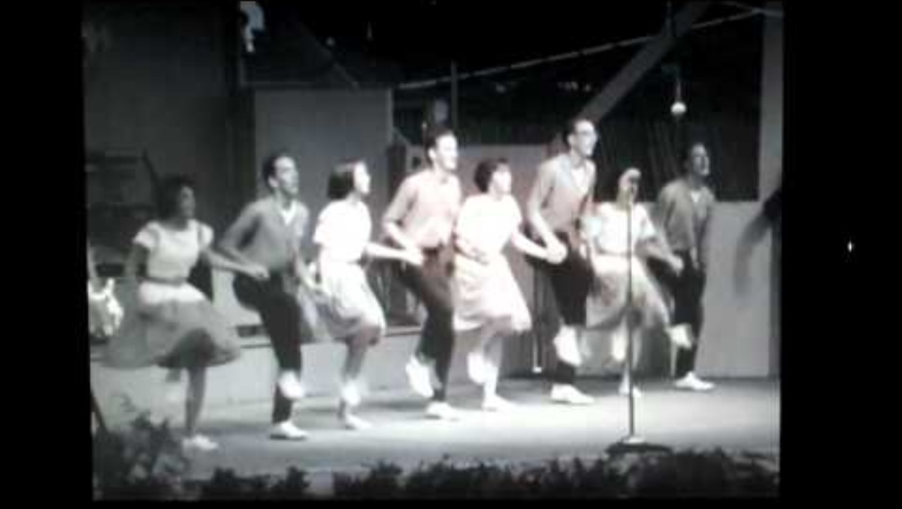
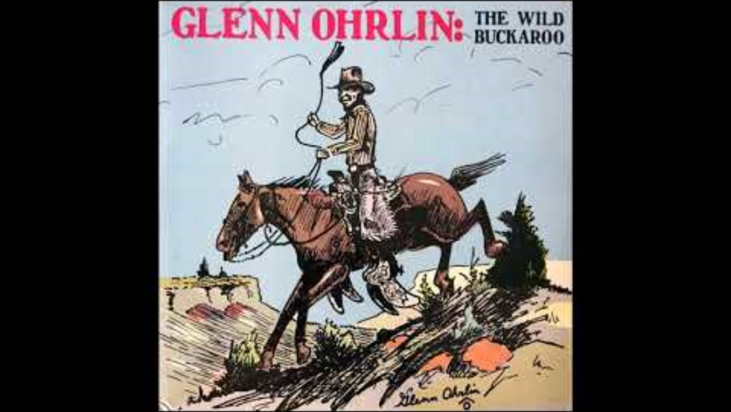
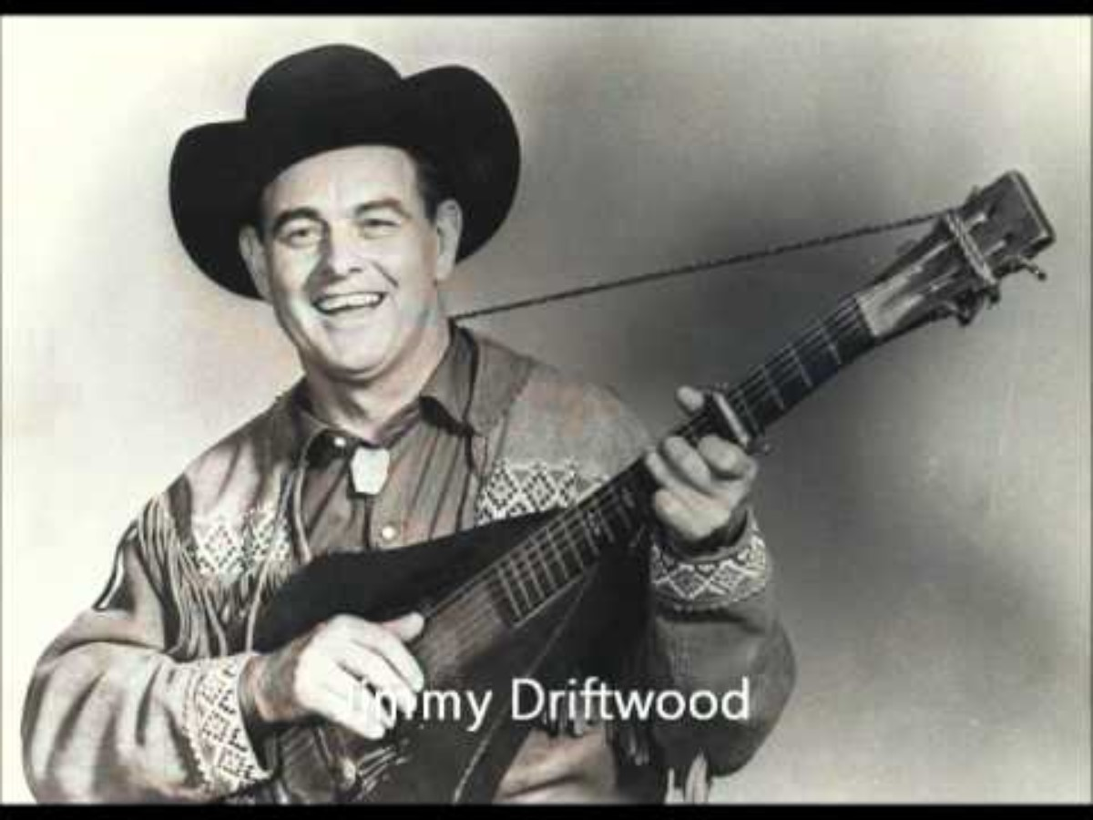
Country Radio Songs and Singers
Jimmie Driftwood
Clayton McMichen
Glenn Ohrlin

Slide 10
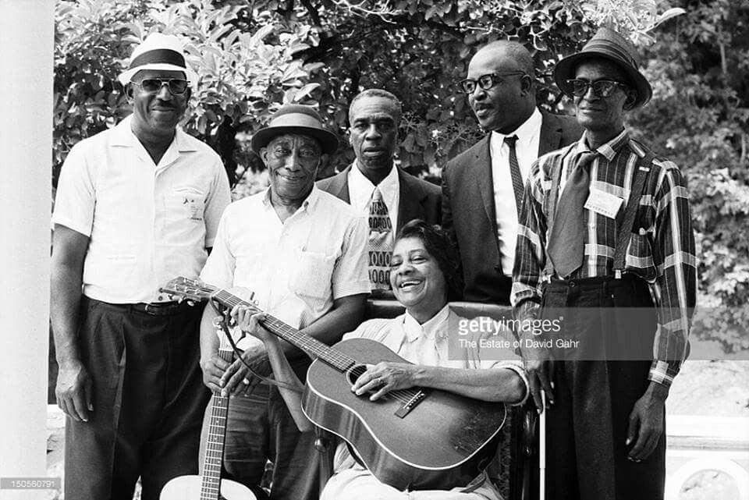
Blues Singers
Elizabeth Cotten
Jesse Fuller
Mississippi John Hurt
Fred and Annie Mae MacDowell
Doc Reese
Muddy Waters
Robert Pete Williams
Rev. Robert Williams
Yank Rachell, Mississippi, Skip James, Elizbeth Cotton, Doc Reece, Sleepy John Estes
https://i.pinimg.com/originals/3d/02/a8/3d02a885f257b2a4c400cf0167296ca5.jpg

Slide 11
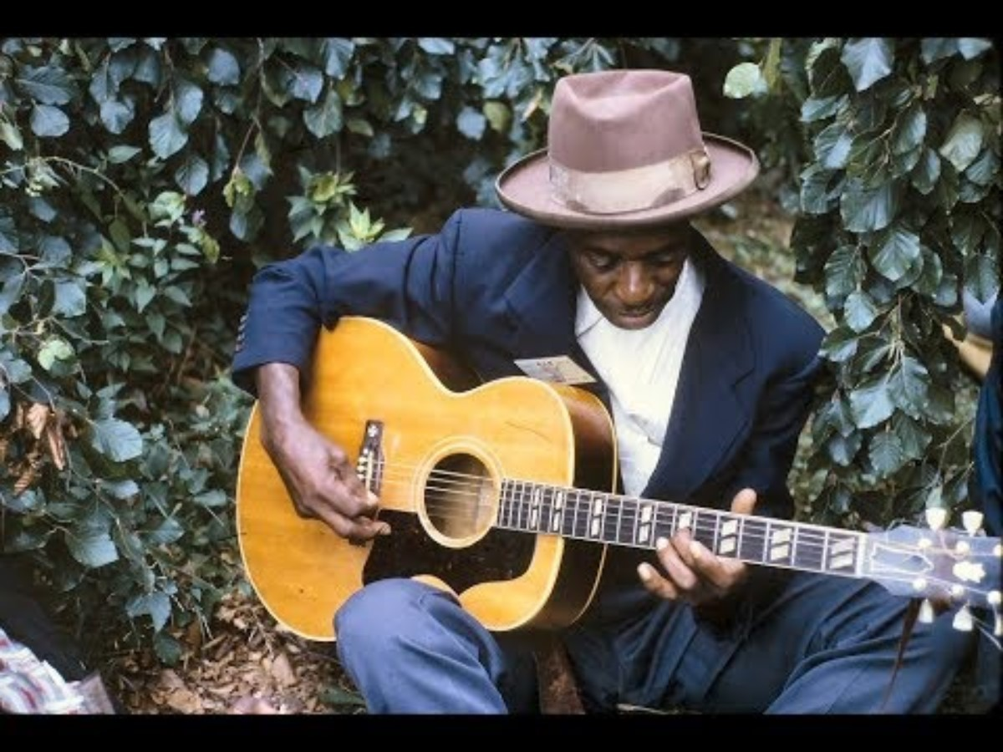
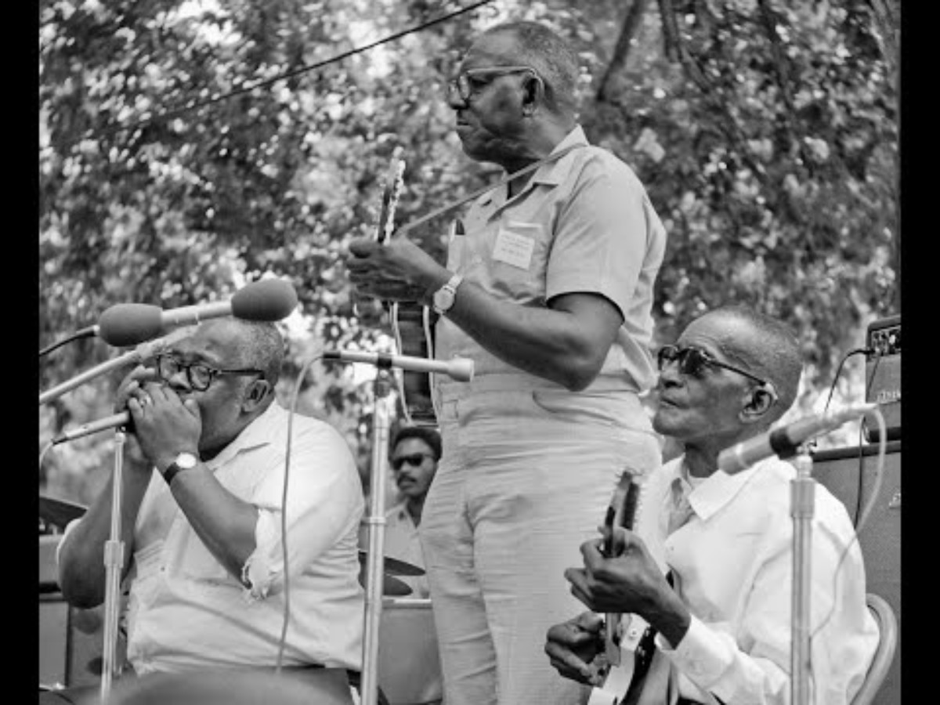
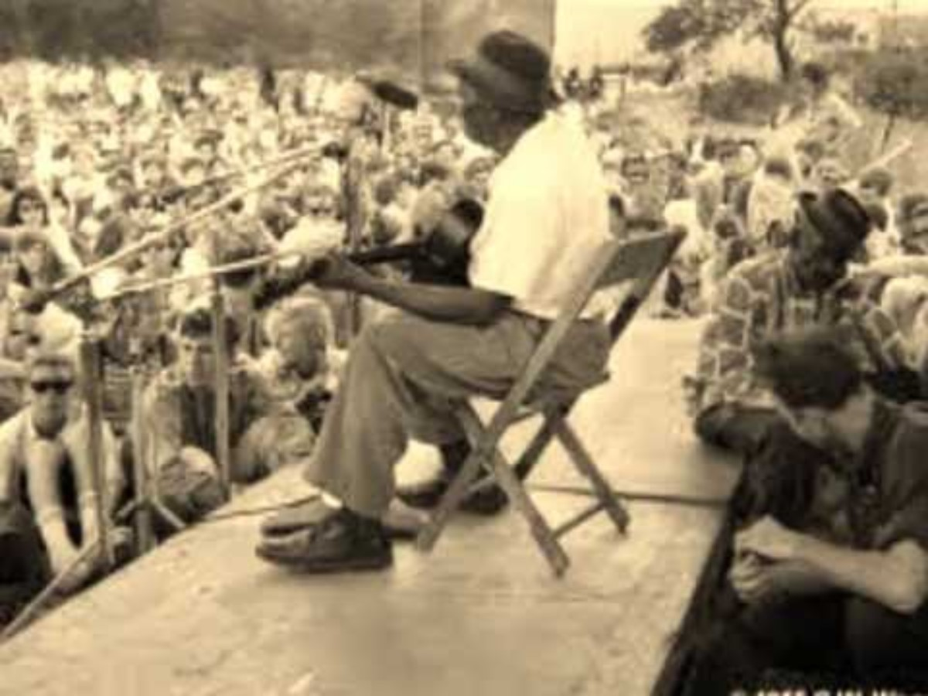
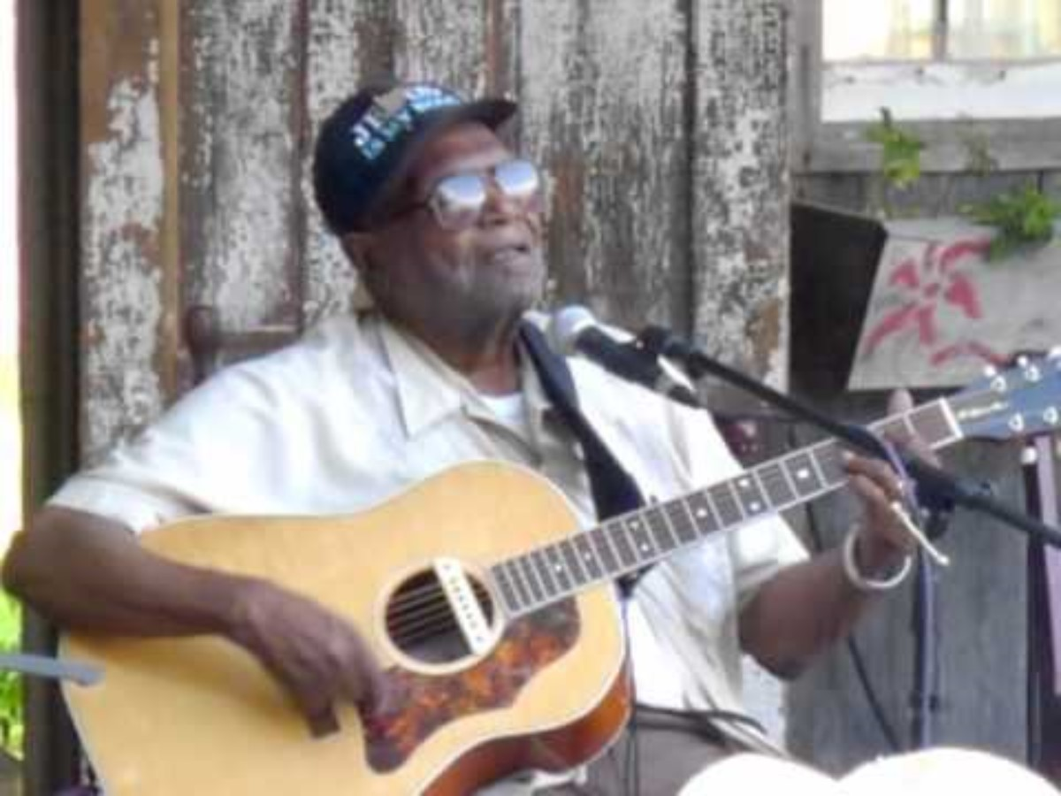
Blues at Newport in 1964
Skip James
Yank Rachell, Sleepy John Estes, Hammy Nixon
Mississippi John Hurt
Doc Reese

