Slide 1
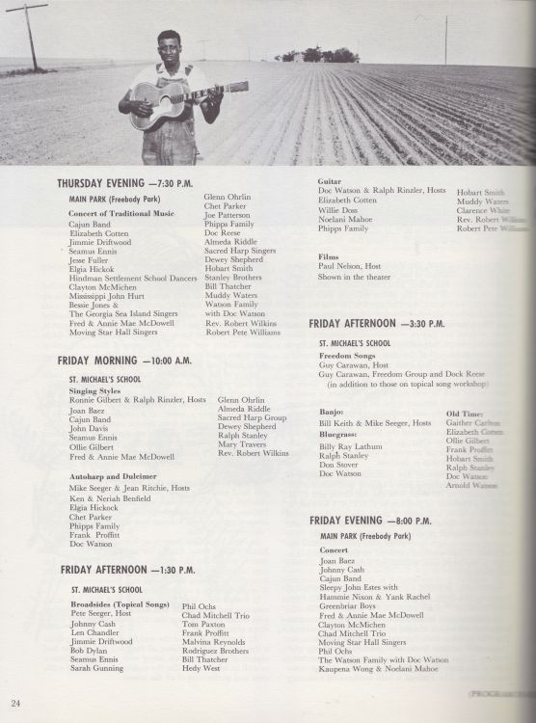
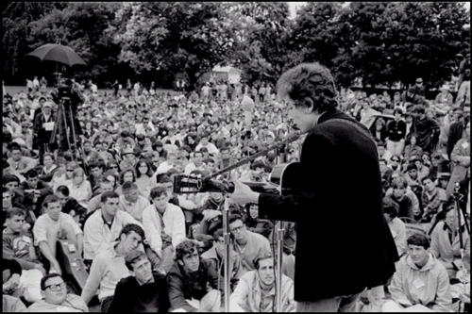
Songs of the 1964 Newport Folk Festival
Friday
https://longandwastedyear.com/2014/01/23/newport-folk-festival-1964/

Slide 2
A Busy Day
10:00 AM
Sing Styles (Ronnie Gilbert and Ralph Rinzler)
Autoharp & Dulcimer (Jean Ritchie)
1:30 PM
Broadsides (Pete Seeger)
Guitar (Doc Watson and Ralph Rinzler)
3:30 PM
Freedom Songs (Guy Carawan)
Banjo (Bill Keith and Mike Seeger)
The Evening Concert
Joan Baez
Cajun Band
Sleepy John Estes, Yank Rachell, Hammy Nixon
Greenbriar Boys
Fred and Annie MacDowell
Clayton McMichen
Morning Star Singers
Phil Ochs
Kaupena Wong and Noelani Mahoe

Slide 3
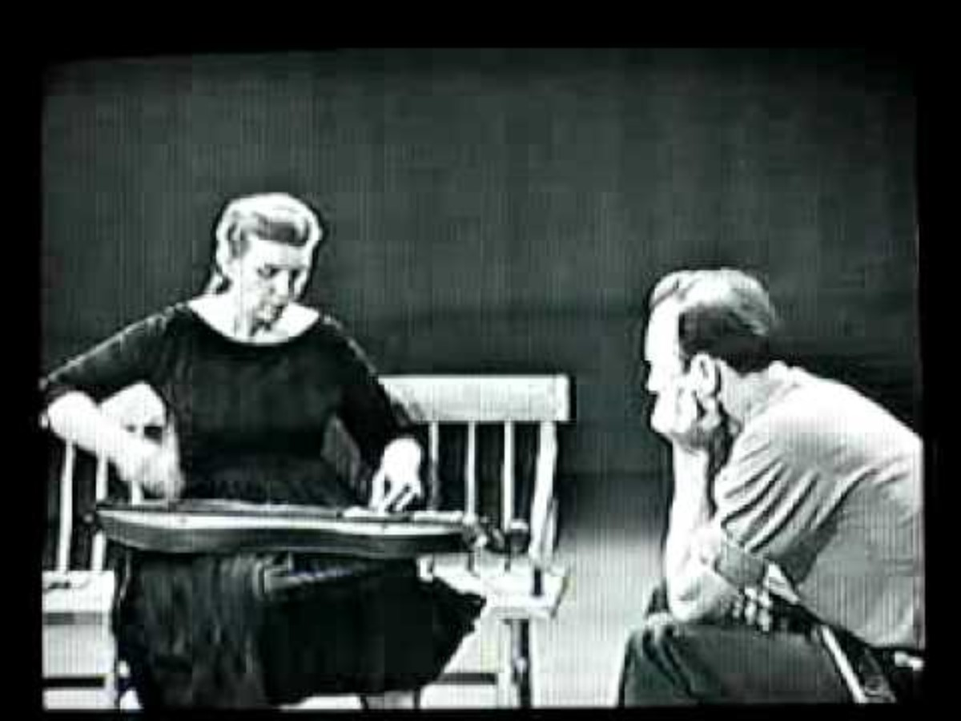
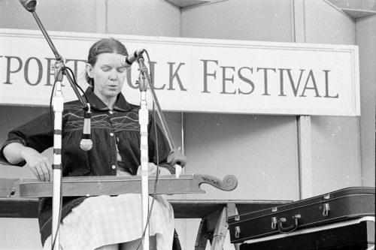
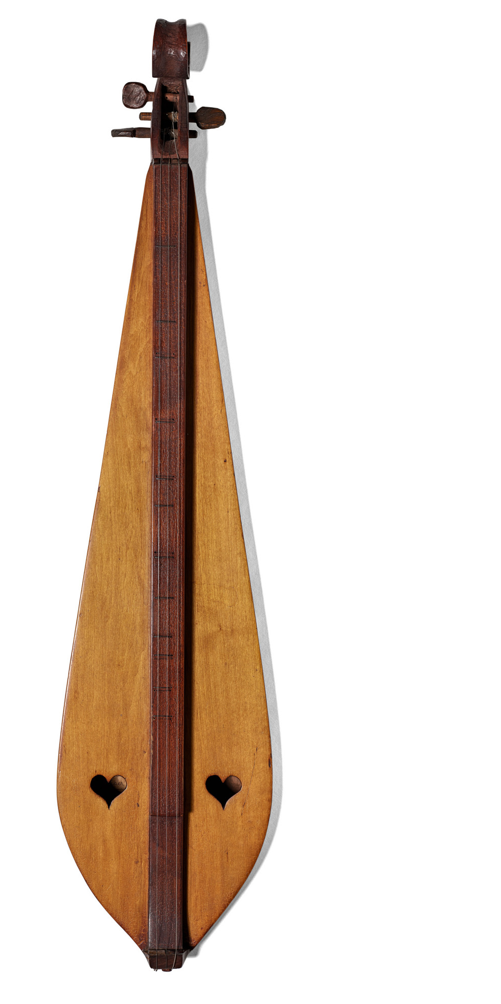
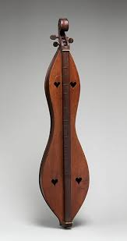
Jean Ritchie and the Appalachian Dulcimer
https://www.tornlightrecords.com/jean-ritchie-the-beauty-of-kentucky/
https://www.metmuseum.org/art/collection/search/692453
https://www.si.edu/object/appalachian-dulcimer-used-jean-ritchie%3Anmah_1803595

Slide 4
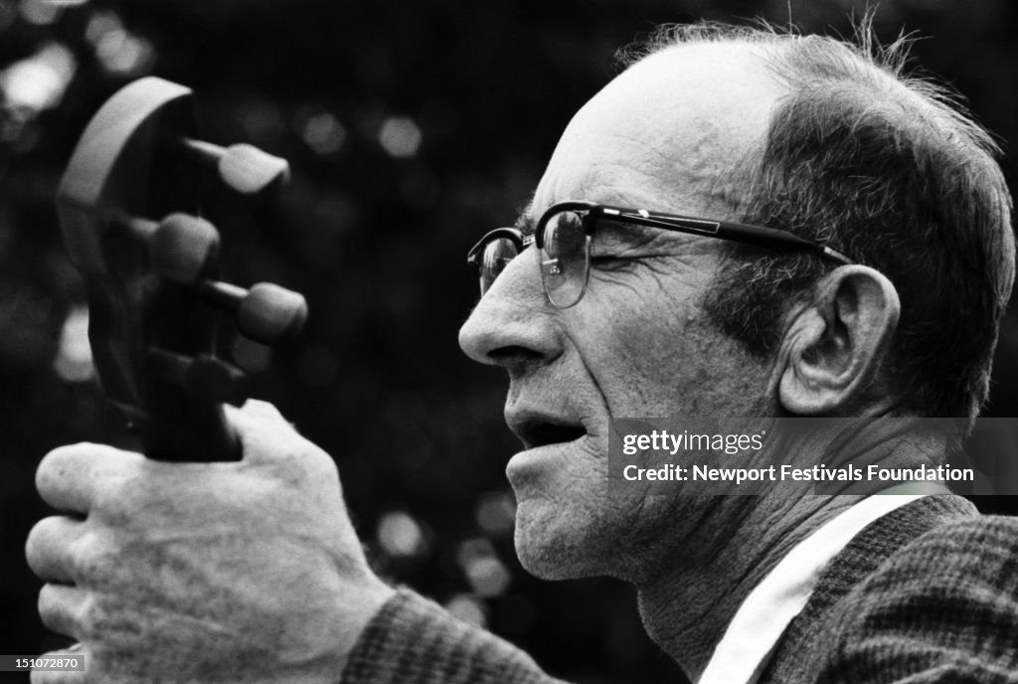
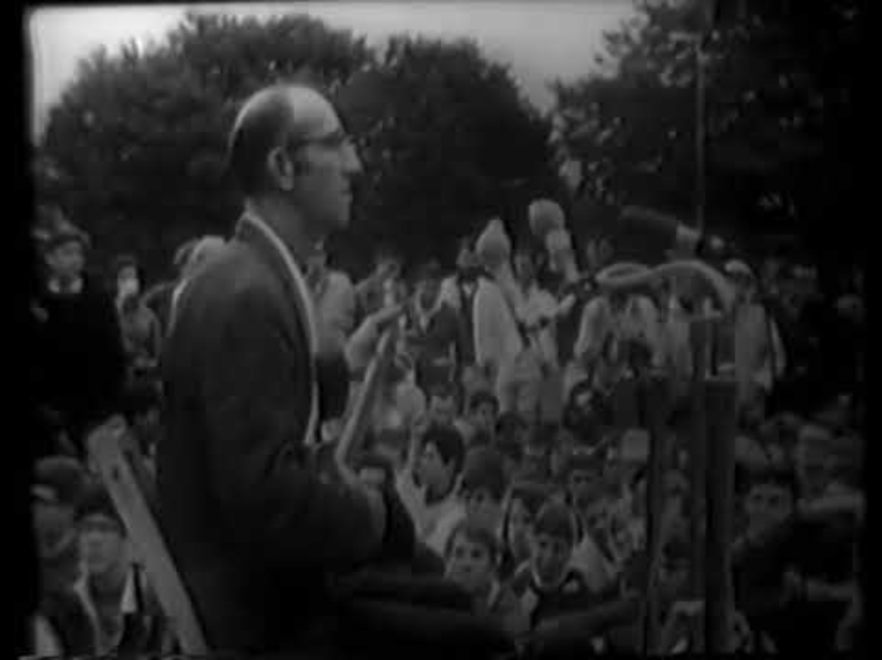
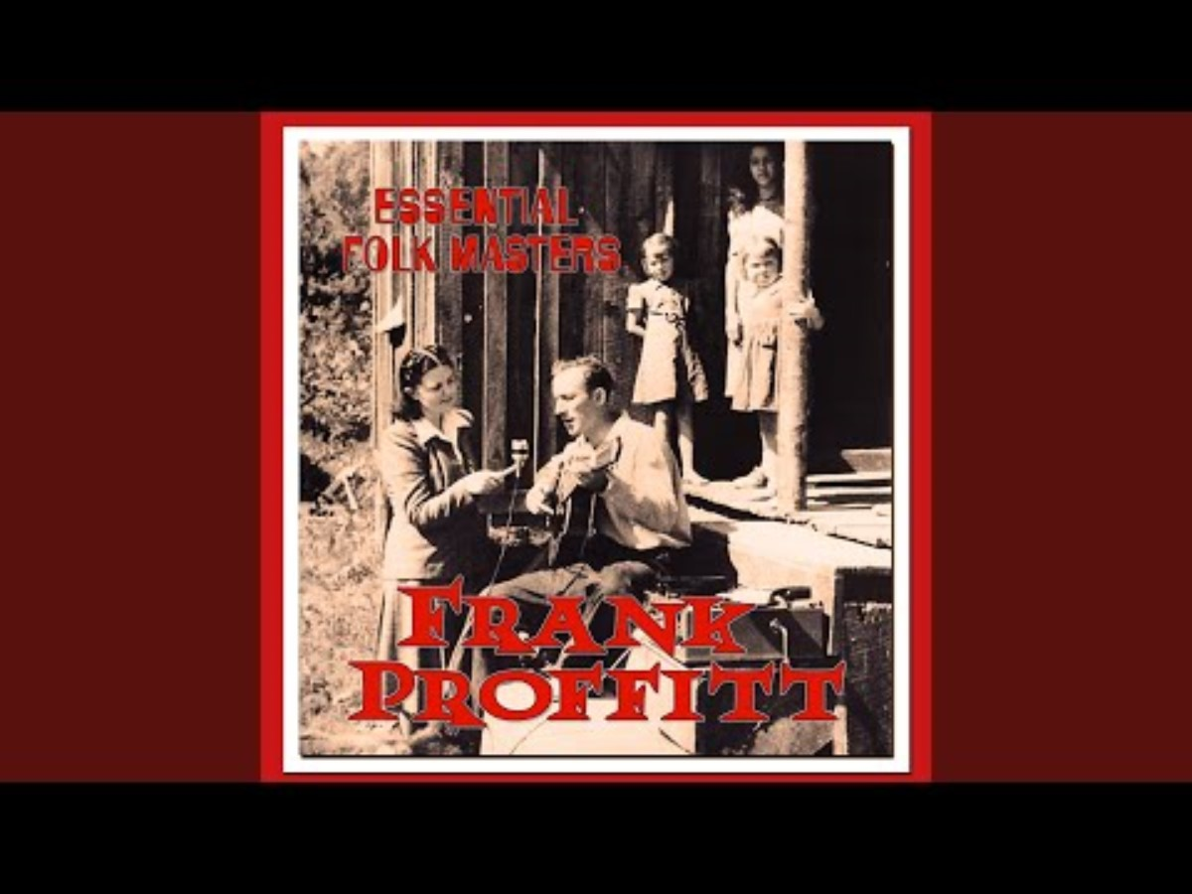
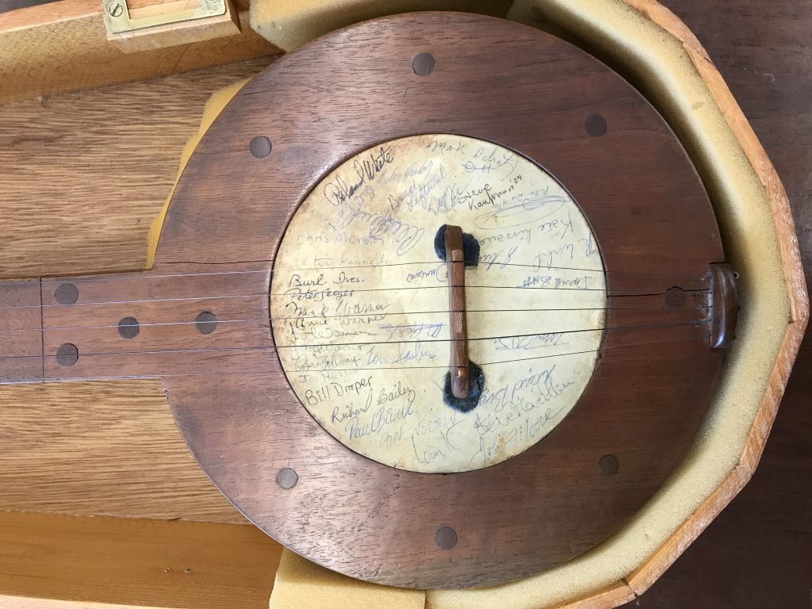
Frank Proffit
Photo by David Gahr
https://www.gettyimages.ca/detail/news-photo/old-time-musician-and-banjoist-frank-proffitt-performs-in-news-photo/151072870
ttps://blogs.loc.gov/folklife/2018/04/no-ordinary-banjo/

Slide 5
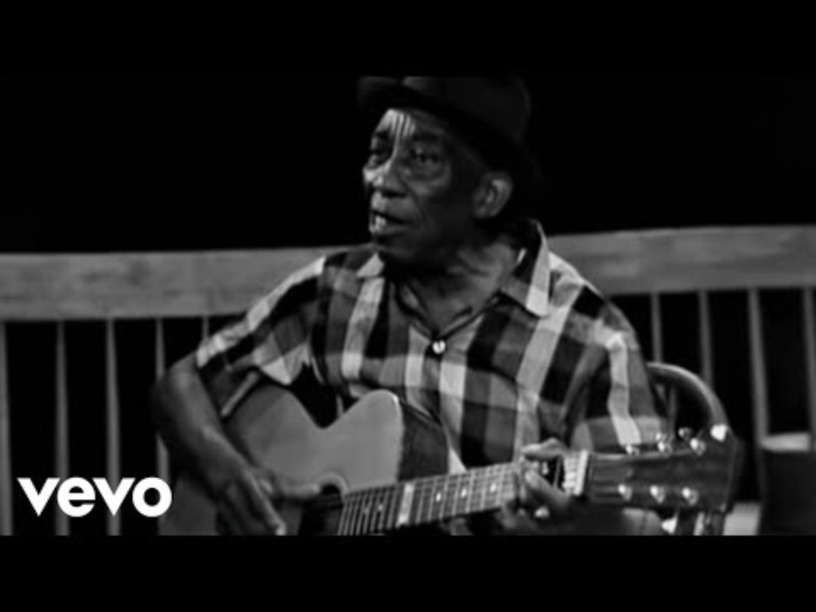
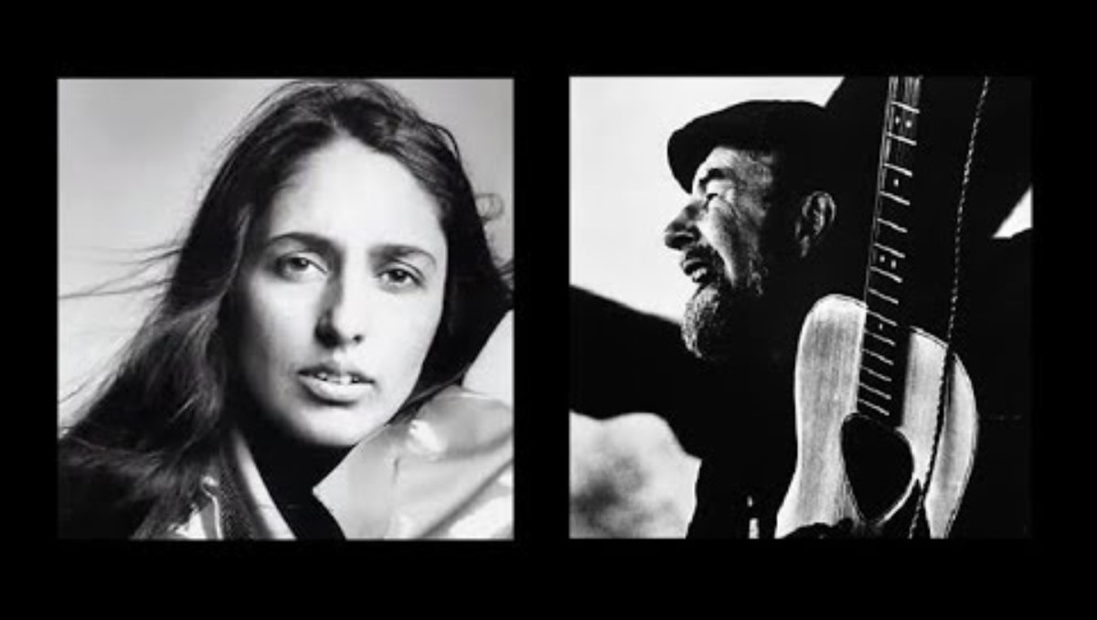
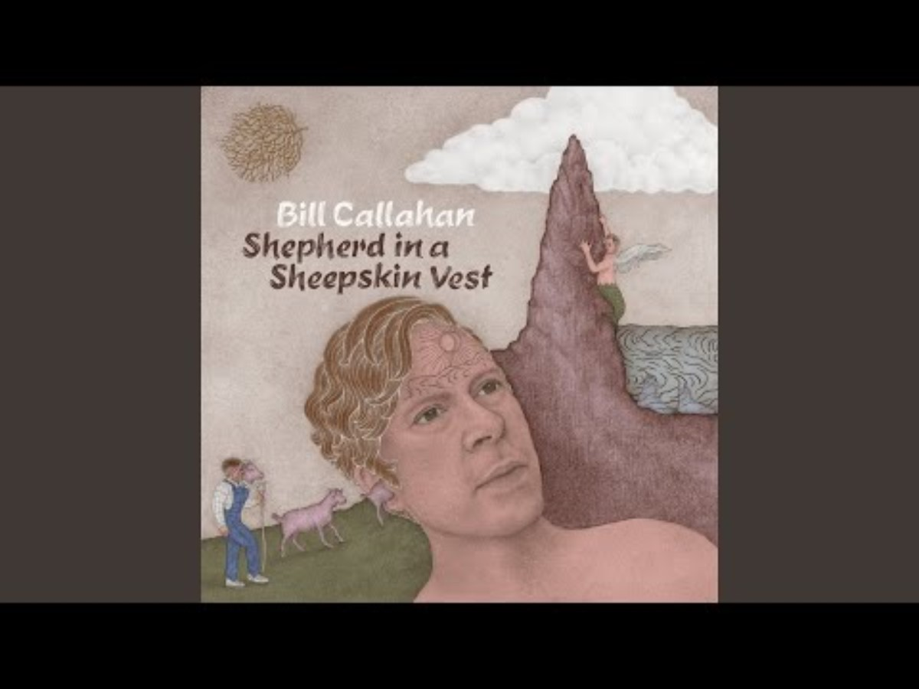
The Afternoon Song Styles Workshop
Ronnie Gilbert & Ralph Rinzler
Joan Baez
Cajun Band w/ Dewey Balfa
John Davis
Seamus Ennis
Ollie Gilbert
Fred & Annie Mar McDowell
Glenn Ohrlin
Almeda Riddle
Dewey Shephard
Ralph Stanley
Mary Travers
Rev. Robert Wilkins

Slide 6
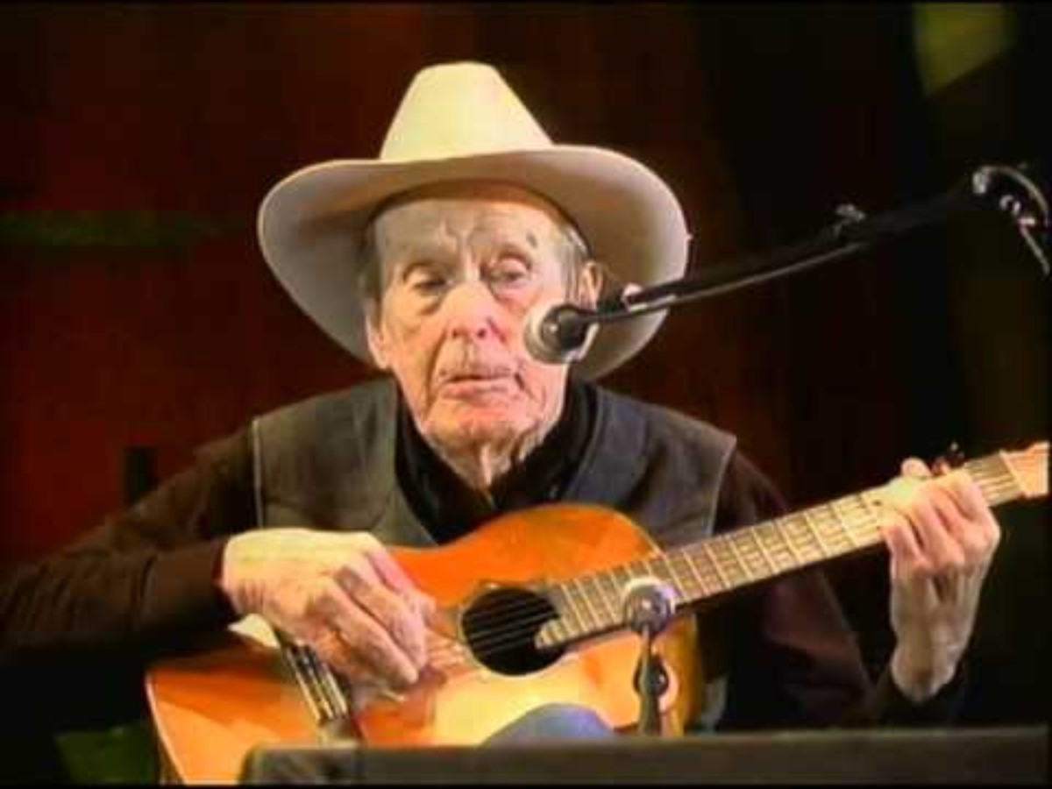
Glenn Ohrlin

Slide 7
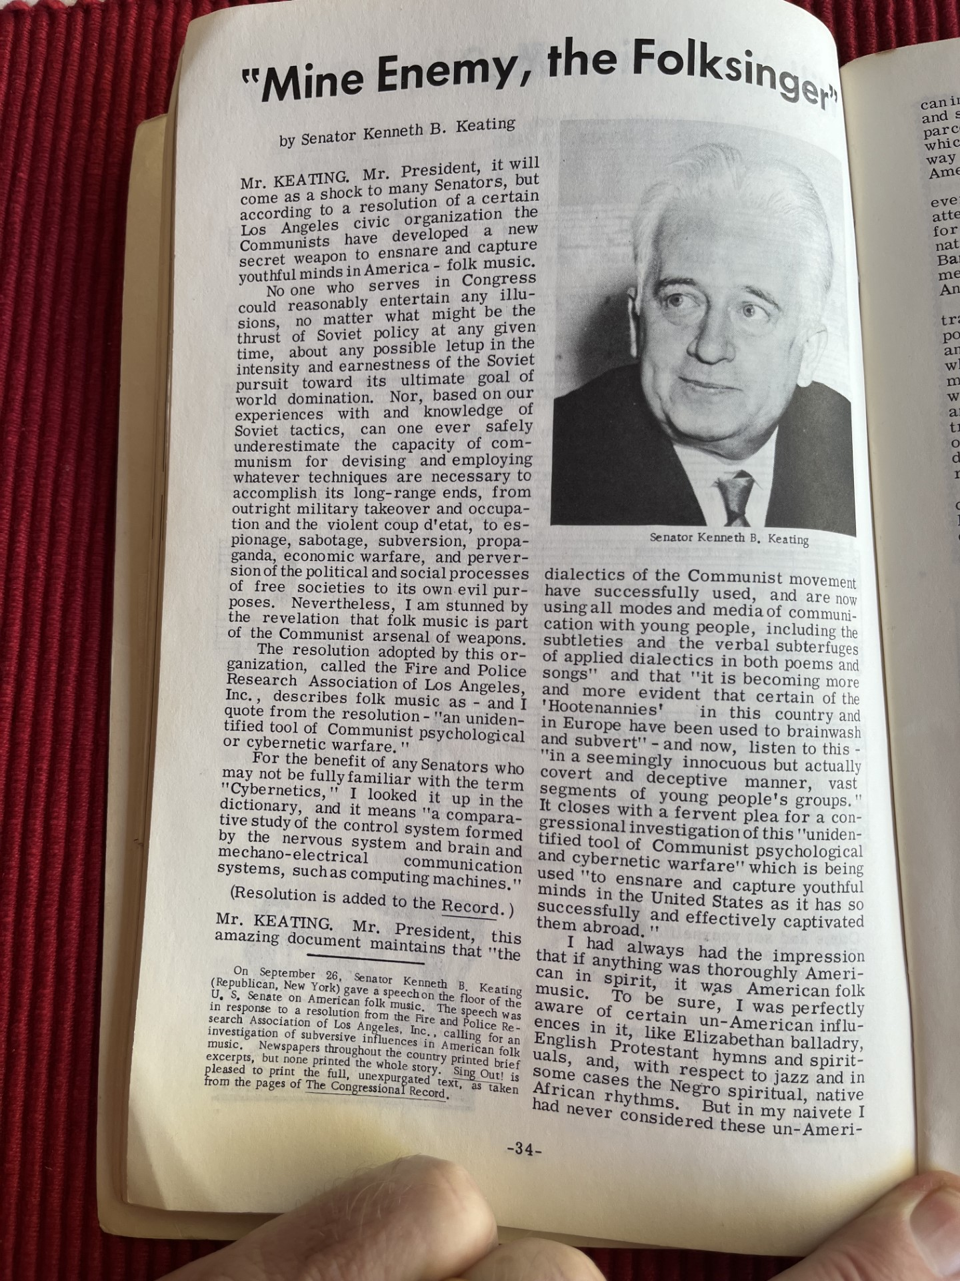
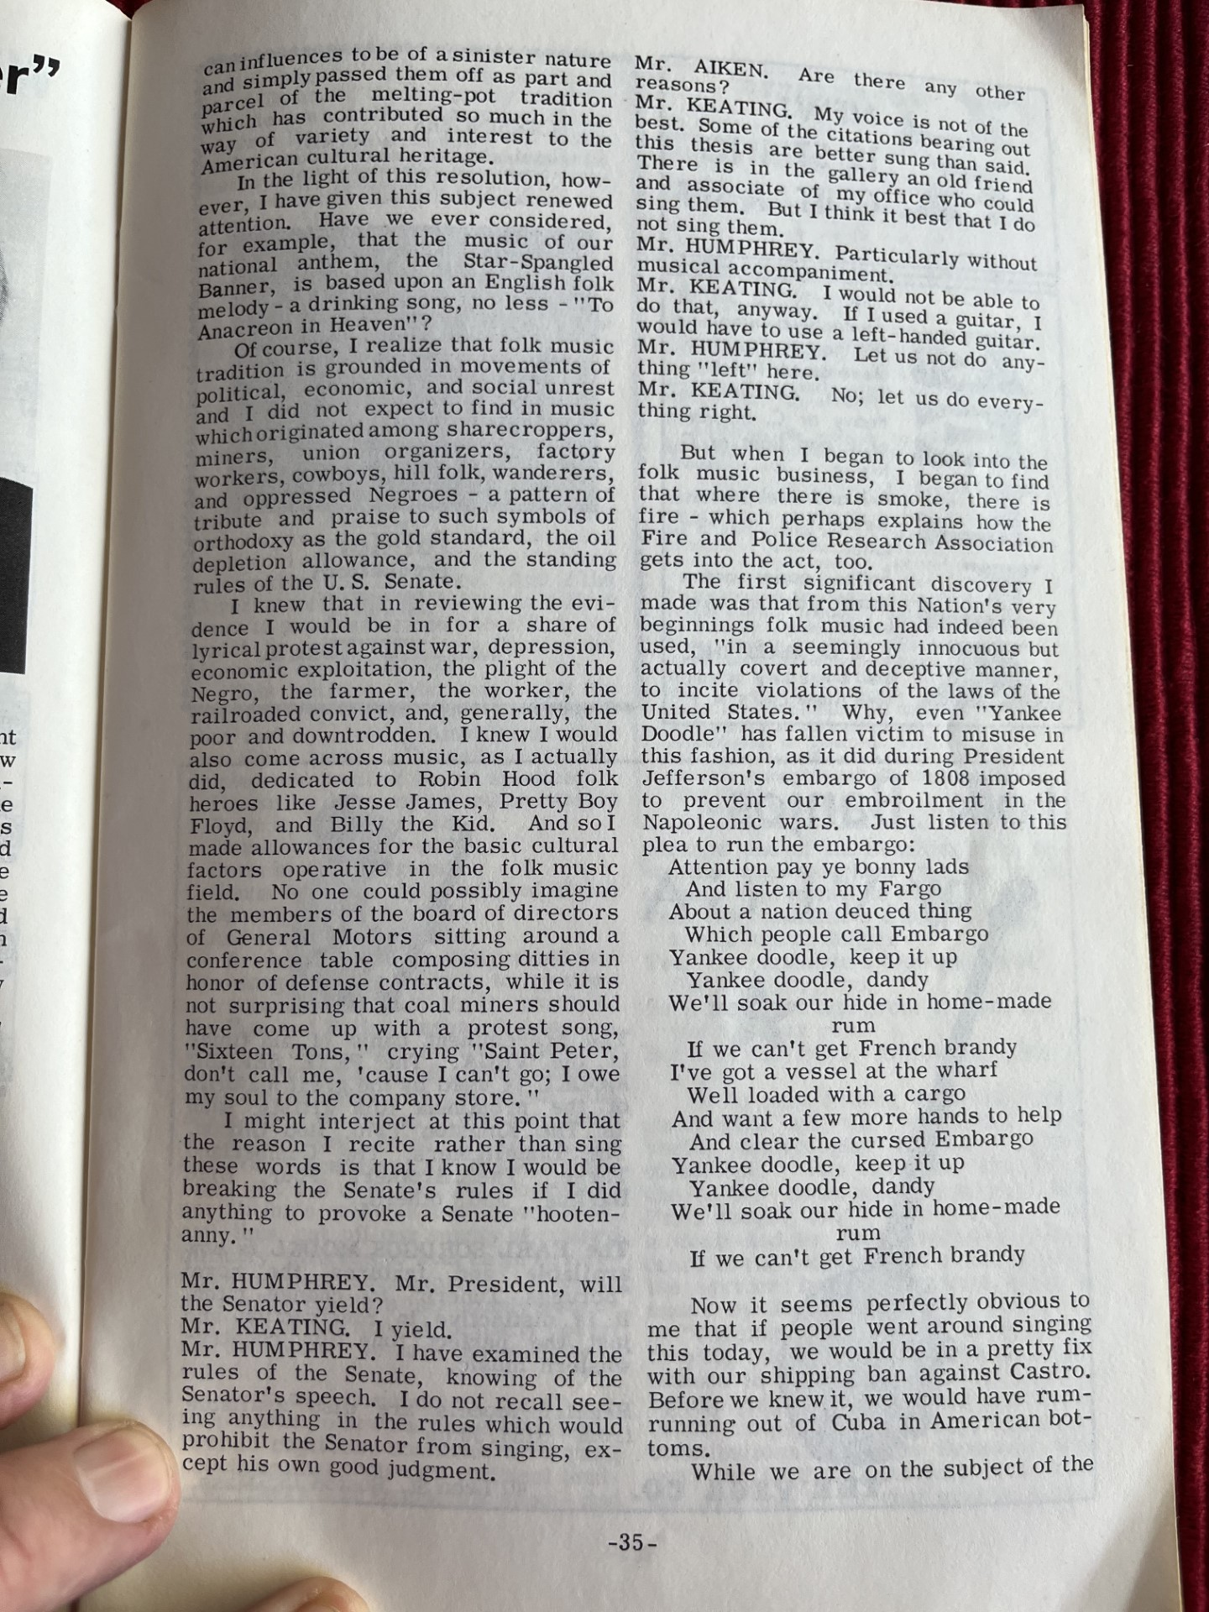
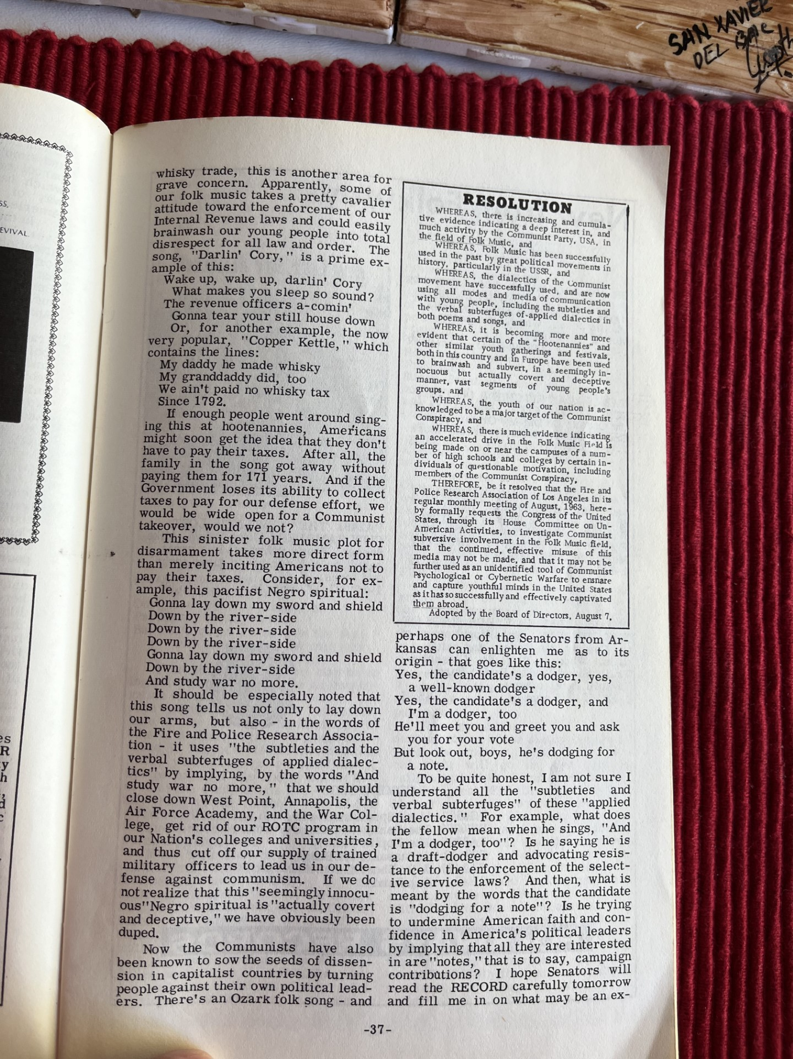
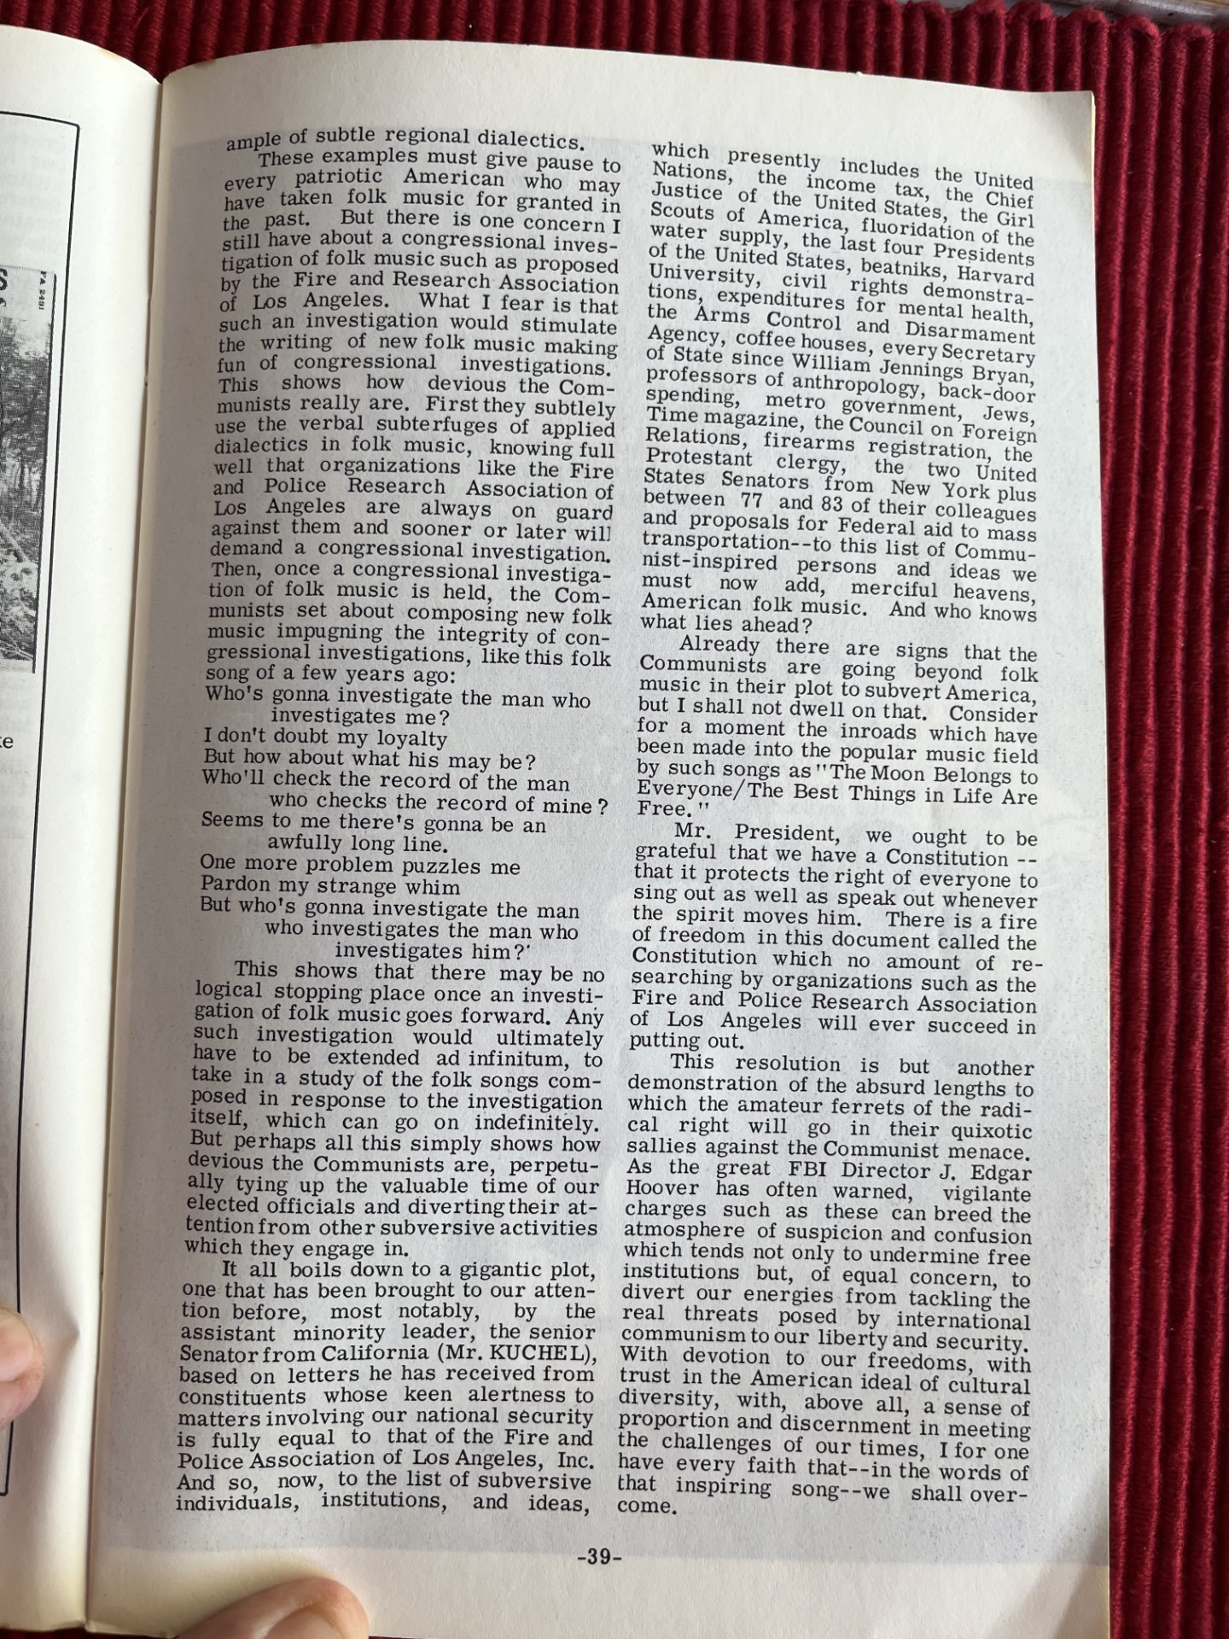
“Mine Enemy, the Folksinger”
Senator Kenneth B. Keating of Connecticut
September 26, 1964

Slide 8
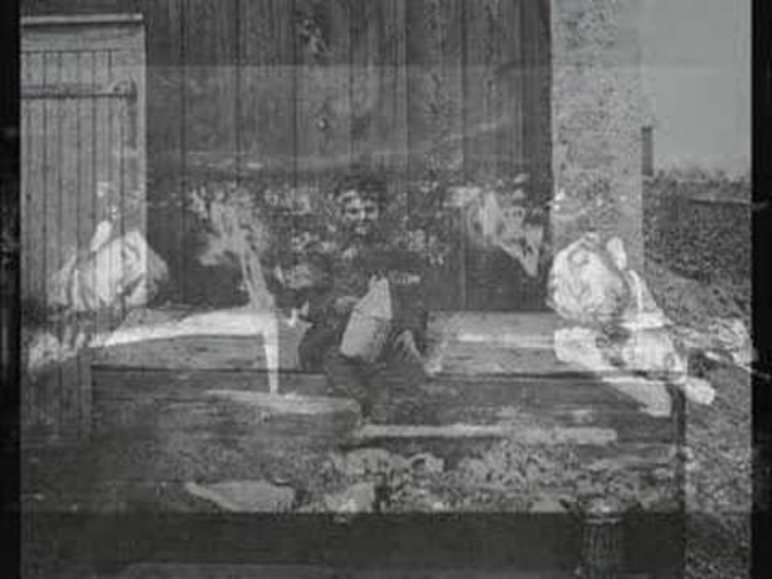
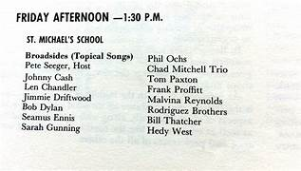
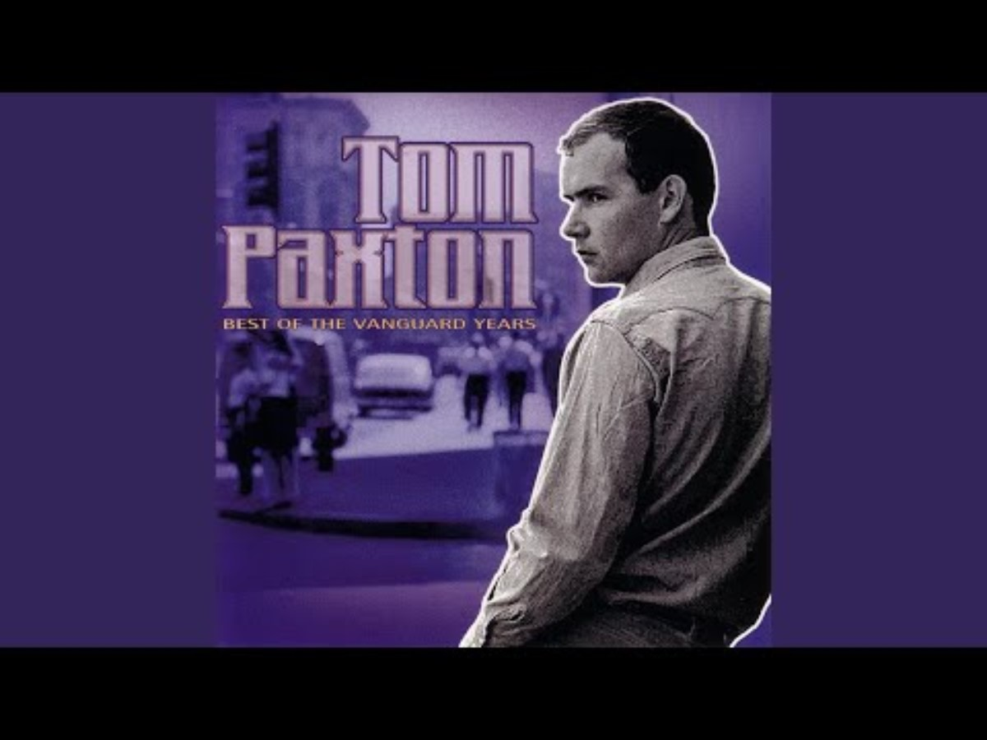
The Topical Songs Workshop
https://tse2.mm.bing.net/th?id=OIP.0hFjGapUeCZzu_v-ROiwEgHaEN&pid=Api&P=0&h=180

Slide 9
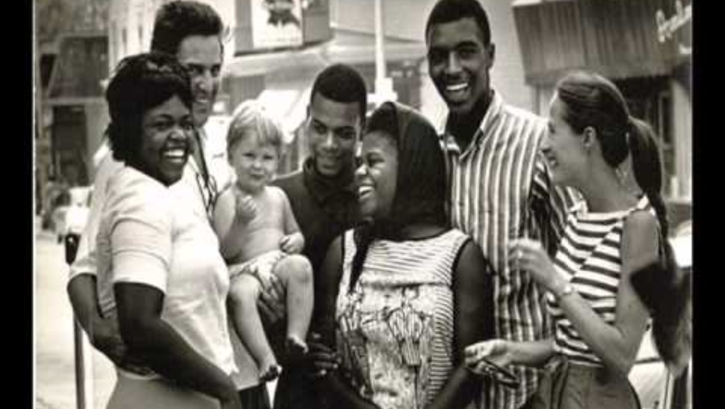
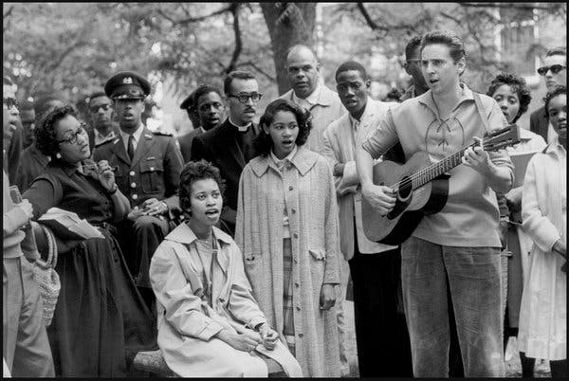
Freedom Song Workshop
Guy Carawan and the Freedom Singer
Bernice Johnson
Rutha Harris
Cordell Hull Regon
Charles Neblitt
https://www.nytimes.com/2015/03/15/opinion/sunday/birth-of-a-freedom-anthem.html

Slide 10
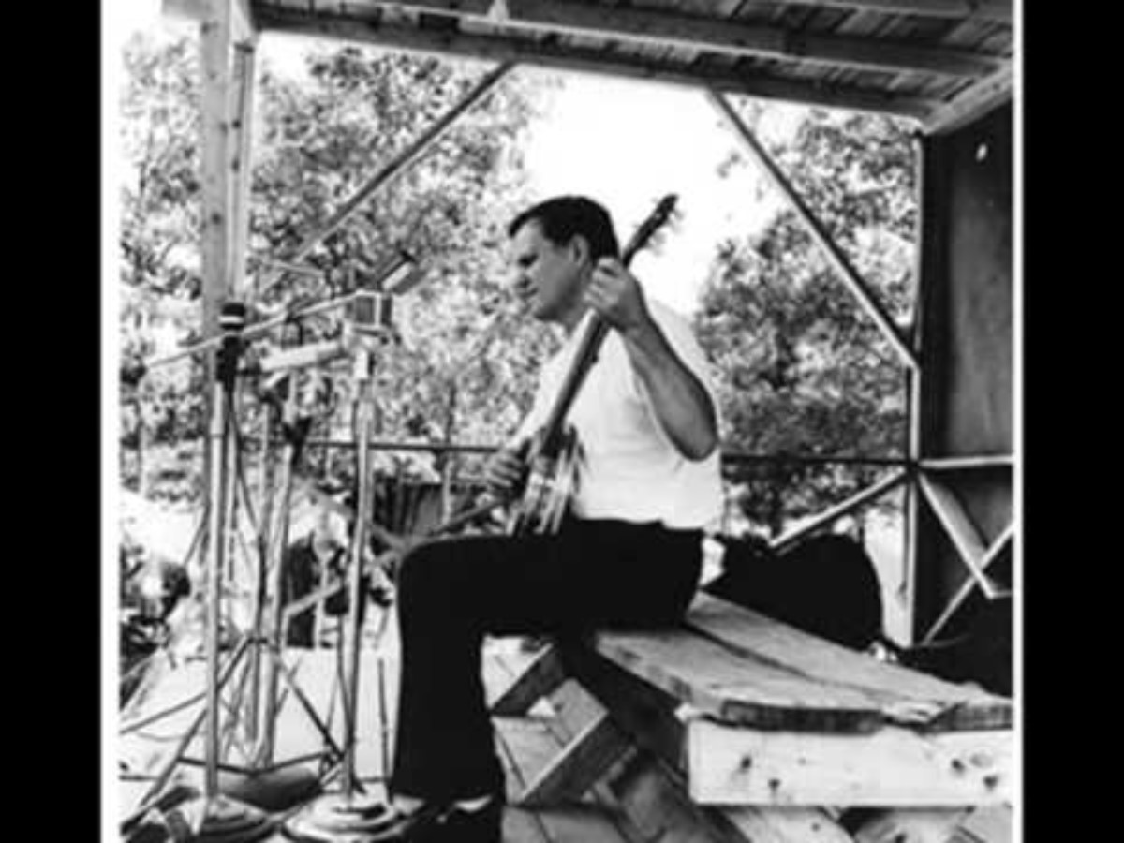
The Friday Evening Concert
Joan Baez
Cajun Band w/ Dewey Balfa
Sleepy John Estes, Yank Rachell and Hammy Nixon
Greenbriar Boys
Fred and Annie McDowell
Clayton McMichen
Chad Mitchell Trio
Morning Star Singers
Phil Ochs
Doc Watson and Family
Kaupena Wong and Noelani Mahoe

