Slide 1
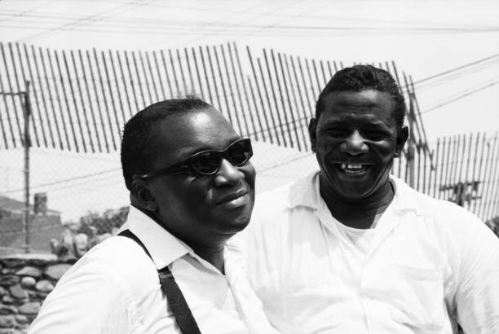
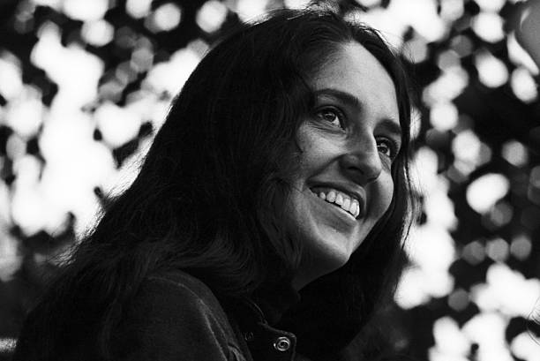
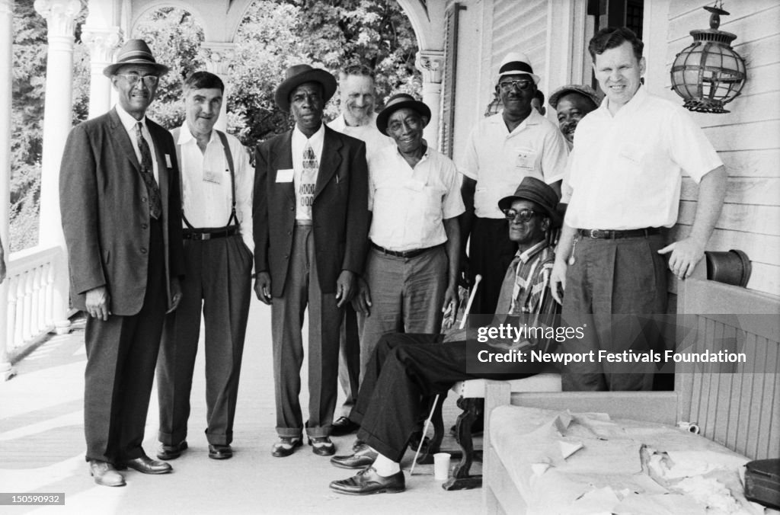
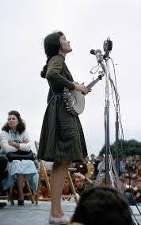
1964 Newport Folk Festival Saturday
https://www.gettyimages.com/photos/newport-1964
https://www.gettyimages.com/photos/newport-1964
https://sfae.com/Artists/Jim-Marshall/Johnny-Cash-Newport-Folk-Festival-1964
https://www.gettyimages.com/photos/newport-1964
https://en.wikipedia.org/wiki/File:Hedy_West_performing_at_the_Newport_Folk_Festival,_1964.jpg

Slide 2
1964 Newport Folk Festival Saturday Workshops
10:00 a.m.
String Bands: Ralph Rinzler and Mike Seeger
Estes, Nixon & Rachel
Greenbriar Boys
Osborne Brothers
Stanley Brothers
Watson Family
Phipps Family
International Songs: Theodore Bikel
Joan Baez
Clancy Brothers
Ron Eilran
Hansa El Din
Seamus Ennis
Rodriguez Brothers
Kaupena Wong & Noemi Mahoe
Negro Group Singing & Rhythmic Patterns: Alan Lomax, Pete Seeger, and Willis James
Jesse Fuller
Mississippi John Hurt
Bessie Jones and the Sea Island Singers
Doc Reese
Morning Star Singers
1:30 p.m.
Blues: Willis James, Sam Charters
Willy Doss
Koerner, Ray & Glover
Son House
Fred and Annie Mae McDowell
Judy Roderick
Hobart Smith
Dave Van Ronk
Robert Pete Williams

Slide 3
Saturday Workshops & Evening Concert
Play Party and Children’s Songs: Jean Ritchie
Joan Baez
Blue Ridge Mountain Dancers
Seamus Ennis
Bessie Jones
Almeda Riddle
Pete Seeger
Hedy West
Fiddle: Jimmie Driftwood
Gaither Carlton
Louis Vinis LeJeune
Clayton McMichen
Dewey Shephard
Hobart Smith
3:30 p.m.
Traditional Dance: Jean Ritchie
Blue Ridge Mountain Dancers
Hindman School Dancers
Country Music: D.K. Wilgus
Jimmie Driftwood
Clayton McMichen
Carter Stanley
Doc Watson
Evening Concert:
Theodore Bikel
Judy Collins
Johnny Cash
Seamus Ennis
Jesse Fuller
Osborne Brothers
Peter, Paul, and Mary
Phipps Family
Frank Proffitt
Rodriguez Brothers
Swan Silvertones
Robert Pete Williams

Slide 4
Connecting World Music and American Folk Music
The legacy of English And Scots-Irish traditions in early America.
The immigrant experience in 19th century America, especially Irish and Yiddish cultures.
Multicultural borders with Mexico and French Canada.
Solidarity with international union and feminist movements.
The Smithsonian and Folkways Records increasingly marketed world music in the 1950s.
Sing Out! had an “international section” in their bi-month magazine.
The Weavers had a hit with the South African song, Wimoweh, in 1950.

Slide 5
Glenn Ohrlin
When I was in Nebraska rodeoing, I got in a lot of singing as the ranchers were nearly all Irish. Now it seems funny to think of a bunch of cowboys singing “Galway Bay” with tears in their eyes, but it seemed logical at the time.
I try to play a lot of Spanish music. Maybe it isn’t logical, but the cowboys all seem to like it… It’s kind of an adventure call.
Sing Out! 15/2

Slide 6
International Songs Workshop

Slide 7
Conversations Around Race and the Blues
Julius Lester, Sing Out! 14/4 1964
Paul Nelson, Sing Out! 14/3 1964

Slide 8
The Blues Workshop

Slide 9
Johnny Cash at Newport
Saturday Nigh setlist
Big River
Folsom Prison Blues
I Still Miss Someone
Rock Island Line
Don’t Think Twice, It’s All Right
I Walk the Line
The Ballad of Ira Hayes
Keep on the Sunny side
The secret is simple: Johnny has the heart of a folksinger in the purest sense, and he has a very lovely soul. He is capable of anything he puts his soul and his band-aid heart to, and he is capable of being a folksinger in the very essence of folk truth.
Peter La Farge in Sing Out! 15/2

Slide 10
Saturday Night at Newport 1964
Evening Concert:
Theodore Bikel
Judy Collins
Johnny Cash
Seamus Ennis
Jesse Fuller
Osborne Brothers
Peter, Paul, and Mary
Phipps Family
Frank Proffitt
Rodriguez Brothers
Swan Silvertones
Robert Pete Williams

