Slide 1
1964 Newport Folk Festival Sunday
https://www.wallofsoundgallery.com/en/dylan-by-joe-alper-bob-dylan-C-newport-folk-festival-C--i3100

Slide 2
Sunday Morning
Meeting House Songs:
Sarah Gunning; Almeda Riddle; Jean Ritchie; Hobart Smith; Sacred Harp Group.
Country Gospel:
Kentucky Colonels; Jimmie Driftwood and Ollie Gilbert; Phipps Family; Dewey Shepherd Stanley Brothers; Watson Family.
Negro Spirituals:
Bessie Jones & the Georgia Sea Island Singers; Swan Silvertones; Staple Singers.
Blues Gospel:
Dock Reese and Rev. Robert Wilkins

Slide 3
Sunday Afternoon Concert

Slide 4
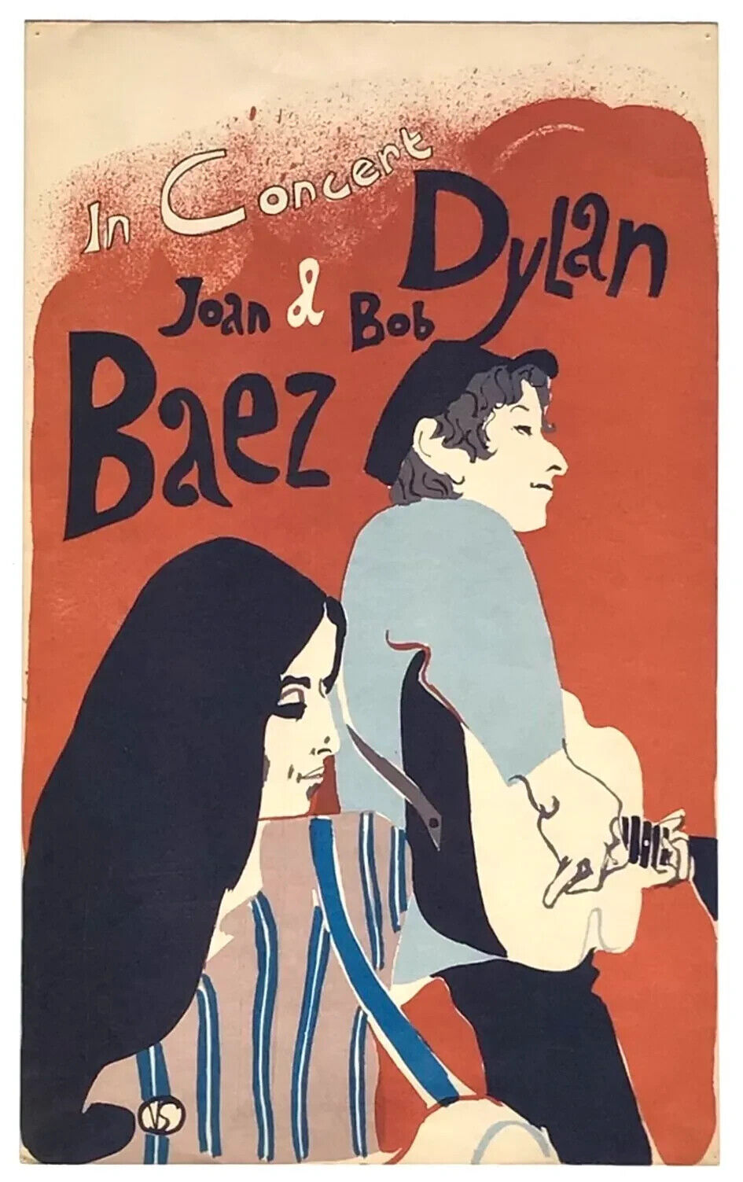
Joan Baez and Bob Dylan
Born January 9, 1941 in Staten Island, NY.
1959: first performances at Club 47 in Cambridge; first appearance at Newport w/ Bob Gibson.
1960: First year on Newport the program; Joan Baez, Vol 1.
1961: Met Bob Dylan at Gerde’s Folk City in NY.
1962: On the cover of Time.
1963: Return to Newport and invited Bob Dylan on stage to sing With God on Our Side; Don’t Think Twice included on In Concert Part 2.
Born May 24, 1941 in Duluth Minnesota.
1961: Moved to NYC; visits Woody Guthrie; begins playing in Greenwich Village Clubs.
1962: Bob Dylan (5000 copies sold)
1963: The Freewheelin’ Bob Dylan; Blowin’ in the Wind cover is a hit for PP&M.
1964: Another Side of Bob Dylan, a move away from “finger-pointing” songs.

Slide 5
Saturday Afternoon/Sunday Evening Bob Dylan
Sunday Setlist: All I Really Want to Do; To Ramona; Mr. Tambourine Man; Chimes of Freedom; With God on Our side

Slide 6
Sunday Evening Finale

Slide 7
Program for the 1965 Newport Folk Festival
https://recordmecca.com/item-archives/newport-folk-festival-1965-program/

