Slide 1
BECOMING A MIND-MAPPER
Rodwell olli may 2024
Notes:
This one-session course will teach you how to think through and organize for almost any problem or project facing you (and yours). The philosophy behind this skill is that we must switch off the linear, rigid, self-criticizing left brain and stay only in right brain to most effectively come up with ideas. These Ideas are organized in a big messy diagram, and from there, refined to suit your needs.
Mind-mapping is about staying in right brain for as long as possible, to get the creative juices flowing until the point of silliness. Our left brains are all too eager to bust in from the sidelines and tell us that was a stupid idea we just wrote down, as they jump in so readily when we’re writing and tell us we have a grammatical or spelling error in what we just wrote. The left brain gets its chance when the Mind-mapping is done, as I’ll explain.
A lot of high achievers have really well-developed left brains – it’s our default mode. Can we achieve more by developing out right brains?

Slide 2
THE THEORY BEHIND MIND-MAPPING
Allow our right brain creative selves to get into high gear
Ignore the mutterings of our left brain critical selves (at this stage)
Notes:
Picture from BBC.
Michael Gelb:
“Although valuable as a tool for presenting ideas and a formal, orderly fashion, outlining is useful only after the real thinking has been done. If you try to generate your ideas by outlining, you’ll find that it slows you down and stifles your freedom of thought. It is just plain illogical to try to organize your ideas before you generate them.
Moreover, outlining and other linear notetaking systems exclude your brain’s capacity for color, dimension, synthesis, rhythm and image. By imposing one color and one form, outlining guarantees monotony. Outlining uses only half your mind, and a half a mind is a terrible thing to waste.
Mind-mapping frees you from the tyranny of premature organization, which stifles your generation of ideas. Mind mapping liberates your conceptual powers by balancing generation and organization while encouraging the full range of mental expression.”

Slide 3
WHERE DOES THE MIND-MAPPING NOTION COME FROM? (1 of 2: Leonardo da Vinci)
Notes:
Creativity expert Michael Gelb has devoted an entire book to unraveling the key principles that Leonardo da Vinci followed in his richly creative life – How to Think Like Leonardo da Vinci – and has translated them into practical steps that we can use today to be more creative.
One of these principles is da Vinci’s proclivity for visual thinking. In this fascinating book, Gelb points out that the notetaking styles of many of history’s greatest brains – such as Charles Darwin, Michelangelo, Mark Twain and Leonardo da Vinci – feature a branching, organic structure compliment by lots of sketches, creative doodles and keywords. This, in turn, leads the author into an interesting discussion of mind mapping and the advantages that it has over hierarchical outlining.

Slide 4
WHERE DOES THE MIND-MAPPING notion COME FROM? (2 of 2: tony buzan)
In the 20th and 21st Centuries, from Tony Buzan
Notes:
Wikipedia says: Anthony Peter "Tony" Buzan (2 June 1942 – 13 April 2019) was an English author and educational consultant.
Buzan popularized the idea of mental literacy, radiant thinking, and a technique called mind mapping, inspired by techniques used by Leonardo da Vinci, Albert Einstein, and Joseph D. Novak's "concept mapping" techniques.
He has written numerous books. But IMHO you don’t need a book at all.

Slide 5
HOW WE TIRE OUR BRAINS OUT…..by jumping from right brain to left and back, all day!
Notes:
Writing on Both Sides of the Brain: Breakthrough Techniques for People Who Write
Klauser, Henriette A.
WE EXHAUST OURSELVES BY SHIFTING FROM RIGHT BRAIN TO LEFT TO RIGHT AGAIN TOO MANY TIMES IN A FEW MINUTES. This book is old and is specifically for writers. She explains that it’s not just that we self-criticize, a negative activity, but that we flip-flop too fast. The brain works better when you don’t make it shift gears so much.
Sticking to, in this case, the creative right side, is part of the recipe for getting the best out of our thinking.

Slide 6
THERE ARE MANY WAYS TO ORGANIZE OUR TASK LISTS
I like the bagua from feng shui; it’s about placement of items in your home and I've modified it to address placement of my activities on my computer
Notes:
My bagua-based system became eight areas of life, in no particular order:
Spiritual
Health (actually all things body including grooming, fashion and exercise)
Home
Family & friends
Professional
Recreation & fun
Life partner
Personal business & finance

Slide 7
DO YOU NEED TO RESEARCH AND STUDY TO BECOME A MIND-MAPPER?
No, just jump in!
The Yin and Yang of Action vs. Thinking…
You can make it a key tool in your life
All you need are marker pens and paper. I like giant Post-it paper, but it’s not essential
Notes:
I’ll hold up the Post-It pad. This of course is “old-school”.
Today AI is getting into the mind-mapping picture; see https://mindmappingsoftwareblog.com/tag/mind-map/
and no doubt many more.

Slide 8
BASIC RULES OF MIND-MAPPING
1. All ideas are good
2. Only one person speaks / annotates at a time
3. It’s OK to be messy
4. Left brain can be deployed when you’re done with recording ideas (OOPS, you use left brain to tell you when that is!)

Slide 9
Where might one use Mind-mapping?
Here we’ll brainstorm using a Mindmap, with Zoom’s whiteboard function
Potential Topics:
Whatever you’re struggling with today
Any event you are supposed to be planning
Preparation for one of life’s transitions

Slide 10
TOPICS SUGGESTED IN THE CLASS OUTLINE
Writing your memoir (or even your own obituary)
Planning a more balanced life
Goal-setting
How to prepare for a big family gathering
A game plan for decluttering, or for the “big downsize”
Grandparents’ strategy for “parenting” those grandkids.

Slide 11
YOU CAN USE ZOOM TO CREATE A MIND-MAP—BUT IT’S A LEFT BRAIN KINDA PROCESS!
Notes:
THE CAPS ARE THE LIST THAT WAS IN THE CLASS OUTLINE. The lowercase are new topics. We can play around with adding more…..
But my own conclusion is that pen and paper are quicker and more intuitive.

Slide 12
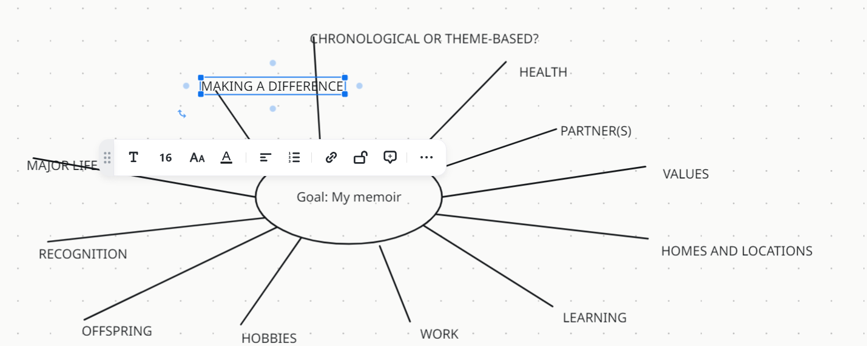

Slide 19
So I have this big messy diagram…
NOW WHAT?
Paste it somewhere prominent in your home such as kitchen wall.
Use a different color pen to add more thoughts as they occur, for a few days.
If multiple people are involved, give each a color.
Use another color to put the Mind-map thoughts into logical order (to calendar, to create a written outline…). Yes, now you’re in left brain.
Notes:
IF TIME, WE’LL DO THIS IN ZOOM WHITEBOARD

Slide 20
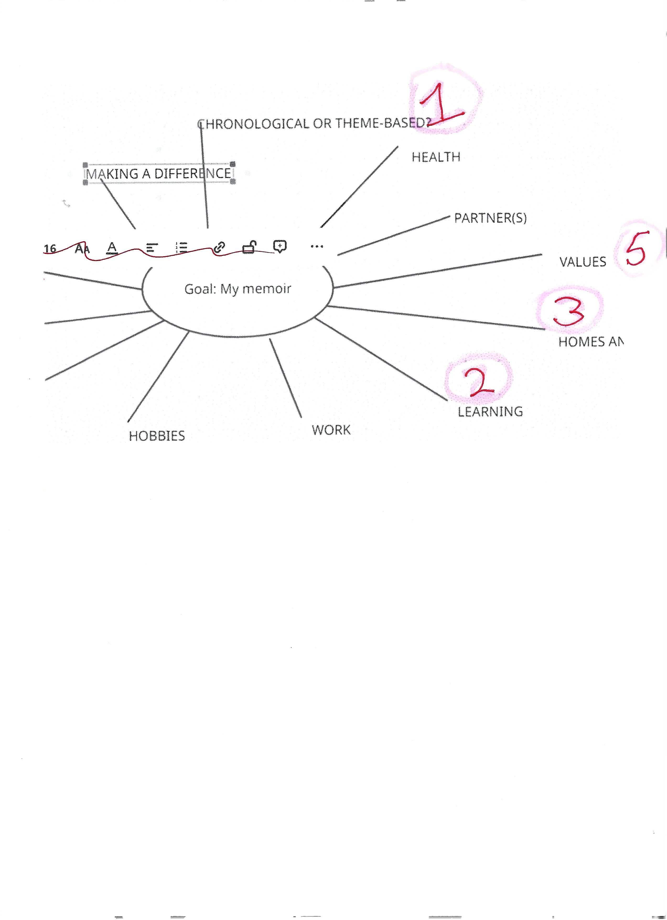
Notes:
So, we start with the big question – chronological or theme-based. I think it will be more interesting if theme-based. Once you feel you have all the themes on the mindmap, take another color and mark the order you want to tackle them in,
This is how the right-brain mind-map process switches over into the left-brain outlining or listing process. As you start to write, more ideas may come; park them in the correct (or new) places on the mindmap and stick to the part you were writing.
A right-brain writing trick from Ernest Hemingway: always stop for the day in the middle of an idea. Today you can even note that next thought in your doc without fleshing it out. Then when you start up again, this will help your creative juices to flow.
Another trick I’ve found useful is not to run spellcheck but leave it for when I start up again. Doing that task seems to wake my brain up.
But mind-mapping isn’t just about writing; it’s about getting ready to tackle any challenge. THE END

Slide 21
RESOURCES
Zoom whiteboard tutorial article
https://support.zoom.com/hc/en/article?id=zm_kb&sysparm_article=KB0059671
and video
https://support.zoom.com/hc/en/article?id=zm_kb&sysparm_article=KB0060766
and more
https://www.google.com/search?q=%22Zoom+Whiteboard+tutorial+site%3Asupport.zoom.us%22&oq=%22Zoom+Whiteboard+tutorial+site%3Asupport.zoom.us%22+&gs_lcrp=EgZjaHJvbWUyBggAEEUYOdIBCTM3NDhqMGoxNagCALACAA&sourceid=chrome&ie=UTF-8
YouTube videos about Zoom whiteboard
https://www.youtube.com/watch?v=jQ4-wrwHAxk great explanation of annotation permissions and of using two screens to test
https://www.youtube.com/watch?v=2tSTMbI1omA best so far!
Didn’t find this one to be any help https://www.youtube.com/watch?v=y2W2zx9TbDY

