Slide 1
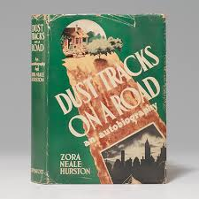
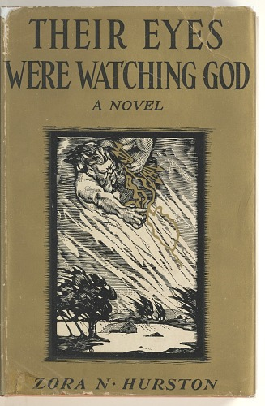
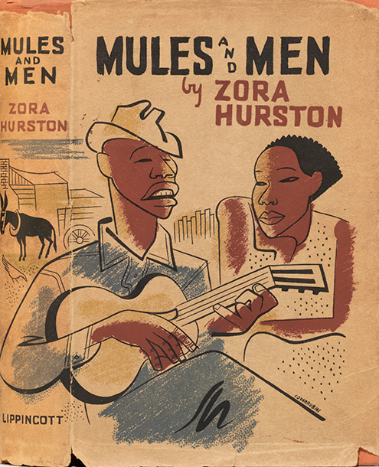
Songcatchers: Field Collecting and the Preservation of American Folk Music Zora Neale Hurston
1935
1942
1937
https://en.wikipedia.org/wiki/Zora_Neale_Hurston

Slide 2
Fieldwork
1927-1932: North Florida, sponsorship from Charlotte Osgood Mason.
1935: Florida and Georgia, with Alan Lomax and Mary Elizabeth Barnicle.
1936-1937: Jamaica and Haiti, on Guggenheim Fellowship.
1938-1939: Florida, for Federal Writer’s Project.
1940: South Carolina
1947: Honduras

Slide 3
Early Years
Born on Jan. 7, 1891, in Notasulga, Alabama. Father, John Hurston, was a carpenter and Baptist preacher; her mouther, Lucy Potts Hurston, a schoolteacher.
Raised in Eatonville Florida, first incorporated black township.
1904: after her mother’s death, she was sent to a Baptist boarding school. She left after her father stopped paying her tuition.
1917-18: Earned a high school diploma at Morgan Academy in Baltimore at age 27. She lied about her age to qualify for free tuition.

Slide 4
At Howard, Barnard and Columbia
The Hilltop, Howard University 1924
Howard University (1918-1924): cofounder of The Hilltop; studied with Alain Locke.
Barnard College (1925-1928): only Black student; began to study with Franz Boas at Columbia, part of a circle that included Ruth Benedict and Margaret Mead. Earned a BA in Anthropology.
Columbia University (1928-1932): graduate work with Boas; met Langston Hughes; published short stories in Opportunity: A Journal of Negro Life.
https://magazine.howard.edu/stories/a-centennial-of-writers-the-hilltop-celebrates-100-years-of-storytelling

Slide 5
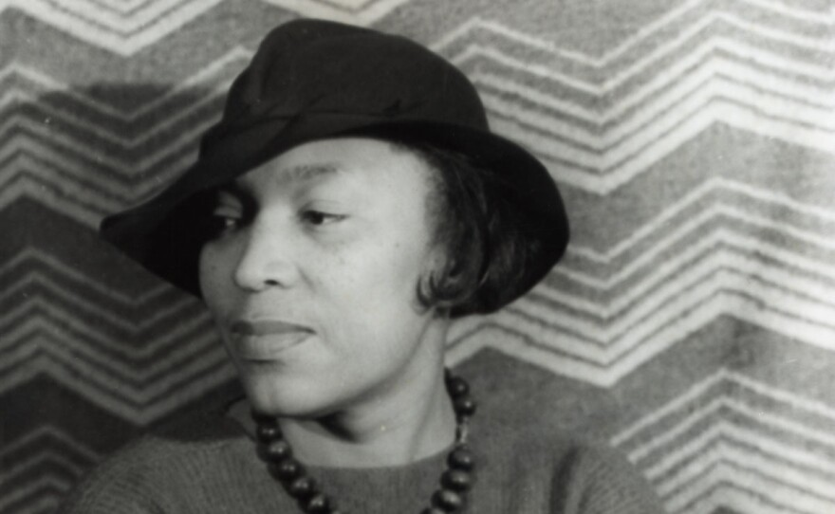
The New Negro Movement and the Harlem Renaissance in the 1920s
Promoted by NAACP, inspired by W.E.B. Dubois.
Post-World War I experiences of Black veterans.
Hubert Harrison founded the Liberty League and The Voice in 1917.
Alain Locke published the anthology The New Negro in 1925, which included Hurston short story “Spunk”.
Mule Bone, a play co-written with Langston Hughes.
In Harlem, 1935
portrait by Carl Van Vechten
With Jessie Fauset and Langston Hughes, Tuskegee, 1927
https://www.kpbs.org/news/2023/01/11/american-experience-zora-neale-hurston-claiming-a-space
https://barnard.edu/zora-neale-hurston-at-barnard

Slide 6
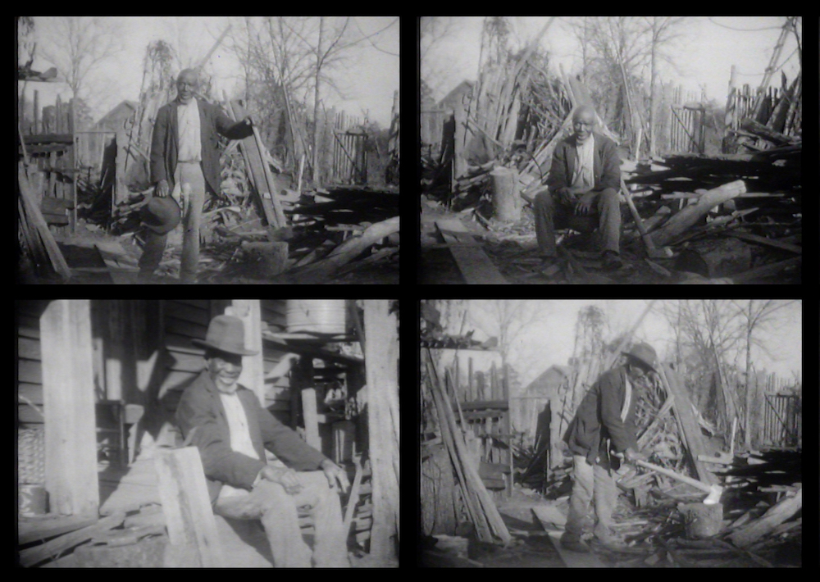
First Fieldwork: 1927-1932
Undertaken while a student of Franz Boas.
Funded by Charlotte Osgood Mason, a white philanthropist, who also supported other artists and writers associated with the Harlem Renaissance, including Alain Locke, Langston Hughes, Miguel Covarrubias.
Fieldwork conducted in lumber camps, turpentine camps and local “jook” joints.
First documentary film by an African-American woman, about 85 minutes of silent footage.
Audio Recordings in the Library of Congress
https://www.loc.gov/audio/?q=zora+neale+hurston
https://zepfanman.com/2023/09/all-films-by-zora-neale-hurston/

Slide 7
Mule on the Mount
Cap'n got a mule, mule on the mount called Jerry
Haa!
Cap'n got a mule, mule on the mount called Jerry
Gonna ride him down, Lawd, Lawd gonna ride him down.
I got a woman shake like jelly all over
Haa!
I got a woman shake like jelly all over
Haa!
Her hips so broad, Lawd, Lawd her hips so broad.
My little woman, she had a baby this morning
Haa!
My little woman , she had a baby this morning
Haa!
He had blue eyes, Lawd, Lawd, he had blue eyes
I outa had told her
He musta be the hell fired captain’s
Hmm
I outa had told her
He must be the hell fired captain’s
Haa!
He had blue eyes, Lawd Lawd he had blue eyes
Oh don’t you hear them
A coo coo bird a keep on hollerin
Haa!
Oh don’t you hear them
A coo coo bird a keep on hollerin
Haa!
It looks like rain, Lawd, Lawd, it looks like rain.
I got a rain-bow wrapped and tied around my shoulder,
Haa!
I got a rain-bow wrapped and tied around my shoulder,
Haa!
It ain't goin' rain, Lawd, Lawd, it ain't goin' rain
Oh hand me down two, three cans of tomatoes
Haa!
Oh hand me down two, three cans of tomatoes
Haa!
And a can of corn, Lawd Law a can of corn
I got a woman she's pretty but she's too bulldozing,
I got a woman she's pretty but she's too bulldozing,
She won't live long, Lawd, Lawd, she won't live long.

Slide 8
The Turkle Dove
The turkle dove done drooped his wing
The turkle dove done drooped his wing
The turkle dove done drooped his wing
Went on Zion hill to sing
Chorus:
Adam and Eve, do-do
Adam and Eve, don't tell it to me
Just meet me at the do'
Don't tell it to me
Sa-sa-la-do on sa-la-sa-ree
My name written on David line
My name written on David line
My name written on David line
I'm goin' to heaven on the wheel of time
Chorus:
When I get to heaven I know the rule
When I get to heaven I know the rule
When I get to heaven I know the rule
Keep right down to the bathing pool

Slide 9
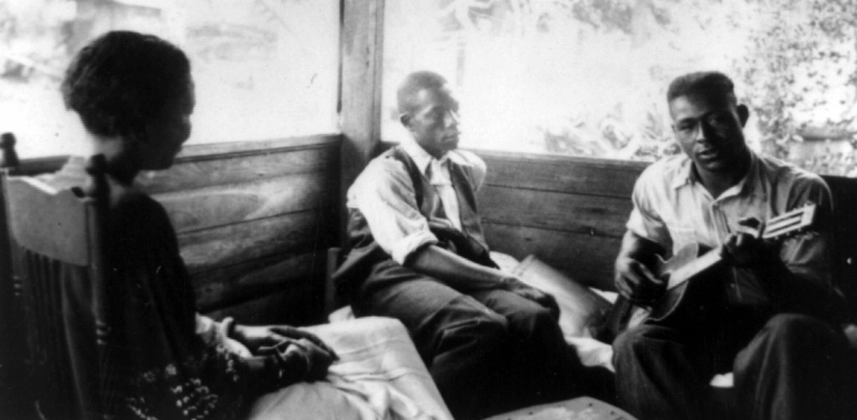
With Alan Lomax and Mary Elizabeth Barnicle in Florida and Georgia 1935
Lulu Wiles
https://blogs.loc.gov/folklife/2020/04/no-depression-features-zora-neale-hurston/
1935 Recordings in the Library of Congress https://www.loc.gov/audio/?q=zora+neale+hurston

Slide 10
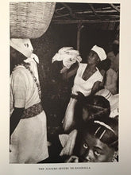
1934-1942: Writer, Dancer, Singer
1934: Founded a school of dramatic arts at HBC Bethune-Cookman College.
1934: First novel, Jonah’s Gourd Vine.
1935: Resumed graduate study at Columbia; summer work with WPA Theater Project; Mules and Men, a collection of African-American folktales.
1936-1937: Guggenheim supported research in Jamaica and Haiti.
1937: The Eyes Were Watching God.
1938: Tell My Horse, a study of Caribbean voodoo.
1939: Moses, Man on the Mountain, a novel
1939-1940: Worked at NC College for Negroes, and performed with local black theaters.
1942: Dust Tracks on a Road, her autobiography.
With the Federal Writer Project, 1937
https://barnard.edu/zora-neale-hurston-at-barnard
https://blackcatcaboodle.com/products/tell-my-horse-zora-neale-hurston-1st-1st-1938-voodoo-haiti-jamaica-zombies

Slide 11
Later Years
1943-1951: Political essays for Saturday Evening Post and American Legion Magazine.
1947: Last fieldwork, Honduras
1948: Seraph on the Suwanee, a novel.
1957-1959: Columnist for the Fort Pierce Chronicle.
January 28, 1960: Died in the St. Lucie County Welfare Home after a stroke the previous year.
1973: The novelist Alice Walker discovered her gravesite.
1975: Walker wrote “In Search of Zora Neale Hurston” for Ms. Magazine

