Slide 1
Songcatchers: Frank and Anne Warner
Between 1938-1969, they collected about 1000 songs.
Southern Appalachians; Outer Banks; Tidewater Virginia; Maine and Vermont; Adirondacks in upstate New York.
Archive is housed in the American Folklife Center, the Library of Congress.
Traditional American Folk Songs, 1984.
Recording Rebecca King Jones, Durham, NC 1940
https://mountains2thesea.com/

Slide 2
Tom Dula Frank Proffitt, Beech Mountain, NC 1937
Traditional ballad of the murder of Laura Foster by civil war veteran Tom Dula.
A story of a love triangle involving Dula and three women who were cousins, Laura Foster, Ann Foster Melton and Pauline Foster.
Dula believed that Laura had given him syphilis; he passed it on to Ann and Pauline.
Dula was arrested some time later by James Grayson. And Ann was arrested as an accomplice.
Dula was convicted and hanged on May 1, 1868. Ann was acquitted.
Proffitt’s version was recorded by the Kingston Trio, who copyrighted the song.
The settlement assigned copyright to Frank Warner.

Slide 3
Their Careers
Frank Warner (1903-1978) was born in Selma, Alabama in an integrated neighborhood, down the street from an African American church.
He mostly grew up in Durham, NC;
Attended Duke And studied with Frank C. Brown, a folklorist.
After graduation, he went to work for the YMCA, his lifetime worked. But also had a folk music show on a radio station in Greensboro.
He moved to New York in 1931.
Anne Locher Warner was from St. Louis; her family moved the NY when she was in college at Northwestern.
They married in 1938 and lived in an apartment on West 10th St. in Greenwich. They fell into a circle of friends that included Carl Sandberg.
That same year, Maurice Matteson brought a mountain dulcimer to a house party.
Chicago Folk Festival, 1961

Slide 4
Anne Warner on How the Collection Began
We wanted very much to have a dulcimer, so we wrote Nathan Hicks to see if he would make one for us, which he did. So began out relationship with the Hicks family which continues to this day (1982), to the second and third generations.
A letter from Nathan Hicks: Dear Mr. Warner, I Received your Letter that you wanted a Dulcimer like Mr. Matteson I cant send it unless I get some money as Postage and glue and nails cost me money and times are so Hard and m wife is sick most of the time and we have tin chilrlden and times are so Hard I cant get much money…Please send the money and I will have the Dulcimer Redy time I hear from you.
Before we went to see Nathan and Rena for the first time we sent them a big box of clothes and bedding which we had gathered from all our friends.

Slide 5
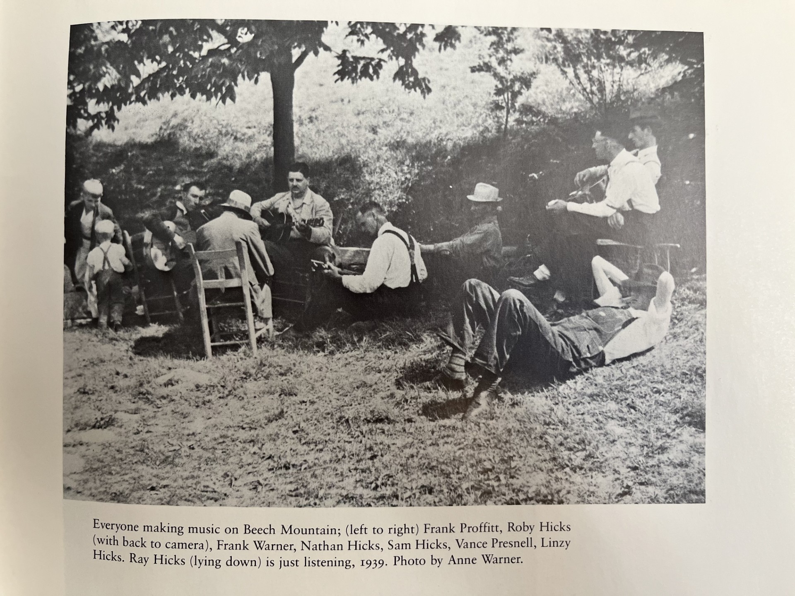
The Hicks Family Nathan and Rena, Buna Vista (Presnell) Hicks, Linzy Hicks, Lee Monroe Presnell,
Uncle Dave Macon, Palms of Victory
http://www.bluegrassmessengers.com/nathan-hicks-frank-proffitt-hicks-family.aspx

Slide 6
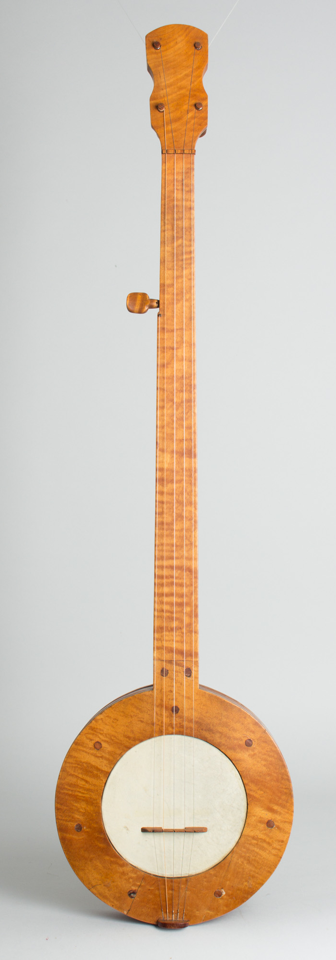
Frank Proffitt
1941
https://blogs.loc.gov/folklife/2018/04/no-ordinary-banjo/
Newport Folk festival 1964
https://www.retrofret.com/product.asp?ProductID=8934

Slide 7
Yankee John Galusha
Logger, farmer, trail guide and forest ranger from warren County, NY.
81 years old when the Warners recorded 60 songs with him.
Revolutionary and Civil War songs; Irish ballads; sea shanties.
http://woods.tauny.org/subpages/69/3/6/john-galusha

Slide 8
Lena Bourne Fish
Born in 1873, in Black Brook NY. Her father was a lumber salesman.
She lived her adult life in New Hampshire and married a farmer, John Fish, and had 7 children.
She was 70 when the Warners met her, with a reputation in her community as a singer.
She recorded nearly 100 songs for the Warners, including ballads, sea shanties, Irish songs, and children’s song.
The Ship Carpenter
Castle By the Sea
https://folktrax-archive.org/menus/cassprogs/922.htm

Slide 9
More Songs from the Warner Collection
2nd South Carolina String Band
Sheila Kay Adams, Branson Raines and Dan Lewis
Estil C. Ball

Slide 10
Fathers Now Our Meeting Is Over Buna Vista (Presnell Hicks) 1959
Now, my friends, the meeting is over;
Fathers, we must part.
And, if I never see you any more,
I’ll love you in my heart.
Chorus (repeated after each verse):
We will land on shore,
We will land on shore,
We will land on shore
And be safe forever more.
Now, my friends, the meeting is over;
Brothers, we must part.
And, if I never see you any more,
I’ll love you in my heart.
Now, my friends, the meeting is over;
Sisters, we must part.
And, if I never see you any more,
I’ll love you in my heart.

Slide 11
Resources
Traditional American Folk Songs, Syracuse University Press, 1984.
From the Mountains to the Sea: The Anne and Frank Warner Collection. https://mountains2thesea.com/about
Frank and Anne warner 1999 Folk Alliance Lifetime Achievement Award. https://www.youtube.com/watch?v=mpyzauPzKjE
Anne and Frank Warner Collection, Library of Congress. https://findingaids.loc.gov/exist_collections/ead3pdf/afc/2005/af005001.pdf
LOC Oral History: Jeff and Gerret Warner. https://www.youtube.com/watch?v=FkgTnjDx_sE
Frank Warner recordings: Hudson Valley Songs (1946); American Folk Songs and Ballads (1952); Songs and Ballads of America’s Wars (1954); Our Singing Heritage (1958); Songs of the Civil War (1961); All You Good People (1976)
Her Bright Smile Haunts Me Still & Nothing Seems Better to Me. The warner Collection, Vols, I-II. Appleseed Recordings.

