Slide 1
Astrophysics: Great Advances and Grand Challenges
OLLI U Arizona 2026
Lockwood Carlson PhD
This course will start with an introduction to astrophysics and cosmology. We will then go on to investigate key areas currently under study, such as the nature of dark matter and dark energy (two completely different things), the expansion of the universe (“Hubble tension”), the so called ‘big bang’ that has several components (mostly not understood today), how stars and galaxies are created and evolve (mostly not understood). The last decade has been revolutionary, in scope and detail, driven by new telescopes on earth and in space (DESI, Rubin telescope, James Webb Space Telescope and more), extending probes beyond light (gravitational waves, neutrinos, cosmic rays), and computational power and machine learning (“AI”). This has led to rapid expansion of our ignorance about these topics; an exciting time. We will finish with some thoughts on futures and quantum gravity.
No math required. Only curiosity and desire to understand science.

Slide 2
Astrophysics- references and sources
OLLI – Univ. of Arizona Lockwood Carlson PhD
Hare some good sources of insights and explanations by several experts in theoretical physics. They are all skilled in speaking to the public about the issues we are covering in our ILR classes. All are highly recommended.
Becky Smethhurst Astrophysicist Dr. Becky – YouTube Covers latest research in cosmology and astrophysics- excellent teacher
Anton Petrov see his channel. Up to date news in astrophysics and cosmology with clear explanations
Ethan Siegel https://www.startswithabang.com/ always fascinating and wide ranging topics and a skilled teacher
PBS Space Time- Matt O’Dowd https://www.youtube.com/c/pbsspacetime/videos a series on all of the issues in physics today with some attitude
Sabine Hossenfelder Sabine Hossenfelder – YouTube
Don Lincoln https://www.youtube.com/playlist?list=PLcrmvrXrZyHNXokuL0Xk8SE0tyMOqGfam masterful explanations for non- physicists
Sean Carroll https://www.preposterousuniverse.com/ interesting blogs on a broad variety of physics topics. See also, but more advanced, the series “Biggest Ideas in the Universe”

Slide 3
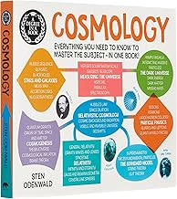
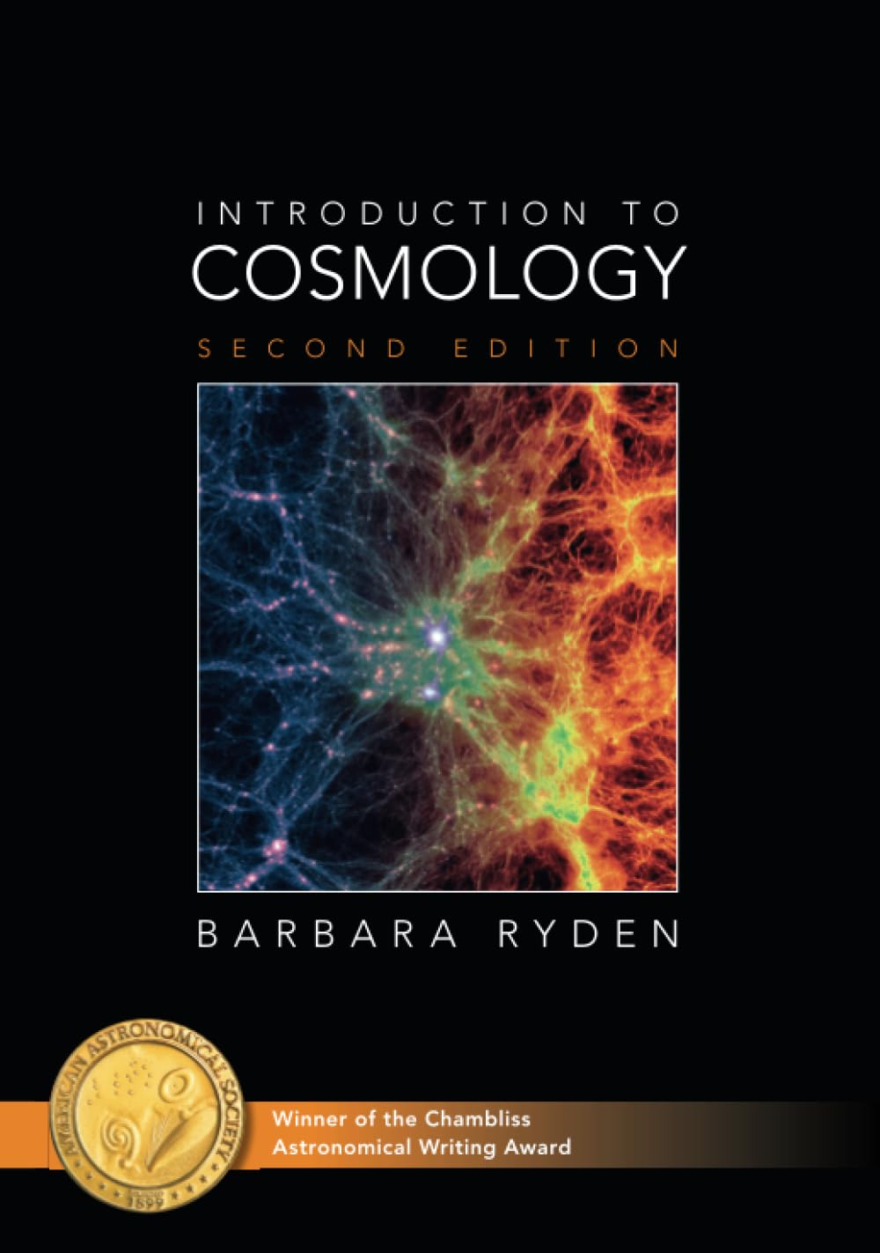
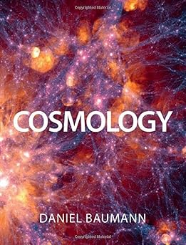
By Sten Odenwald.
Highly recommended guide for beginners with history, data, explanations, and more.
No math required.
By Barbara Ryden
Undergrad physics text. Complete introduction and well written.
She makes it interesting.
By Daniel Baumann.
Grad school text. Gives a solid foundation and well written.
Math heavy.
Daniel Baumann: Introduction to Cosmology (Lecture 1)

