Slide 1
VOTING
The Best Way
To Control Government Power

Slide 2
Voting & Democracy
Control of government power is the impetus
Magna carta
Declaration of Independence
Constitution
The balance between ‘pure’ and representative democracy
The balance between too much and too little government power

Slide 3
Voting & Democracy
House voting is one person-one vote
Votes for senators are diluted
Two per state
Votes for President are diluted
The electoral college

Slide 4
Voting & Gerrymandering
Elbridge Gerry in 1812
Used to disenfranchise minorities
Still theoretically improper
Used for partisan political purposes
SCOTUS holds it’s not their business

Slide 5
Voting & Gerrymandering
Newly drawn Texas congressional districts
2025 Texas redistricting – Wikipedia
Newly drawn California congressional districts
California's congressional districts - Wikipedia

Slide 6
Voting & Gerrymandering
On the other hand…
Some states have resisted
Indiana
Utah
Kansas
Can it get worse? A ‘gerrymander apocalypse’

Slide 7
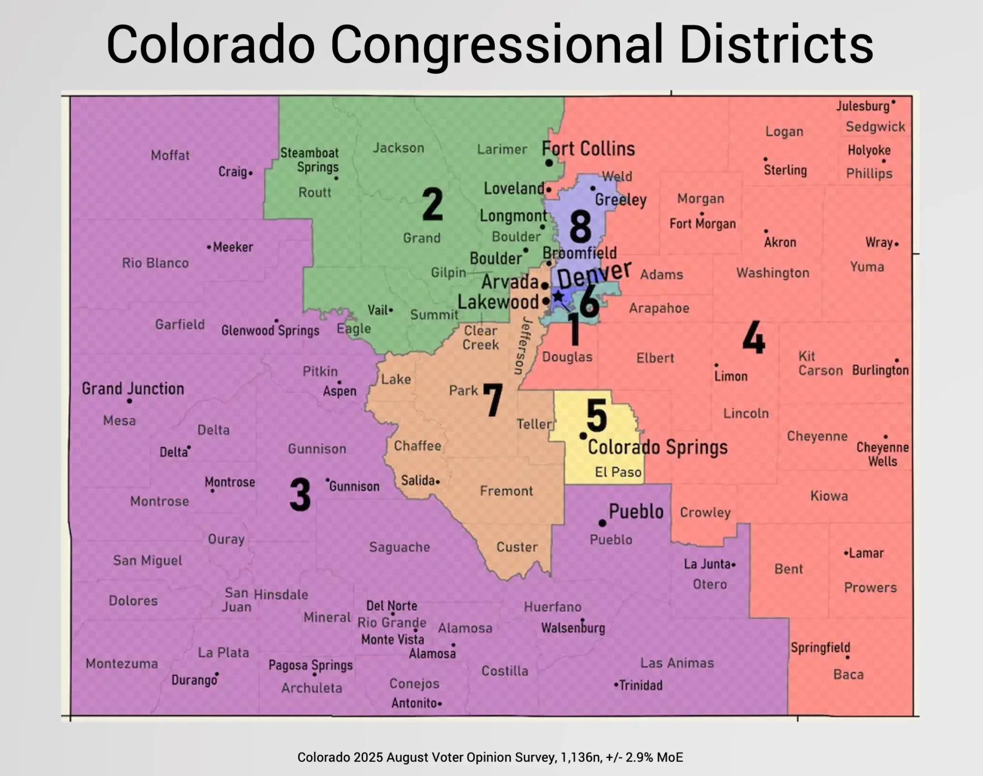
Western slope
Eastern Plains
Front range

Slide 8
Voting & Gerrymandering
Arizona’s congressional districts
Arizona's congressional districts - Wikipedia
Why is Tucson split in half?

Slide 9
Voting & Gerrymandering
Arizona statistics: 7,200,000 people in 2020
5,100,000 in Phoenix metro area
1,000,000 in Tucson metro area
1,100,000 in the rest of the state
9 congressional districts
800,000 people per district

Slide 10
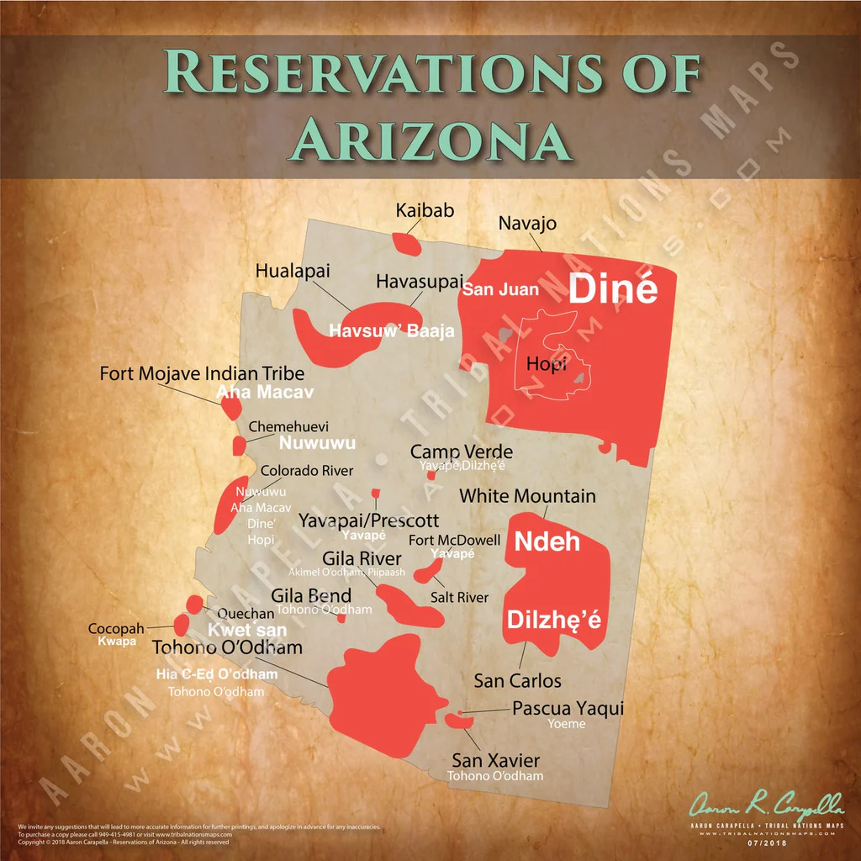
NATIVE AMERICANS
17 reservations
22 tribes
367,000 people

Slide 11
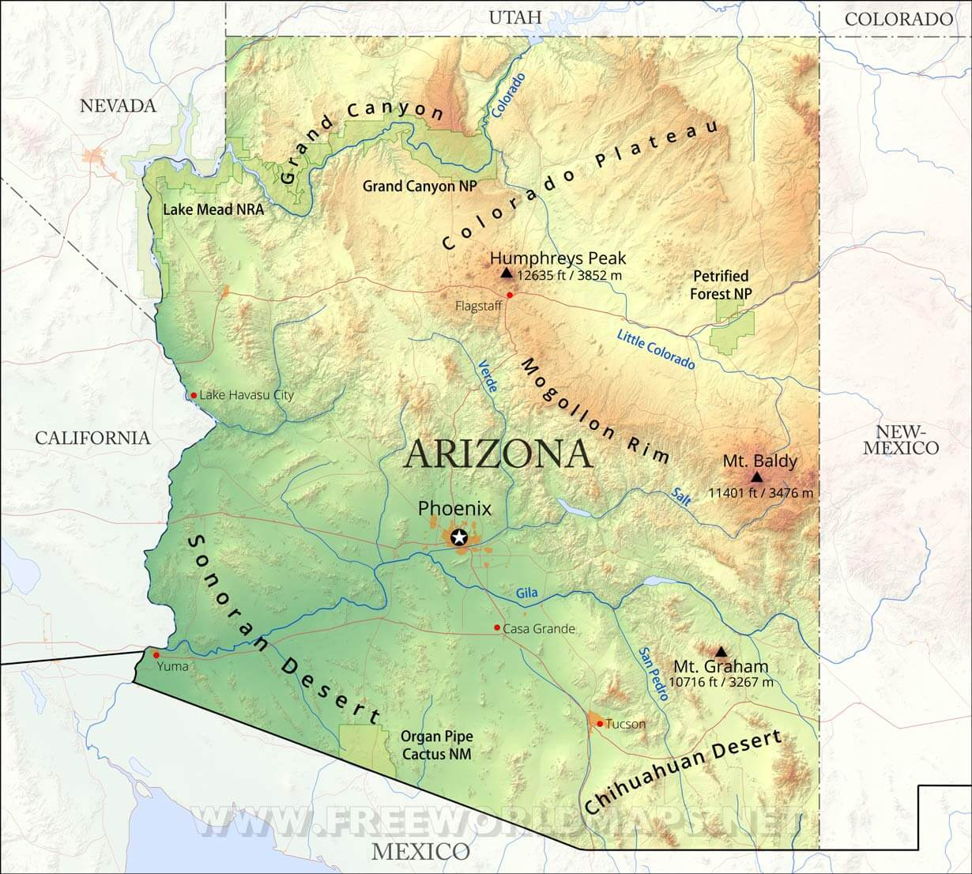
How to divide?
Nine Pie slices?
Shared interests?
Political boundaries?
Water issues?

Slide 12
Voting & CITIZENSHIP
Only U.S. citizens can vote in federal elections
States and municipalities control eligibility in their elections

Slide 13
Voting & CITIZENSHIP
The 14th Amendment
All persons born or naturalized
Subject to the jurisdiction thereof
Intended to help newly freed slaves
Native Americans excluded
Children of diplomats excluded
Occupying forces excluded

Slide 14
Voting & CITIZENSHIP
Wong Kim Ark
Parents’ allegiance does not matter
Trump’s executive order redefining
Four districts and one circuit have said no
The court has authority to make this call
Judicial limiting executive

Slide 15
Voting & Campaign Financing
Two competing fundamental principles
We can support (money, time and vote) whoever we want
Large amounts of money can distort the will of the people

Slide 16
Voting & Campaign Financing
Legislation has attempted to limit the influence of money
McCain – Feingold
Scotus has essentially gutted these efforts
‘Dark money’
Donors remain anonymous
Can’t coordinate. Hah!
$900,000,000 in 2024 election

Slide 17
Voting & Political Parties
Washington raised the alarm in 1796
Parties now dilute our ability to control because of the nomination process
Two loud a/o extreme candidates win the nomination
General election options are distorted

Slide 18
Voting & Political Parties
Arizona engaged in a dispute over third parties right now
No Labels Party to Arizona Independent Party
One third of us are ‘independent’

Slide 19
Voting & Political Parties
At a more philosophical level
Political parties (like many organizations)
Often lose sight of their mission
And focus inappropriately on self-preservation

Slide 20
Voting & federalism
Who gets to decide the voting process?
Constitution gives the power to the states
But provides that the feds can jump in
Hamilton said they would rarely do so

Slide 21
Voting & federalism
The feds sometimes get involved in racial gerrymandering cases
Now going both ways
The political gerrymandering cases make it clear that Congress has authority over political gerrymandering
Not the states, not the courts

Slide 22
Voting & federalism
The feds are getting more involved
Demand for Minnesota voter rolls
Seizure of Atlanta ballots
The SAVE Act would be a significant increase in federal control of the election process
Passed the House, stalled in the Senate

Slide 23
Who Is On The Ballot?
Colorado S.C. took Trump’s name off the ballot
Finding of insurrection
SCOTUS reversed
States can’t control federal ballot.
That harms other states.
Free to control state ballots.

Slide 24
Who Gets To Vote?
We’ve already touched on the citizenship issue
Big picture
Accuracy of voting
Ease of voting

Slide 25
Who Gets To Vote?
Arizona’s history is instructive
Felony for ‘ballot harvesting’
Pending suit against Hobbs’ efforts to make it easier to vote
Competing initiative efforts are pending
One enshrines mail-in voting
One lets legislature terminate it

Slide 26
Who Gets To Vote?
Not entirely clear who benefits from mail in voting process
Generally thought to be Democrats
Virtually all legislation and lawsuits against it come from Republicans

Slide 27
Who Gets To Vote?
How real is voting fraud?
Heritage Foundation study
36 Arizona elections
Over a 25 year period
With a total of 42,626,379 votes cast
36 cases of fraud reported

Slide 28
Who Gets To Vote?
Obviously, there could have been more than 36 cases
But that number is tiny: .0000845%
The 36 cases resulted in 10 convictions
Two were ballot harvesting
Which does not go to accuracy
Three felons not entitled to vote
Three voted for a dead family member

Slide 29
Who Gets To Vote?
The remaining two convictions appeared more serious. San Luis politician
Claims of filling out ballots
Claims of improper persuasion or coercion
Prosecutors dismissed those claims and guilty pleas were entered to ballot harvesting charge

Slide 30
Who Gets To Vote?
WSJ editorial on nationalizing the vote, 2/6
Georgia investigation in 2024
9 non-citizens voted
Trump lost by 11,799
Michigan investigation in 2025
15 non-citizens voted
Trump lost by 154,188

Slide 31
Who Gets To Vote?
WSY times story on February 10
Affidavit for Fulton county seizure
Came from a ‘denier source’
Whose claims have been debunked
And/or rejected by courts

Slide 32
Referenda
Referenda are a way for people to be heard when the legislature is not listening
No federal process
State processes vary

Slide 33
Referenda: Arizona
10% or 15% of voters must sign a petition
Legislature can refer a measure
Most recently, 2024 Proposition 139 concerning abortion
Republicans are attempting to make the process more difficult
Require signatures in all counties
Increase the Constitution vote to 60%

Slide 34
Recall
Recall is a way for people to be heard when legislators do something objectionable
No federal process
State processes vary

Slide 35
Recall
It should not replace elections
It is difficult to succeed
And it should be difficult
Kyrsten Sinema and party switching?

Slide 36
Other Methods of Voting
Open primaries
More likely to get moderate candidates
Ranked choice voting
More likely to elect moderate candidate
Both political parties generally object

