Slide 1
BEFORE WE BEGIN
WRAPPING IT UP
TWO UPDATES

Slide 2
Executive orders
President’s EO ‘firing’ law firms
Based on their politics, not competency
Some settled
Some sued
  The lawsuits were successful
  The Government appealed
  Monday, March 2, government conceded
  Tuesday, March 3, government reversed

Slide 3
War powers
Bombing Iran
Obvious debate over wisdom
Our discussion is authority
War Powers Act of 1973
  Origins
    Vietnam era joint resolution
    LBJ lied and RMN bombed
    Congress overrode Nixon veto

Slide 4
War powers act
Constitutionality remains unclear
Tension between
  President as Commander in Chief, and
  Congress’s power to declare war
Lots of dancing around the issue
  Clinton and Somalia
  Bush got authorization for Iraq
  Obama & Trump 1 and Syria

Slide 5
War powers act
Yesterday’s justifications:
President’s mandated letter to Congress: Advance American national interests and eliminate Iran as a global threat
Secretary Rubio: Iran was going to be attacked and would then counter-attack

Slide 6
War powers act
Current situation
Congress should act
Support the action or reject it
  Significant political statement
Take budgetary action
  Raises significant practical issues

Slide 7
WRAPPING IT UP
Controlling the Powers of Government

Slide 8
Today’s class
A few more topics
  Impeachment
  Presidential term limits
  Congressional procedures
What should we do?

Slide 9
IMPEACHMENT OVERVIEW
Article II, § 4
The process:
House impeaches
  Files charges
Senate holds trial
  Two thirds required to convict

Slide 10
IMPEACHMENT
Most powerful weapon
Unique to the legislative branch
Grounds for impeachment:
  Treason and bribery
  “other high Crimes and Misdemeanors”

Slide 11
IMPEACHMENT HISTORY
Andrew Johnson
Richard Nixon (almost)
Bill Clinton
Donald Trump
  Abuse of power and election interference
  Inciting insurrection

Slide 12
IMPEACHMENT POLITICS
Rare to vote against a President from your party
Mitt Romney, Ben Sasse, Susan Collins, etc
Compare this to the jury in a criminal trial

Slide 13
  PRESIDENTIAL TERM LIMITS
Constitution is silent – Washington
In response to FDR, 22nd Amendment
Is Trump serious about finding a loophole?
  Some of his supporters clearly are
Can’t run as VP: The 12th Amendment
Get appointed as Speaker

Slide 14
  PRESIDENTIAL TERM LIMITS
What would SCOTUS do?
Literal and strict interpretation
  No bar to Speaker loophole
Looser interpretation based upon intent
  Ban on anyone being President too long

Slide 15
  Filibusters
The filibuster: Mr. Smith Goes to Washington
All a Senator now need do is file notice
Sixty votes needed to shut off debate
  It is a Senate rule not a constitutional rule
  Has been limited – Judicial appointments
  Efforts to eliminate it have failed
Both parties use it for political purposes

Slide 16
  Filibuster effects
The upshot: 40 Senators can bring the entire Senate to a complete halt
40 Senators might represent as few as 34,000,000 out of 338,000,000 (10%)
The use of this rule is entirely up to the Senate

Slide 17
  the blue slip
Another Senate procedure
One Senator can hold up appointments
  Other business can continue
Designed to foster collaboration
Tuberville used it to block military promotions
  He wanted to change Pentagon’s abortion policies

Slide 18
  the blue slip effect
One Senator, perhaps representing fewer than 600,000 people (Wyoming)
Can thwart the will of everyone else
Party leaders on both sides criticized Tuberville
  He relented after eight months

Slide 19
THE ROTOR ACT
The House is sometimes ‘anti-democratic’ as well
Just last week
The Rotor Act
  Rotorcraft Operations Transparency and Oversight Reform Act

Slide 20
THE ROTOR ACT
Act designed to improve air safety
Unanimous Senate with Defense support
DOD withdrew its support: Not clear why
House vote required two thirds due to use of expedited process
Needed 265 votes, got 264 votes
  Only 397 representatives voted

Slide 21
THE ROTOR ACT
The upshot?
133 Representatives blocked the will of
264 (or more) Representatives and
100 Senators
Maybe there’s a good explanation; we shall see

Slide 22
SO, WHAT CAN WE DO?

Slide 23
Does ANCIENT HISTORY TELL US ANYTHING?
I DON’T WANT TO PREACH,
BUT…

Slide 24
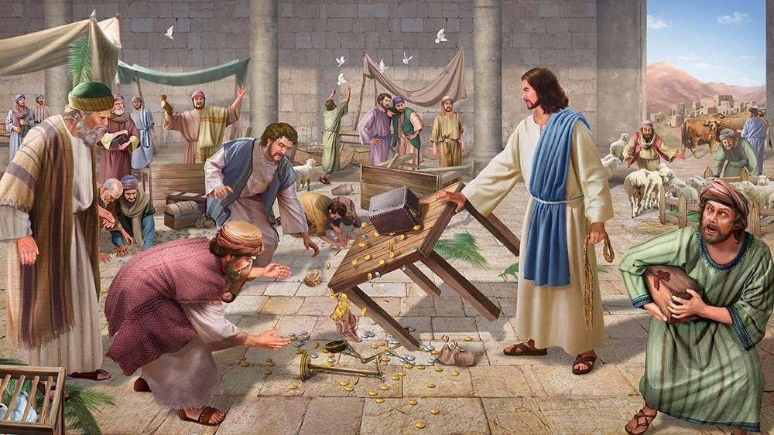

Slide 25
Does the AMERICAN REVOLUTION TELL US ANYTHING?

Slide 26
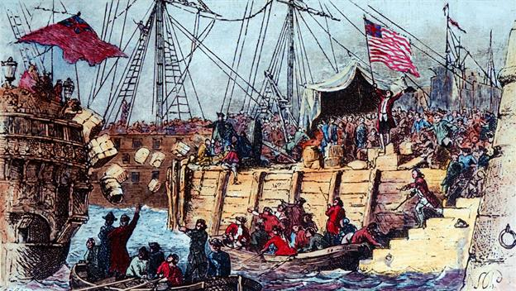

Slide 27
Does the civil rights fight tell us anything?

Slide 28
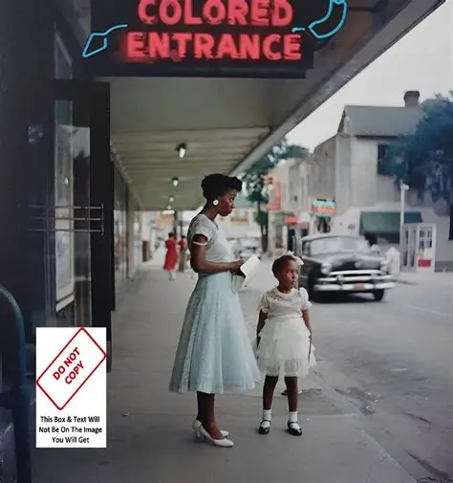

Slide 29
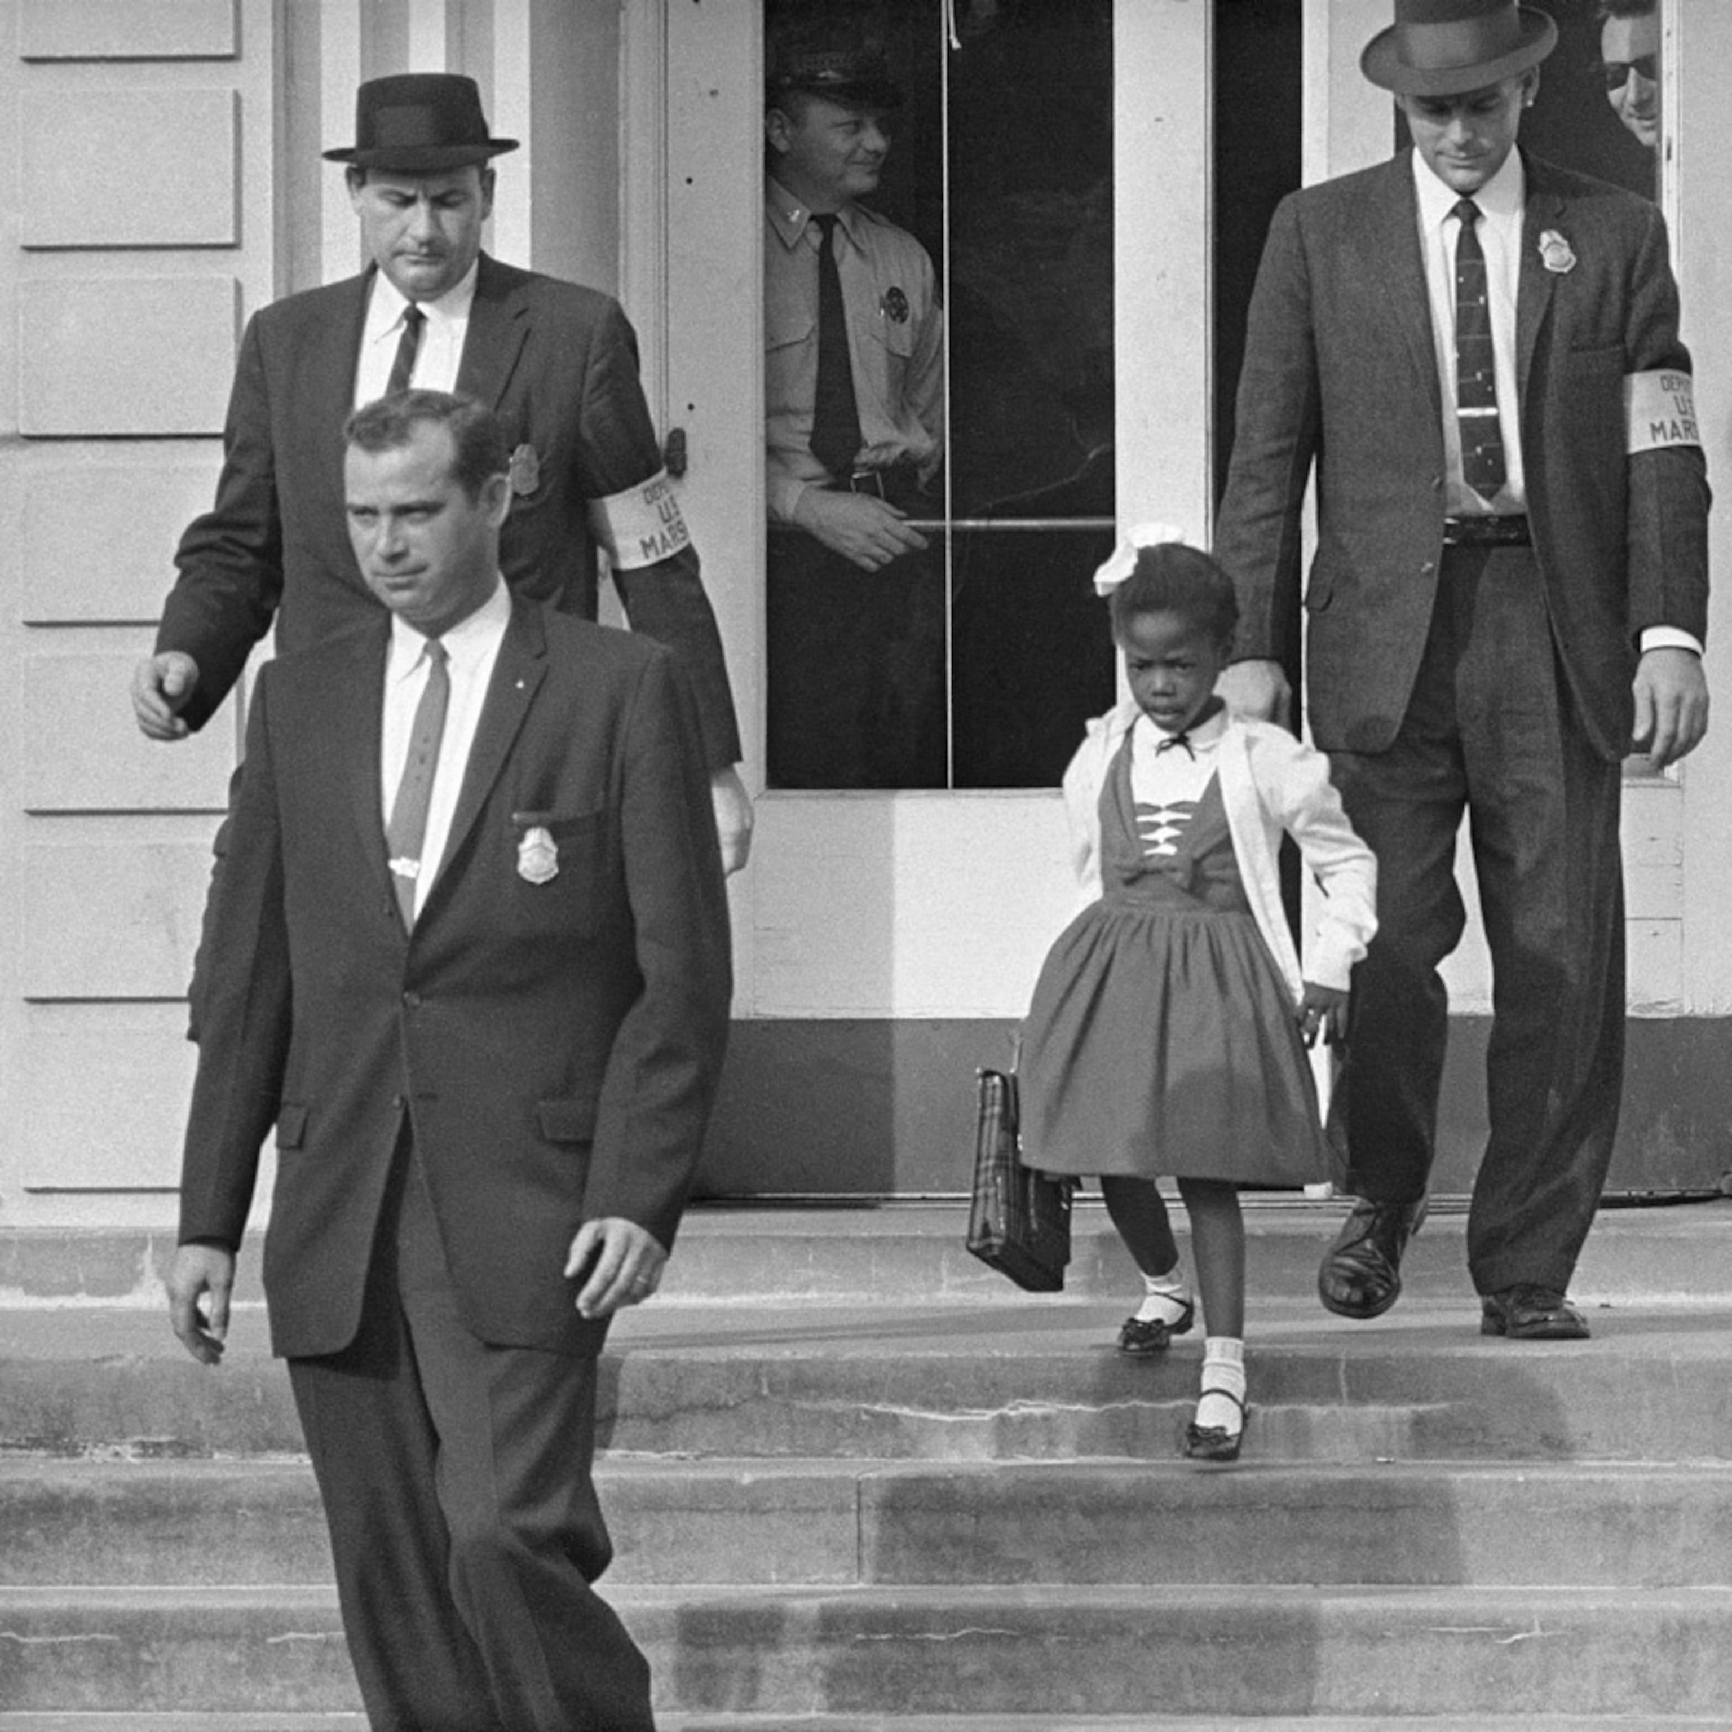

Slide 30
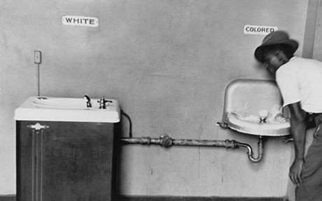

Slide 31
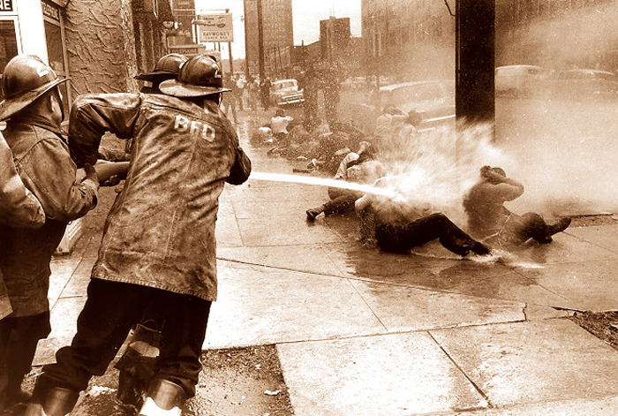

Slide 32
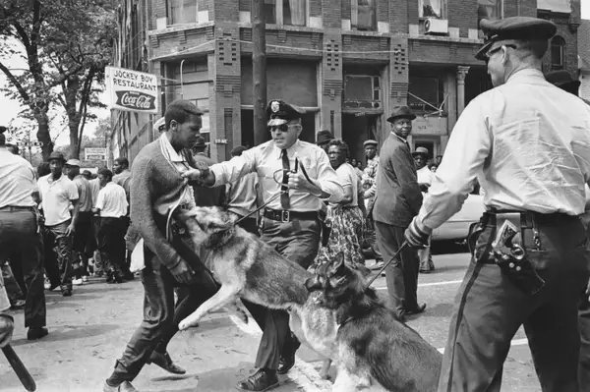

Slide 33
MINNESOTA
Whether you agree or disagree with the protesters there,
They have brought national attention to the issue,
And the administration has modified its policies

Slide 34
ONE PERSON
OR A MOVEMENT?
Jesus
Gandhi
Martin Luther King
Rosa Parks
They inspired others to demand change
Changes requires leaders and followers

Slide 35
DEMONSTRATIONS
Non-violence is critical
  Keeping the moral high ground
  Not giving opponents another line of attack
Disobedience?: Your choice
  Going to jail is a statement
  Dragging us off in our wheelchairs: Photo Op

Slide 36
MORE PRACTICAL THOUGHTS
Vote
  Give money (as if we have enough)
Get others to vote
Political party
LTE
Attend meetings
If you don’t do something, and you complain, you’re just a whiner

Slide 37
FINAL THOUGHT
If you get arrested,
Don’t call me…
I’m not licensed in Arizona

