Slide 1
Global Supply Chains and the History of Tariffs

Slide 2
Course Leader Michael Gray
Manufacturing and Distribution Executive
45 years experience in Global Supply Chains and Manufacturing imported more than 1 billion USD into the NA
Deep experience in Global Metals Supply Chains including rare earth metals
C Level experience in Power Generation, Solar, Nuclear, Fossil Fuels and Electronic assemblies
Recent experience in Power electronics including in demand silicon wafer chips

Slide 3
NEXT Four WEEks
Thank you for your interest in this critically important time in our Nations history
We are going to explore together Global Supply Chains and tariffs
Facts are important and the only way we all gain understanding, knowledge is KING
Ask questions, even the tough ones ! Offer suggestions as to what else you may want me to present, this is your course !

Slide 4
Global supply chains
Not a new concept or practice:
Europe trading with the Far East, Marco Polo’s journeys can be considered “Global Trade”
Christopher Columbus and his journeys to find the passage to the Far East
The opening up of North America by trading furs to the Europeans for metal goods and firearms
Tariffs and Duties and taxes have been part of the global supply chain for hundreds of years for most countries

Slide 5
The Language of Tariffs and Trade
Tariff: a tax imposed by the government on imported goods and sometimes exports
Duty: Technically a tariff is a policy that results in a duty rate
For the US, duties come in three flavors:
Ad Valorem: tariff is defined as a % of the customs value
Specific: tariffs based on a defined quantity
Compound: Combination of Ad Valorem and Specific
Types of Tariffs:
Section 301 of the Trade Act of 1974 authorizes the President to act against foreign trade practices that are unreasonable or discriminatory and that burden or restrict U.S. commerce
Section 232 tariffs are import duties authorized by the Trade Expansion Act of 1962, allowing the U.S. President to impose trade restrictions (tariffs, quotas) on products deemed to threaten national security after a Department of Commerce investigation

Slide 6

Language of Tariffs and Trade Cont’d
IEEPA tariffs: Invoking the International Emergency Economic Powers Act (IEEPA) to increase tariffs on US imports at levels not seen since the 1930s.
No set % ‘s more of a political action rather than trade policy
All noted tariffs are in addition to established duty / tariff rates:
If the standard or normal duty is 5% and a Section 301 tariff of 25% is announced, then the new duty rate is 30%

Slide 7
Language of Tariffs and Trade Cont’d
AD/CVD; Antidumping (AD) and Countervailing Duties (CVD): special tariffs imposed by the U.S. government on imported goods to counteract unfair trade practices like selling products below cost (dumping) or receiving foreign government subsidies, thereby protecting American industries and ensuring a level playing field
AD duties stop dumping (selling below fair value), while CVDs offset unfair government subsidies, both aiming to restore fair competition for domestic producers facing injury from these practices, enforced by the Commerce Department and Customs and Border Protection (CBP)
Typically, these investigations take 12-18 months

Slide 8
HTS Codes: Introduction
HTS Codes: Harmonized Tariff Schedules
Basic code architecture is used world-wide, individual countries add further details as needed
USA has more than 9,500 tariff codes
Codes are 10-digits and provide definition of the imported goods
The complexity of system can lead to misclassification and inaccurate “specific” duty rates
Ad valorem Duties can encompass entire country and product imports and are not always tied to an HTS code

Slide 9
HTS Code Example
Example Breakdown: Men's Cotton T-Shirt (6109.10.00.12)
61: Chapter - Articles of apparel and clothing accessories, knitted or crocheted
09: Heading - T-shirts, singlets, and other vests, knitted or crocheted.
10: Subheading - Of cotton.
00: Further subheading detail (e.g., specifying type of cotton).
12: Statistical Suffix - For U.S. trade data (e.g., for men's/boys').

Slide 10

HTS Codes: Continued
The theory of Substantial Transformation:
The import of goods under one HTS code and the transformation in the importing country of those goods to be now considered “domestic content” hence either qualifying for a lower duty rate or no duty as the goods are now considered domestic
This transformation can be the basis of trade under the various trade treaties such as the USMCA

Slide 11

Notable Trade Agreements
WTO: World Trade Organization, regulates trade between countries and can provide a dispute resolution between countries
International Trade Agreements:
USMCA [USA, Mexico, Canada trade agreement]
Followed NAFTA agreement
RCEP: Regional Partnership covering Asia
CPTPP: Pacific Rim countries pact
EU: European Union that links European Countries

Slide 12
Trade Agreements: Cont’d
Quotas: often imports of specific HTS codes are assigned a quota based on dollar value imported by producing country. The quota could be duty free or reduced duties
Quantities imported > the quota would be subject to tariffs
What is a de minimis exemption?
De minimis provides admission of articles free of duty and of any tax imposed on or by reason of importation, but the aggregate fair retail value in the country of shipment of articles imported by one person on one day and exempted from the payment of duty shall not exceed $800
Currently the de minimis exemption has been eliminated but the elimination has greatly added to the cost / complexity and timing to import in 2024 there were more than 1.4 billion de minimus transactions
Think “Temu “

Slide 13

Global Supply Chain Definitions
Global Supply Chain: International network of suppliers, distributors, manufacturers across multiple countries and can include goods and services
SCM: supply chain management
Supply chain resilience: the ability of the supply chain to withstand disruptions
Trade Deficit: A trade deficit occurs when a country imports more goods and services than it exports, meaning the monetary value of its imports exceeds the value of its exports over a specific period, indicating it spends more on foreign products and services than it earns from selling its own. It's also known as a negative balance of trade.

Slide 14
Evolution of Global Supply chains
Trading globally is not new but advances in transportation, shipping and data management accelerated the evolution of Global Supply Chains
The internal combustion engine , diesel and large transport trucks in the early part of the 20th century made a huge difference in time to ship and the weight of shipments accelerated trade
WW2 saw the development of the pallet and more efficient loading of ships

Slide 15
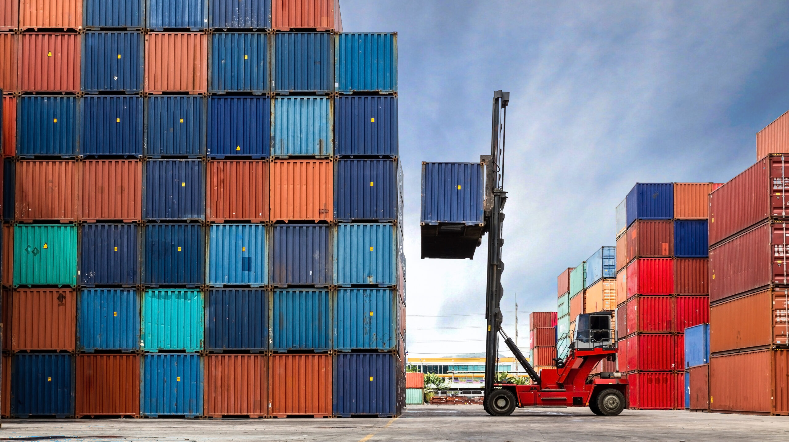
Evolution of Global Supply chains: Containers
Single biggest contributor to global trade was the development of the container and container shipments
Containers greatly accelerated the loading and unloading and dramatically increased the goods that could be shipped at one time
Sophisticated tracking and inventory systems gave companies the ability to more closely manage inventory + inbound and outbound shipments

Slide 16
INCo Terms
INCO Terms: a key concept in ownership of the goods while in transit and assignment of costs; there are 11 different INCO terms that define how goods are shipped and costs
FOB: “free on board” title to the goods and cost of insurance passed to the buyer either at shipping point FOB ex works or FOB destination title passes when goods arrive. Important point, under FOB all duties, tariffs, port charges etc are to the account of the buyer not the seller

Slide 17
INCO Terms Cont’d
FCA: Free carrier, title and costs are assigned to the buyer at a “named” place; ie Port of Los Angeles after arrival at the “named” place all duties , taxes etc are to the account of the buyer
DAP: Delivered at Place, similar to FCA
DDP: Delivery Duty Paid, goods are delivered to named place, all duties taxes , port costs are to the account of the seller
Demurrage: Demurrage is a penalty fee charged in shipping and logistics when cargo (containers) stays too long at a port terminal, rail yard, or other facility beyond the free time allowed in the contract
Containers: Come in two sizes, 20 ft and 40 ft, both open top and sealed
Break Bulk: goods not shipped in containers [ lowest cost method of shipping ]

Slide 18
USA Tariff History: Key Eras
Revenue Generation (1789–1860): The Tariff of 1789 was designed to raise revenue for the new government, often providing 90% of federal income.
Protectionism & Industrialization (1861–1933): Tariffs were used to protect U.S. manufacturers from foreign competition, particularly in industries like steel. This era culminated in the high protective rates of the Fordney-McCumber Tariff of 1922 and the 1930 Smoot-Hawley Tariff, which increased duties to near-record levels.
Reciprocity & Trade Liberalization (1934–2016): The Reciprocal Trade Agreements Act of 1934 allowed the President to negotiate bilateral trade reductions. Post-WWII, the U.S. championed the General Agreement on Tariffs and Trade (GATT), leading to the World Trade Organization (WTO) and significantly lowering global tariffs.
Modern Era (2017–Present): Tariffs have been increasingly used as a tool for economic leverage, with significant tariff increases on products from China and other nations, reversing the long-term trend of declining tariff rates.

Slide 19
Worldwide Tariffs
Virtually all countries in the world employ tariffs of varying rates
Protection of nascent industries
Production of critical materials like steel
Food Supply and the ability of a country to feed itself is often a powerful trade barrier
Marketing boards and internal price controls often cause trade disputes
Politically motivated tariffs occur in other countries
Tariffs can protect sensitive military secrets and intelligence
Export tariffs occur in many countries that want to restrain production or increase pricing very common in the production of metal products i.e., rare earth metals

Slide 20
Transshipment and “Tariff Engineering”
Transshipments involve the shipment of goods from a high “tariff” country to a “lower” tariffed country
Generally, semi finished products
Using the theory of substantial transformation, raw materials or semi finished products are “finished” in different countries and then transshipped to final destination
Objective is to lower the effective tariff rate
Often the original producing company wholly owns the subsidiary

Slide 21
Transshipment and “Tariff Engineering” Continued
Tariff Engineering can also include:
Substantial transformation changes the HTS code often evading prevailing tariffs
Deliberate undervaluing of the cost of shipped goods
Deliberate misclassification of the HTS Code
Currency manipulation
De minimis lead to value manipulation, thousands of small shipments

Slide 22
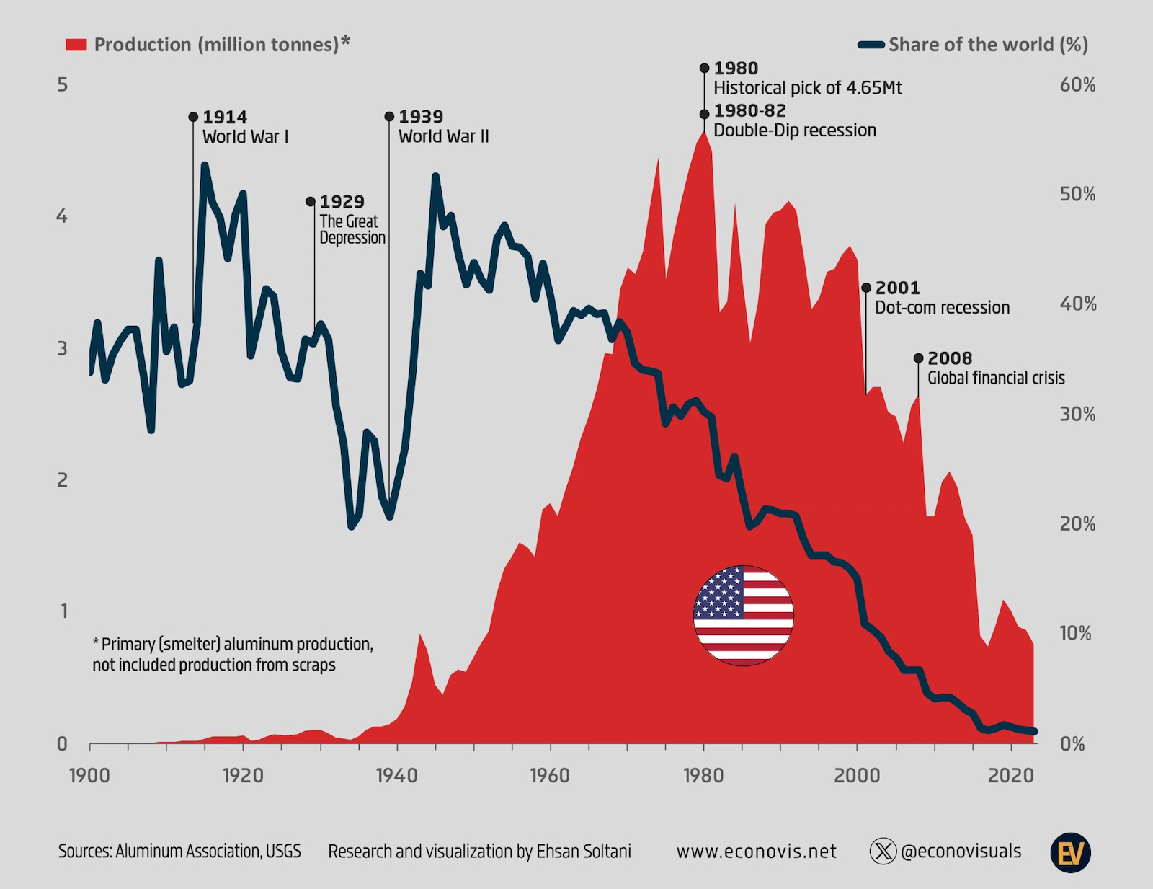

Slide 23
Primary Aluminum Prices USA = LME + Mid West Premium
Month | LME | MWP | TOTAL
Nov-24 | 117.20 | 21.30 | 138.50
Dec-24 | 115.20 | 22.40 | 137.60
Jan-25 | 116.80 | 24.00 | 140.80
Feb-25 | 120.40 | 36.10 | 156.50
Mar-25 | 120.60 | 39.00 | 159.60
Apr-25 | 108.00 | 38.80 | 146.80
May-25 | 109.90 | 38.60 | 148.50
Jun-25 | 114.30 | 57.40 | 171.70
Jul-25 | 118.20 | 67.80 | 186.00
Aug-25 | 117.70 | 71.20 | 188.90
Sep-25 | 120.40 | 74.00 | 194.40
Oct-25 | 126.40 | 81.50 | 207.90
Nov-25 | 128.10 | 87.50 | 215.60
Dec-25 | 130.50 | 89.40 | 219.90
Jan-26 | 142.80 | 99.20 | 242.00

Slide 24
Conclusions
Tariffs / duties have been used for 100 years plus and they are a tax, the importer pays
The seemingly random application of tariffs [ taxes ] today is “new”
Businesses cannot plan so production goes elsewhere
There will always be a need to protect sensitive industries that are critical to national security…….ie we need steel production in the USA
However long term tariffs enable domestic industry to hide behind tariff walls, best example is the USA Steel industry , there have been some sort of tariffs on steel entering the USA for 50 years……today HRC steel prices in the USA are double those in China……..failed policy that does not always encourage manufacturing in the USA

Slide 25
End of Week One
Questions ?
Next week we are going to go a little deeper in the four tariff eras in the United States, some of the parallels to today are interesting
Also more depth on 301 and 232 tariffs
What is a trade deficit…….something new ?? Are we getting ripped off ??

Slide 26
Current Events and Section 122 of the 1974 Trade Act
Supreme Court voted 6 -3 against the use of the IEEPA act to unilaterally impose tariffs
Existing Legislation , Section 301 and Section 232 offer the administration pathways to increase tariffs
We will examine 301 and 232 actions in more detail today
Section 122 may or may not offer the administration a pathway to tariffs that is not legally challengeable

Slide 27
Section 122 of the 1974 Trade act
The actual language of the Trade Act lists requirements that don’t exist today, including a “large and serious” balance-of-payments deficit, it does not say a trade deficit
In 1974 the main issue in balance of payments was currency risk, currencies then were set at fixed values so major change in currency values could be disastrous. Currencies today float so there is much less risk
The U.S. has run a trade deficit for decades, it’s been offset by capital inflows as foreign investors pour billions into financial markets, resulting in a net balance of zero.
“Section 122 of the 1974 Trade Act, on which Trump’s 10% now 15% tariff is based, does not apply in the current macro environment,” said Peter Berezin, chief global strategist at BCA Research,“A balance of payments deficit is not the same thing as a trade deficit. You cannot have a balance of payments [deficit] if you have a flexible exchange rate, as the US currently does.”
Undoubtedly invoking Section 122 will set off a legal challenge

Slide 28
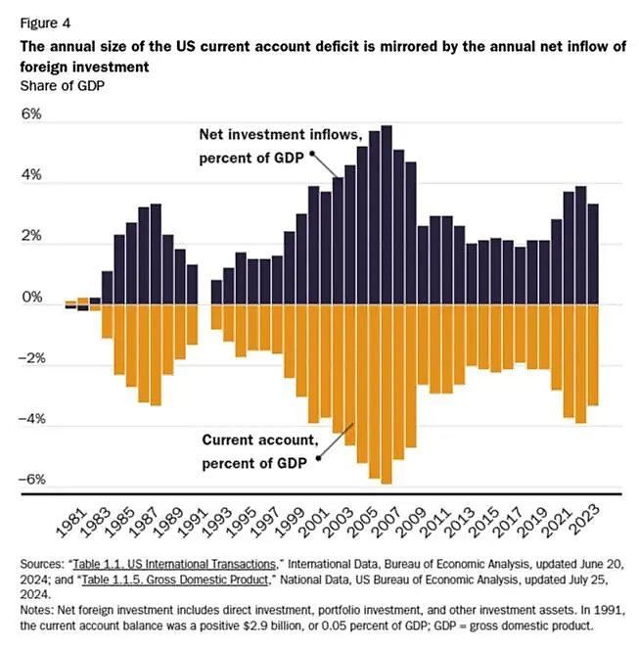
US Current account balance

Slide 29
Current December and full Year 2025 trade deficit
December 2025 Trade Details:
Total Trade Deficit: $70.3 billion, significantly exceeding estimates.
Imports: Increased by 3.6% to $357.6 billion, driven by a surge in goods, particularly industrial supplies, gold, and computer accessories.
Exports: Declined by 1.7% to $287.3 billion.
Goods & Services: The goods deficit widened to $99.3 billion, while the services surplus narrowed to $29.0 billion.
Key Takeaways:
Annual Data: The 2025 total deficit of $901.5 billion was only slightly lower (0.2%) than the $903.5 billion in 2024, despite aggressive new tariffs.
Regional Trends: The trade deficit remains heavily driven by imports, with significant deficits noted with the European Union, China, and Mexico.
Impact of Tariffs: The December surge was part of a volatile year, where importers rushed in goods ahead of, or in response to, shifting trade policy.

Slide 30
Tariff History in the United states
Historically Tariffs in the United States can be broken down into four distinct time periods
The Revenue Period (1790–1860)
The Protectionist/Restriction Period (1861–1933)
Trade Liberalization and Reciprocity (1934–2016)
Modern Era (2017–Present)

Slide 31
The Revenue Period 1790 -1860
.
Tariffs in this era accounted for 90% of the revenue collected by the Federal Government
The US was primarily an agrarian society
New manufacturing industries needed protection from dominant European manufacturers
Over time rates fluctuated but were adjusted to protect new processes

Slide 32
The Protectionist/Restriction Period (1861–1933)
To continue to protect manufacturing and agriculture after the devastation of the Civil War
The Republican party supported high tariffs, including the 1890 McKinley Tariff.
Smoot-Hawley Tariff Act of 1930: Raised tariffs to record levels, which many economists believe worsened the Great Depression.
Context: Rates were high to shield US companies from foreign competition, with average rates around 50% for several years

Slide 33
Smoot Hawley Tariff Act of 1930
In the history of tariffs in the US this legislation is tremendously important
The Smoot-Hawley Tariff Act of 1930 (officially the Tariff Act of 1930) was a U.S. protectionist law signed by President Herbert Hoover on June 17, 1930, which raised import duties on over 20,000 goods by roughly 40-60%. Designed to protect American farmers and industries from foreign competition, it backfired, triggering global retaliatory tariffs, causing international trade to plummet by over 60%, and exacerbating the Great Depression.
Interesting correlation to current events and tariffs………..
Smoot Hawley invited reciprocal tariffs and some economists think the tariffs extended the Great Depression

Slide 34
Trade Liberalization and Reciprocity (1934–2016)
In 1934 the country was still in the depths of the depression
Roosevelt ushered in a “New Deal” to help jump start the economy
Restrictive and reciprocal tariffs were beginning to be seen as detrimental to the economy
World War 2 saw the rise and dominance of US manufacturing prowess
After WW2 much of the world was in ruins and US manufacturing ruled
WTO [ world trade origination ] and GATT drove down tariffs to the benefit of the US

Slide 35
Modern Era (2017–Present)
A move back to using tariffs as a policy tool to address trade deficits and protect national industries, particularly against China.
The Trump administration imposed broad tariffs in 2018, which were largely maintained and extended by the Biden administration.
Increased protectionist measures, with annual tariff revenues rising to approximately $77 billion by 2025.

Slide 36
KEY Takeaways
Evolution: Moved from a major revenue source to a tool for industrial protection and geopolitical negotiation.
Economic Impact: While they can shield domestic jobs, they have historically caused retaliatory actions from other countries and rising domestic prices
Current Trends: The US is navigating a period that some consider a return to economic nationalism.

Slide 37


Section 301
Section 301 of the Trade Act of 1974 (19 U.S.C. §§2411-2420) empowers the Office of the United States Trade Representative (USTR) to investigate and take action, including tariffs or trade sanctions, against foreign countries violating trade agreements or engaging in unjustifiable/unreasonable practices that restrict U.S. commerce.
The act allows for unilateral action as well as investigation by the USTR, unilateral actions have been the norm

Slide 38
Section 301
Purpose: Authorized under the Trade Act of 1974, these tariffs are used to remedy foreign trade practices that violate U.S. commerce.
Impacted Goods: The tariffs, originally in four lists, cover industrial materials, technology, and consumer products. Recent updates in 2026 include increased rates on specific items like permanent magnets (25%) and rubber medical gloves (100%).
List 3 & Other Lists: List 3 (USTR.gov) covers roughly $200 billion in goods, including many consumer products, often facing 25% duties.
Exceptions and Relief: Some products may qualify for exclusions. Duty drawback ( programs may allow recovery of paid duties on goods later exported or destroyed.
Avoiding Tariffs: Strategies include sourcing from non-impacted countries, modifying products to change their HTS classification, and using Foreign Trade Zones (FTZs) to manage costs.
Biden administration left nearly all 301 tariffs in place from the first Trump administration

Slide 39
Section 232
Section 232 of the Trade Expansion Act of 1962 allows the U.S. President to impose tariffs or trade restrictions if the Department of Commerce determines imports threaten national security. As of 2026, these include 25% tariffs on steel and 10% on aluminum, recently expanded to include various derivatives, plus new 2026 tariffs on certain advanced semiconductors, timber, and lumber.
Differ from 301 tariffs which focus on unfair trade practices

Slide 40
Key aspects of 232 tariffs
Recent Expansion: In June 2025, 50% tariffs were implemented on specific steel and aluminum products. Effective Jan 1, 2026, tariffs on upholstered furniture, kitchen cabinets, and vanities increased, with some rates reaching up to 50%.
New Sectors: Beyond metals, Section 232 is being used to address security concerns in other sectors, including a 25% tariff on specific semiconductors initiated in January 2026.
Excluded Goods: The Bureau of Industry and Security (BIS) stopped accepting new exclusion requests for steel and aluminum tariffs on February 10, 2025.
Scope: These tariffs are often applied broadly, sometimes targeting imports from allies, and differ from Section 301 tariffs, which focus on unfair trade practices rather than national security.
The Trump administration has utilized this authority heavily, and the Biden administration maintained or modified many of these actions, with the scope continuing to expand into 202

Slide 41
What is a trade defict….is the UsA being “ripped off “
Broadly speaking a trade deficit is……….
A U.S. trade deficit occurs when the dollar value of goods and services the United States imports exceeds the value of those it exports to other nations. Representing a negative balance of trade, this sustained, long-term trend indicates the U.S. consumes more than it produces.
Can it be that simple…..yes and no !
Is a trade deficit harmful to an economy ?
Following chart shows that the US economy has had a persistent trade deficit since the 1970’s

Slide 42
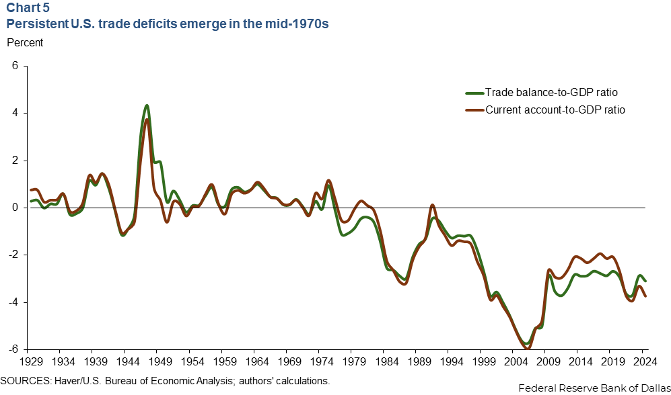
US Trade Surplus / Deficit since 1929

Slide 43
The Facts……….
For starters, there’s little obvious connection between the U.S. trade balance and economic output (gross domestic product). As shown on then next chart on the trade balance, the relationship between higher trade surpluses (or smaller deficits) and higher GDP growth is practically nonexistent. Economist Don Boudreaux and former Sen. Phil Gramm dug through additional periods in a recent Wall Street Journal column and concluded that “between 1890 and 2024, it is impossible to find a statistically significant correlation between America’s trade balance and its economic growth.”

Slide 44
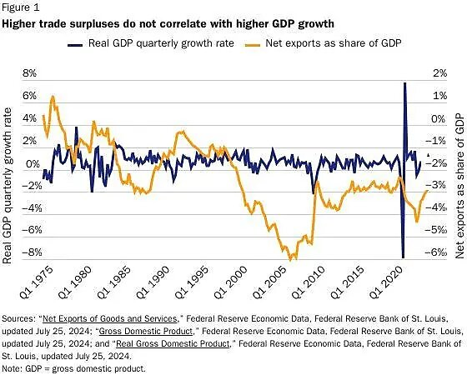
Trade Surplus / deficit effect on GDP

Slide 45
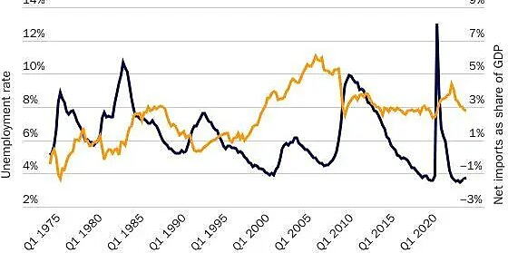
Does unemployment rise with higher trade deficits ? Weak correlation

Slide 46
Economy and the Balance of Payments
“balance of payments” data, which records all international transactions involving the United States: the “current account” measures trade and income flows between the United States and the rest of the world (and is mostly the trade balance we see reported in the news) and is mirrored by the “capital account,” which covers foreign investment and other financial transactions. In each case, a current account deficit/​surplus will always be accompanied by a net inflow/​outflow of foreign investment capital in approximately the same amount.

Slide 47
Consumer Debt and the Trade Deficit “are we being ripped off”
Consumer debt worsens the trade deficit by enabling households to spend more on foreign goods and services than they produce, essentially financing a higher volume of imports. When debt fuels consumer demand, it increases the outflow of dollars to foreign nations, leading to a persistent imbalance where imports exceed exports.
Key Connections:
Higher Purchasing Power: Debt allows consumers to buy more imports (e.g., cars, electronics) than their income allows, boosting imports.
Low Savings Rate: High consumer debt often correlates with low savings, meaning the economy relies on foreign capital inflows to fund spending, which pairs with a trade deficit.
Currency Value: The inflow of foreign money, used to buy debt, strengthens the domestic currency, making foreign goods cheaper and domestic exports more expensive, widening the gap.
Reduced Future Spending: As income goes toward repaying debt, less is spent on domestic products, weakening local growth while the debt-financed imports have already contributed to a higher deficit.

Slide 48
Currency value “the wild card”
The USD is the predominate world currency , 60% plus of the worlds financial transactions are in USD
A strong dollar makes US exports more expensive
A weak dollar makes US exports less expensive
Manipulation of currencies is one lever that many governments use to address trade

Slide 49
“wild Card”
Tariffs & Dollar: Theoretically, tariffs strengthen the dollar because they reduce the need for foreign currency to pay for imports. However, this appreciation can be muted if the tariffs cause significant economic damage or lead to a "risk-off" environment where investors shy away from U.S. assets.
Tariffs & Interest Rates: Tariffs can create a conflict for the Fed. They may boost inflation (arguing for higher rates) but also risk slowing economic growth (arguing for lower rates).
Combined Effect: If tariffs are implemented alongside high-interest rates, the dollar tends to strengthen significantly. Conversely, if tariffs lead to global economic fear, investors might flock to the dollar, even if the Fed stops raising rates.

Slide 50
USD vs other Currencies
USD down 11.5% in the last year to the Euro
3.84 % down to the Canadian dollar
4.75% down to the Chinese RMB
5.54 % down to the Japanese Yen
Currency changes are worth watching, “do we want a weak dollar “ May have a larger effect on the economy than tariffs

Slide 51
Trade Deficits good or Bad ?
A nation’s trade balance isn’t a cause of bad or good things in an economy (and thus a “bad” or “good” thing to be fixed/​encouraged), but instead an indicator of the macroeconomic factors affecting residents’ spending and saving decisions and thus the nation’s overall level of savings and investment/​consumption. These factors include government policies (e.g., taxes or entitlements that encourage immediate consumption over savings, policies that improve a nation’s attractiveness to global investment, etc.) and overall government indebtedness (spending more than it takes in )

Slide 52
Good or bad…continued
Trade deficits in the US have been around for most of recent history in economically good times and bad times
No correlation with good or bad GDP growth
Weak correlation with employment and or unemployment
No effect on “current account”
There are essential industries that are critical to national security and the ability of a country to defend and feed itself but are tariffs the solution ?

Slide 53
What do the Facts show about a trade deficit
The discussion doesn’t end at good or bad and instead trade balances are trotted out to justify all sorts of protectionist trade policy—including today’s tariffs—on the grounds that persistent deficits are a disease killing both American jobs and growth and thus demanding strong government medicine. This common assertion, however, fails on the facts and the economics.

Slide 54
End of week 2 and what’s Next ?
Lots of detail on trade acts and trade deficits
Questions are good !
Next week we will look at the large international trade agreements keying on the US / Mexico and Canada agreements
Lots of personal experience !!

