Slide 1
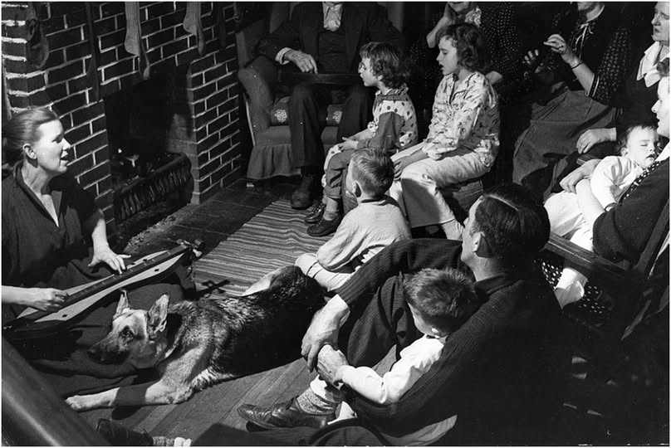
Funny Folk Songs in Traditional Music
Songs for Children
Songs of Love and Marriage
Bawdy Ballads
Topical Songs in the Tradition
Funny Contemporary Songwriters
From Emma Bell Miles, The Spirit of the Mountains, 1905:
The Music, while usually minor, is not of a plaintive tendency. There are few laments, no sobbing and wailing…It is reflective, meditative; the tunes chuckle, nor merrily, but in amused contemplation.
https://www.facebook.com/groups/38510854398/posts/10163534129384399/

Slide 2
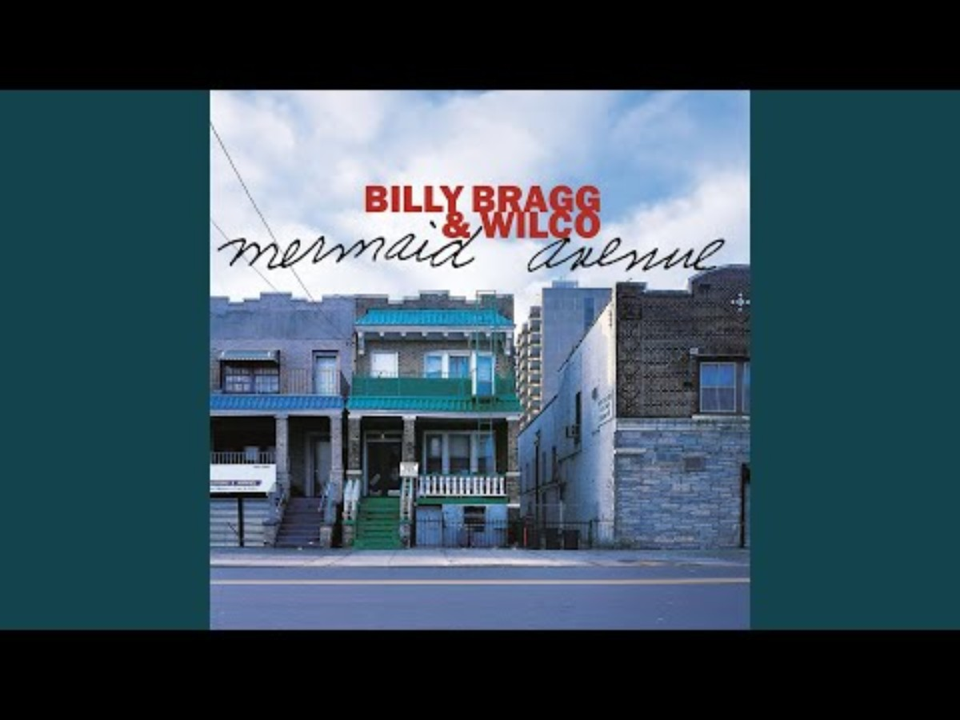
Way Over Yonder in the Minor Key
Woody Guthrie/Billy Bragg 2006
I lived in a place called Okfuskee
And I had a little girl in a holler tree
I said, "Little girl, it's plain to see
Ain't nobody that could sing like me
Ain't nobody that could sing like me"
She said, "It's hard for me to see
How one little boy got so ugly"
Yes, my little girly, that might be
But there ain't nobody that could sing like me
Ain't nobody that could sing like me
Chorus: Way over yonder in the minor key
Way over yonder in the minor key
There ain't nobody that could sing like me
We walked down by the Buckeye Creek
To see the frog eat the goggle-eye bee
To hear that west wind whistle to the east
There ain't nobody that could sing like me
Ain't nobody that could sing like me
Oh, my little girly, will you let me see?
Way over yonder where the wind blows free
Nobody can see in our holler tree
And there ain't nobody that could sing like me
Ain't nobody that could sing like me
Chorus
Her mama cut a switch from a cherry tree
And laid it on to she and me
It stung lots worse than a hive of bees
But there ain't nobody that could sing like me
Ain't nobody that could sing like me
Now I've walked a long, long ways
I still look back to my Tanglewood days
I've led lots of girls since then to stray
Saying ain't nobody that could sing like me
Ain't nobody that could sing like me
Chorus

Slide 3
Three Blind Mice
1609: Original version published by Thomas Ravenscroft, collected in London.
Three Blinde Mice, Three Blind Mice, Dame Iulian, Dame Iulian, the Miller and his merry old Wife, she scrapte her tripe licke thou the knife.
Thought, perhaps, to have reference the execution of three Protestant bishops by the Catholic Queen Mary I (Bloody Mary).
1842: Popularized in J.O. Hartwell’s The Nursery Rhymes of England .
Three blind mice. Three blind mice.
See how they run. See how they run.
They all ran after the farmer’s wife,
Who cut off their tails with a carving knife,
Did you ever see such a sight in your life,
As three blind mice?

Slide 4
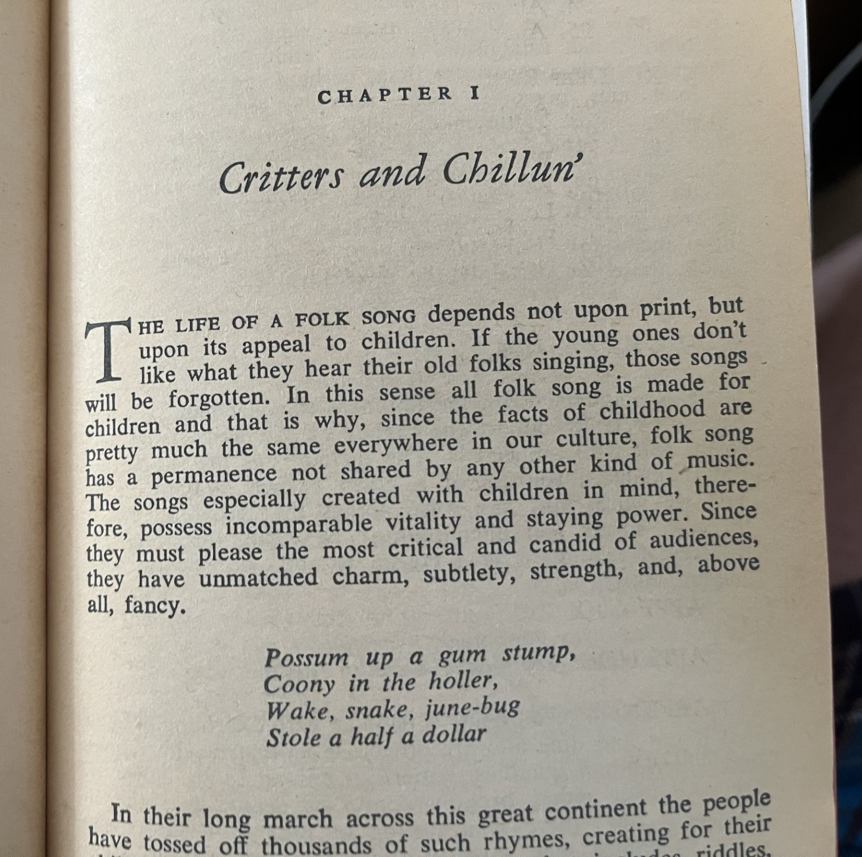
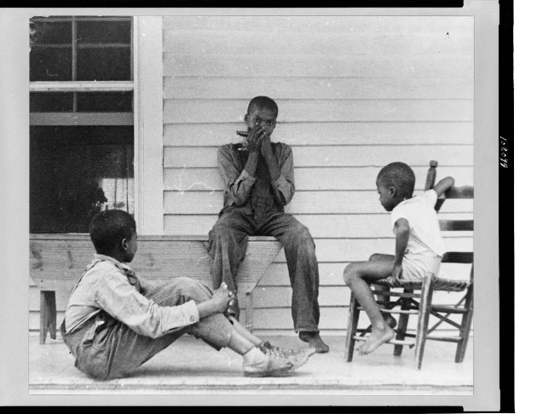
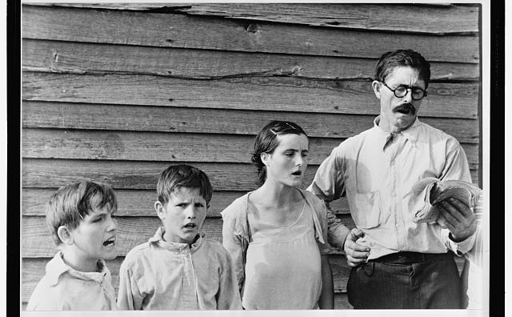
Songs for Children
Arthur Rothstein 1935 North Carolina
https://www.loc.gov/resource/cph.3c08099/
Walker Evans 1936 Alabama
From: John Lomax, Folk Songs USA
https://commons.wikimedia.org/wiki/File:Frank_Tengle,_an_Alabama_sharecropper,_and_family_singing_hymns.jpg

Slide 5
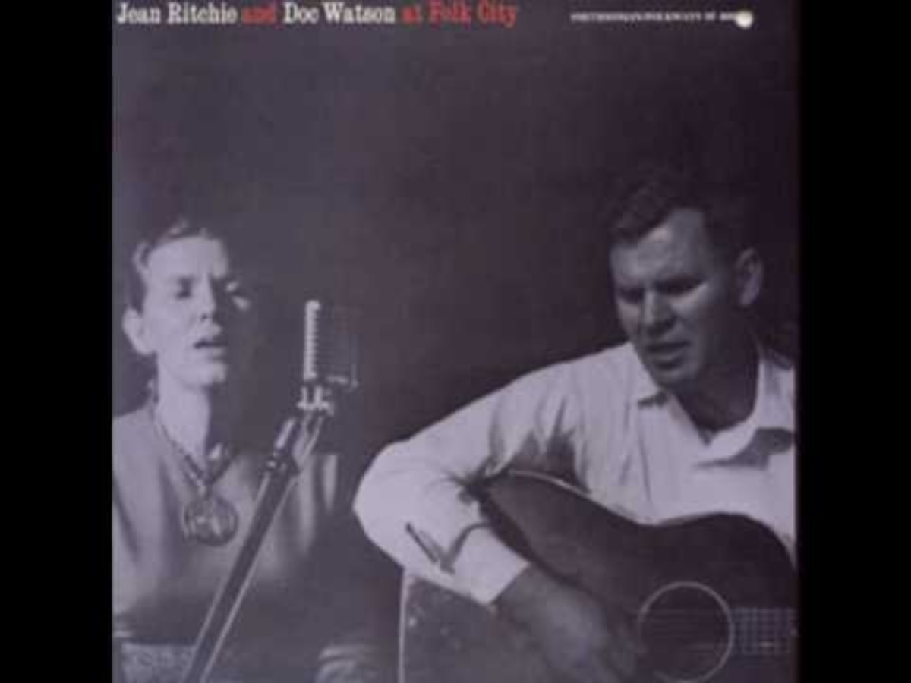
Jean Ritchie: The Singing Family of the Cumberlands
Dad and the girls and boys would come in hot and dusty from the fields around 4 o’clock, and we’d all head for the cool willow-hung river that ran around the foot of the mountain in front of our house. Mom and one or two of the girls would get supper and we’d eat, and then I’d begin the work of getting everybody out on the porch. I remember I would always be so afraid that the family would decide not to sing tonight…

Slide 6
What’ll I Do With the Baby-O
The wind blows high, the wind blows low
The wind blows sugar in my coffee-o
What’ll I do with the baby-o
What’ll I do with the baby-o
Wrap him up in calico
Give him to his daddy-o
That’s what I’ll do with the baby-o
That’s what I’ll do with the baby-o
Wrap him up in the table cloth
Throw him up in the ol’ hay loft
That’s what I’ll do with the baby-o
That’s what I’ll do with the baby-o
Hang him up in the ol’ tree top
When the wind blows the cradle will rock
That’s what I’ll do with the baby-o
That’s what I’ll do with the baby-o
How in the world do the old folks know
I like sugar in my coffee-o
What’ll I do with the baby-o?
What’ll I do with the baby-o?
What'll I do with the baby-o?
What'll I do with the baby-o?
What'll I do with the baby-o?
If she won't go to sleepy-o?
Wrap her up in calico
Wrap her up in calico
Wrap her up in calico
Send her to her Mommy-o.
Wrap her up in a tablecloth
Wrap her up in a tablecloth
Wrap her up in a tablecloth
Throw her up in a fodder-loft.
Tell your daddy when he gets home,
Tell your daddy when he gets home,
Tell your daddy when he gets home,
I'll give Old Blue your chicken bone.
Pull her toes and tickle her chin
Pull her toes and tickle her chin
Pull her toes and tickle her chin
Throw her in the county bin.
Dance her north and dance her south,
Dance her north and dance her south,
Dance her north and dance her south,
Pour a little moonshine in her mouth.
Every time the baby cries,
Stick my finger in the baby's eye!
That's what we'll do with the baby-o
That's what we'll do with the baby-o!

Slide 7
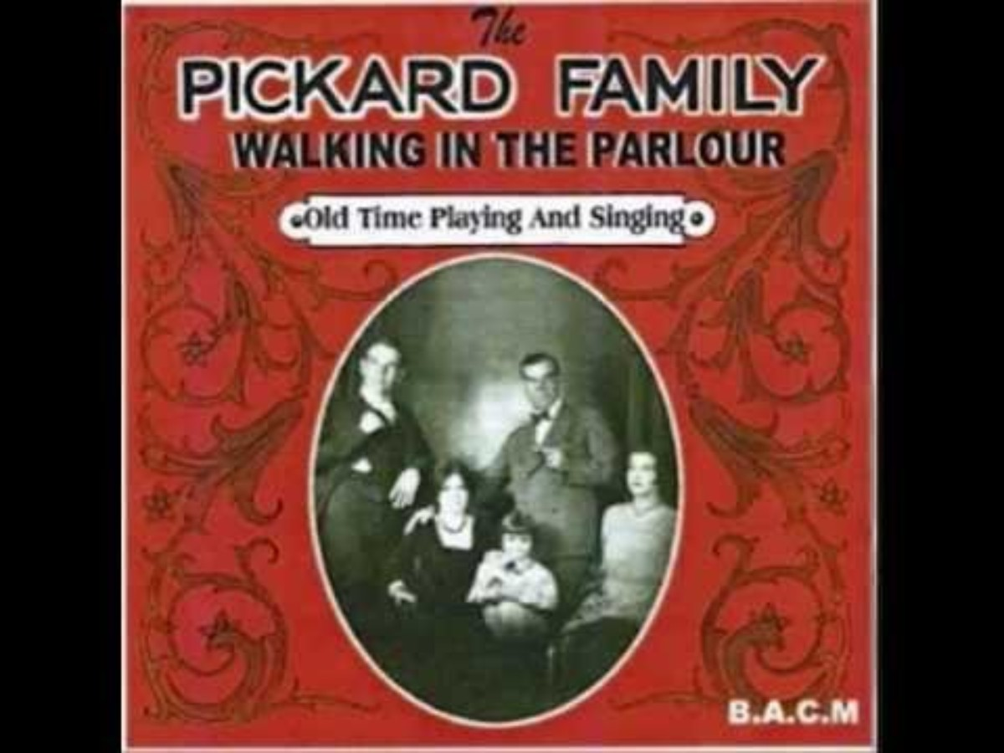
Go Tell Aunt Rhody/The Old Grey Goose
Go tell Aunt Rhodie,
Go tell Aunt Rhodie,
Go tell Aunt Rhodie
Her old gray goose is dead.
The one that she’s been saving,
The one that she’s been saving,
The one that she’s been saving
To make her a featherbed.
She died last Friday,
She died last Friday,
She died last Friday
Behind the old barn shed.
She left nine little goslins,
She left nine little goslins,
She left nine little goslins,
To scratch for their own bread.
1930

Slide 8
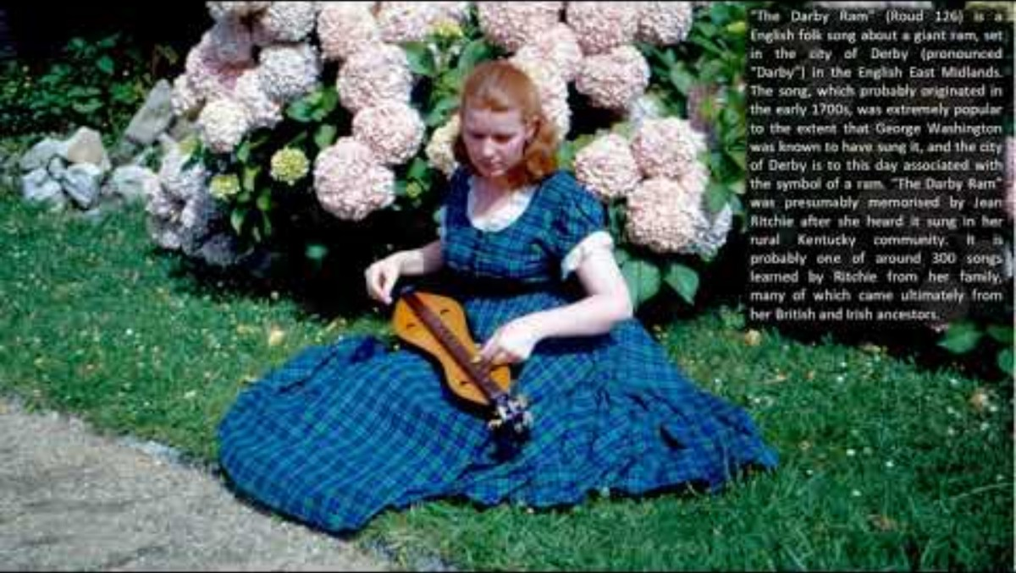
The Darby Ram
From Ritchie, The Singing Family of the Cumberlands:
‘The Darby Ram’ was Grandmother Hall’s lullaby song my mom would tell me, and that she could hear Grandmother singing it more than any other…[My mother] sang this song then with its bright memory to all her many babies, and the love and the remembering in her voice made it a very special song for all of us.

Slide 9
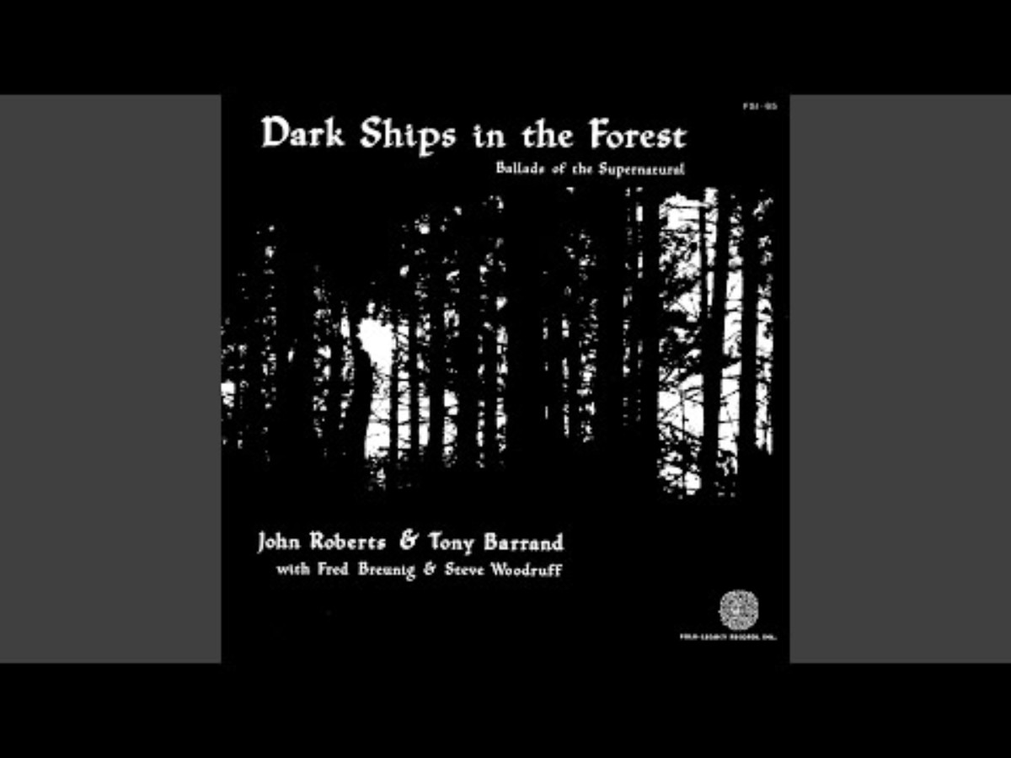
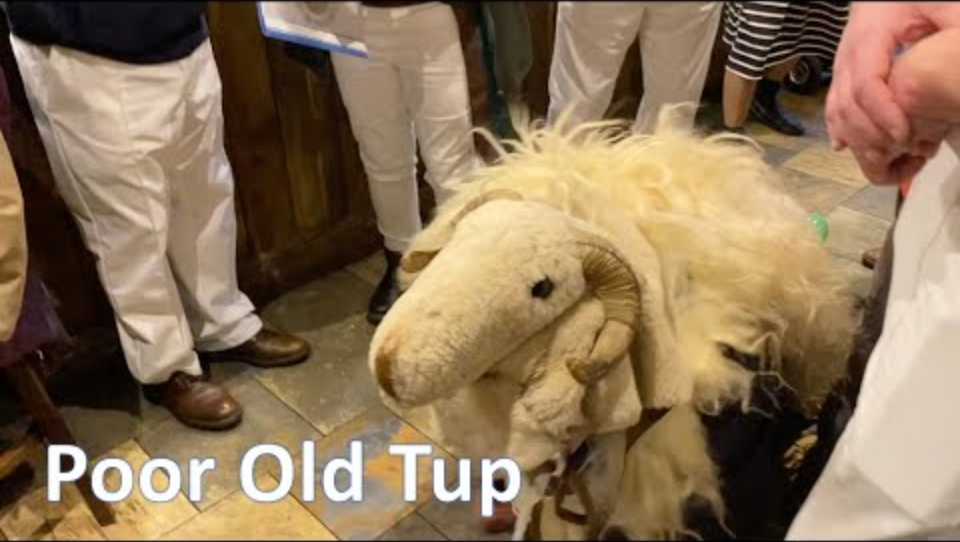
The Derby Ram
As I went out to Derby, upon a market day,
I spied the biggest ram, sir, that ever was fed on hay.
Chorus (after each verse):
Hey ringle dangle, hey ringle day,
It was the biggest ram, sir, that ever was fed on hay.
The horns upon this ram, sir, they reached up to the moon,
A lad went up in April and didn’t get down till June.
The fleece upon this ram, sir, it reached up to the sky,
The eagles made their nests there, you could hear the young ’uns cry.
And all the boys of Derby came begging for his eyes,
To kick around the streets, sir, ’cause they was football size.
And all the women of Derby come begging for his ears,
To make ’em leather aprons to last ’em forty years.
And all the men of Derby come begging for his tail,
To ring St. George’s passing bell from top of Derby jail.
It took all the boys of Derby to carry away his bones,
Took all the maids of Derby to roll away his stones.
Now, the butcher that killed this ram, sir, was up to his thighs in blood,
The boy that held the basin was washed away in the flood.
[And the man that wrote this song, sir, he must be mighty rich,
The one that sings it now, sir, is a lying son of a bitch.]
And now my song is over, I’ve got no more to say,
Just give us eggs and brandy, and we’ll be on our way.
1790: First print edition
Sung by mummers’ processions at mid-winter in southeast England. The featured performer was Old Tup, a man dressed in a sheep’s costume with ram’s horns.
In America, it evolved into a country blues, Didn’t He Ramble, performed by Jelly Roll Morton, Charlie Poole and others.

Slide 10
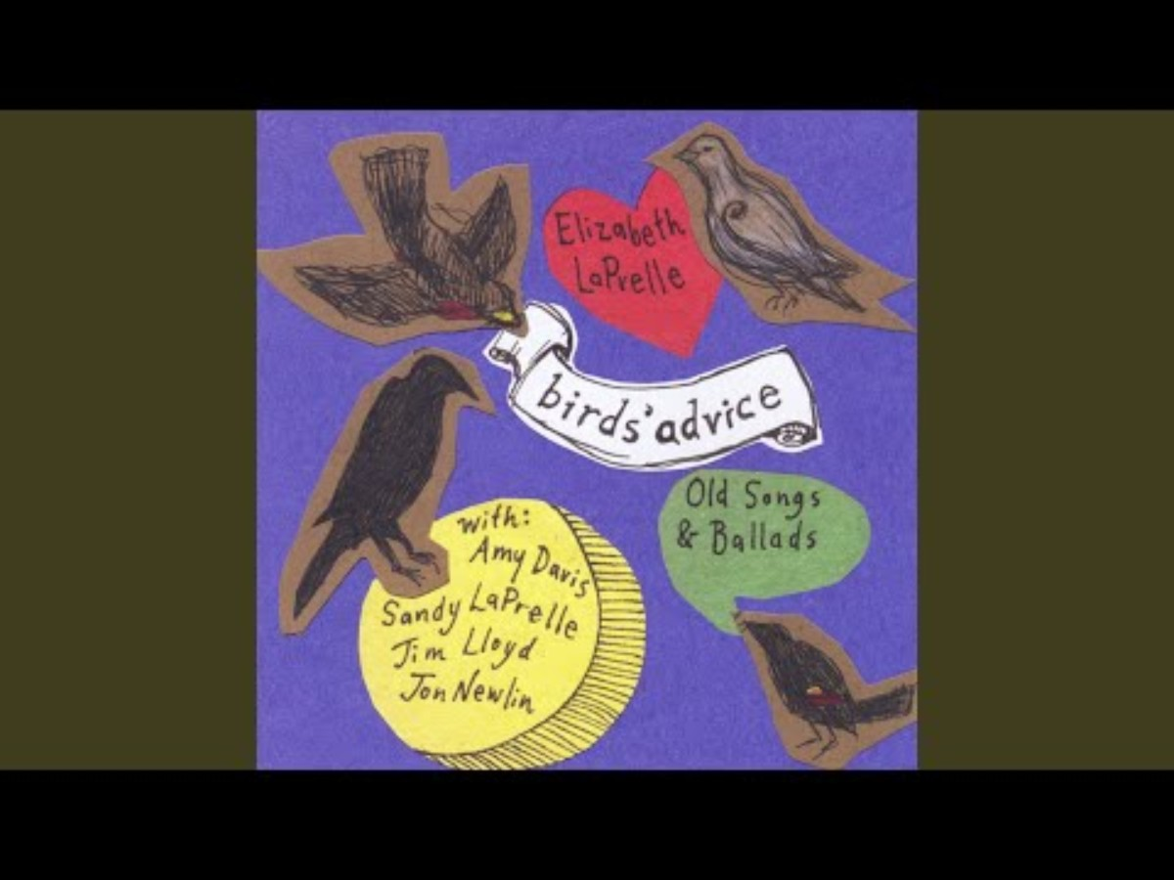
The Ground Hog from the African American Tradition
Old Joe Digger, Sam, and Dave, (3x)
They went a-hog-huntin' hard as they could stave,
Ground hog!
Whistle up yer dog and loaden up yer gun,
Away to the hills to have some fun.
Too many rocks and too many logs,
Too many rocks to ketch groun'hogs.
They picked up their guns and went to the brash
By damn! Joe, here's the hog sign fraish.
One took a tree and it's one took a log,
Damn my soul if it ain't a groun'hog!
Git away, Sam, and le' me load my gun,
The groun'hog hunt has jist begun.
He's in here, boys, the hole's wore slick;
Run here, Sam, with yer forked stick!
Git down, Sam, and in there peep,
Fer I think I see him sound asleep.
Stand back, boys, and le's be wise,
Fer I think I see his beaded eyes.
Hold them dogs, boys, don't let' em howl,
I thought I heerd the groun'hog growl.
Hello, Johnnie, cut a long pole,
To roust this groun'hog out of his hole.
Up jumped Sam with a ten-foot pole,
He roused it in that groun'hog's hole.
Work, boys, work jist as hard as ye can tear,
The meat'll do to eat and the hide'll do to wear.
Work, boys, work for all you earn,
Skin'im atter dark and tan'im in a churn.
Stand back, boys, le' me git my breath,
Ketchin'this groun'hog's might' nigh death.
I heerd' im give a whistle and a wail,
I've wound my stick right in his tail.
Stand back, boys and gi' me a little air
I've got a little o' the groun'hog's hair
Here he comes right in a whirl,
He's the biggest groun'hog in this worl'
Sam cocked his gun and Dave pulled the trigger,
But the one killed the hog was old Joe Digger.
They took'im by the tail and wagged' im to a log,
And swore by gosh! he's a hell of a hog!
Up stepped Sal with a snigger and a grin:
Whatcha goin' to do with the groun'hog skin?"
Scrapes' im down to his head and feet,
By damn, Sam, I here's a fine pile o' meat!
Carried him to the house and skinned 'im out to bile,
I bet forty dollar you could smell' im fifty mile.
They put' im in the pot and all begin to smile,
They eat that hog before he struck a bile.
Run here, man, hit's bilin'-hot,
Sam and Dave's both eatin' outn the pot.
Old Uncle Jack says, "I'll be damn!
If I can't git a foreleg I'll take a ham."
The children screamed and the children cried,
They love groun'hog cooked and fried.
Hello, mama; make Sam quit,
He's eatin'all the hog, I can't git a bit.
Hello, boys, ain't it a sin,
Watch that gravy run down Sam's chin!
Hello, mama, look at Sam,
He's eat all the hog 'n a-soppin'out the pan!
Watch' im, boys, he's about to fall,
He's eat till his pants won't button at all.
Hello, boys, what ye think o' that?
Sam's eat hog till he's right slick fat.
He eat that grease till it run to his nabel
He'll eat no more hog until he's able.

Slide 11
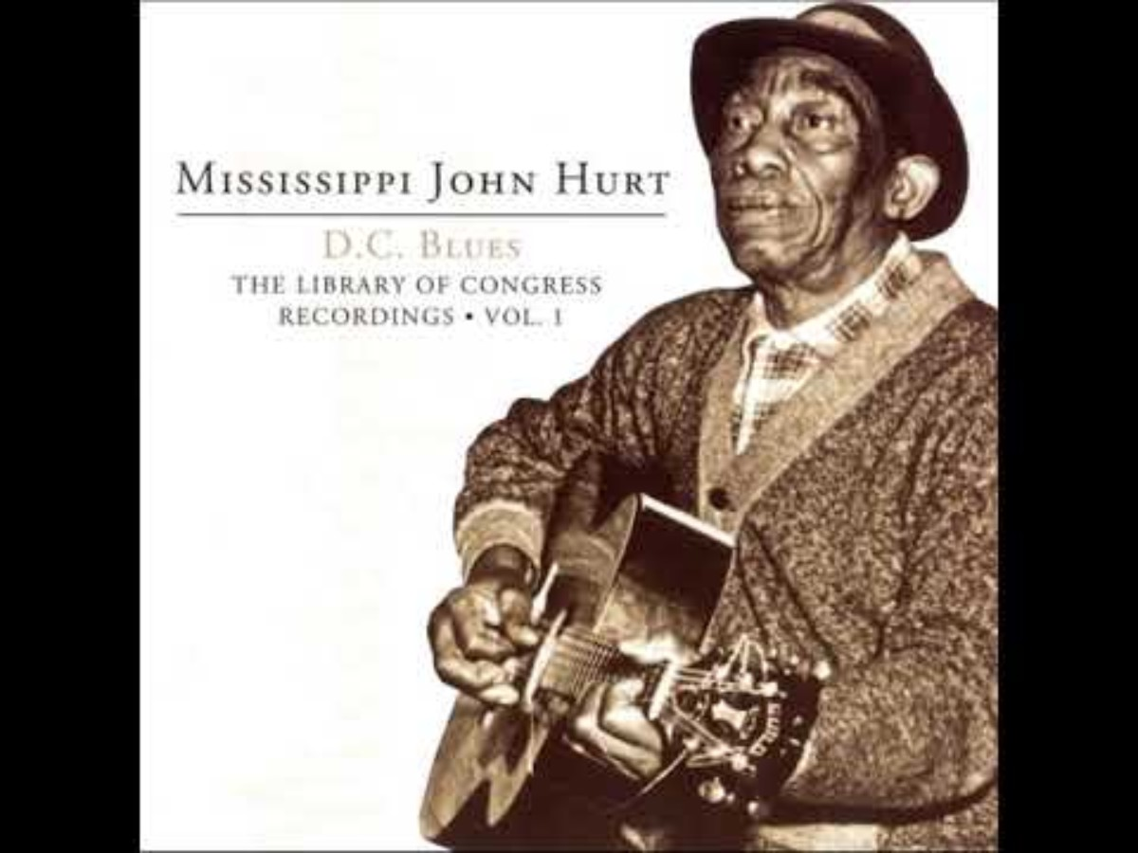
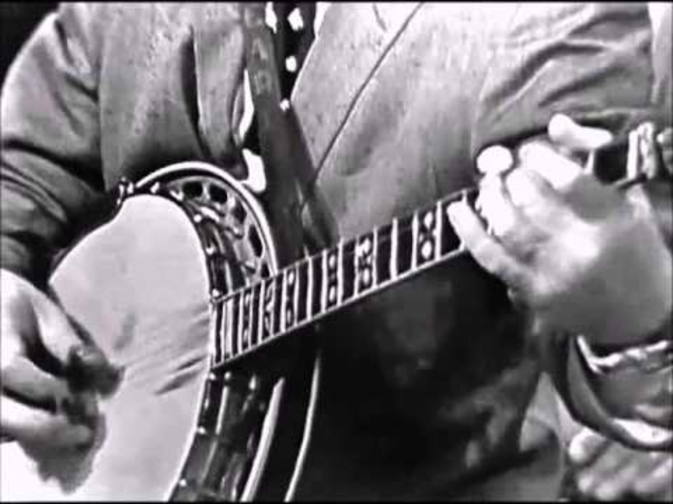
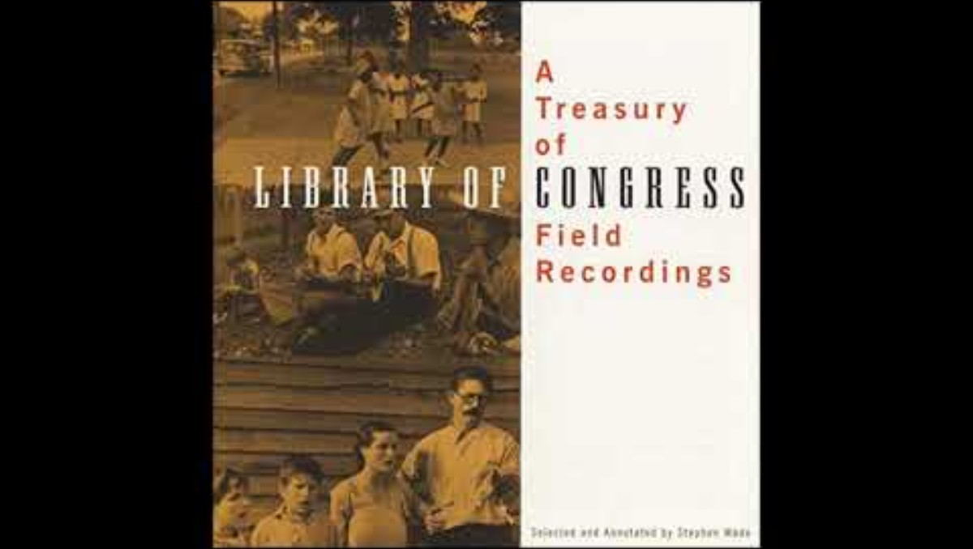
Shortnin’ Bread
Put on the skillet, slip on the lid,
Mammy's gonna make a little shortnin' bread,
That aint all she's gonna do,
Mammy's gonna make a little coffee too.
Mamas little baby loves shortnin', shortnin,
Mamas little baby loves shortnin' bread.
Mamas little baby loves shortnin', shortnin,
Mamas little baby loves shortnin' bread.
Three little children lying in bed,
Two were sick and the other almost dead.
Sent for the doctor and the doctor said,
“Give those children some shortnin' bread”.
Mamas little baby loves shortnin', shortnin,
Mamas little baby loves shortnin' bread.
Mamas little baby loves shortnin', shortnin,
Mamas little baby loves shortnin' bread.
When those children sick in bed,
Heard the talk about shortnin' bread,
Popped up well to dance and sing,
Skipped around and cut the pigeon wing.
Mamas little baby loves shortnin', shortnin,
Mamas little baby loves shortnin' bread.
Mamas little baby loves shortnin', shortnin,
Mamas little baby loves shortnin' bread.
He slipped to the kitchen, he slipped up the lead,
Filled his pockets full of shortnin' bread,
He stole the skillet, he stole the lead,
He stole the girl making shortnin' bread.
Mamas little baby loves shortnin', shortnin,
Mamas little baby loves shortnin' bread.
Mamas little baby loves shortnin', shortnin,
Mamas little baby loves shortnin' bread.
Caught him with the skillet, caught him with the lead,
Caught him with the girl making shortnin' bread.
Paid six dollars for the skillet, six dollars for the lead,
Spend six months in jail eating shortnin' bread.
Mamas little baby loves shortnin', shortnin,
Mamas little baby loves shortnin' bread.
Mamas little baby loves shortnin', shortnin,
Mamas little baby loves shortnin' bread.

Slide 12
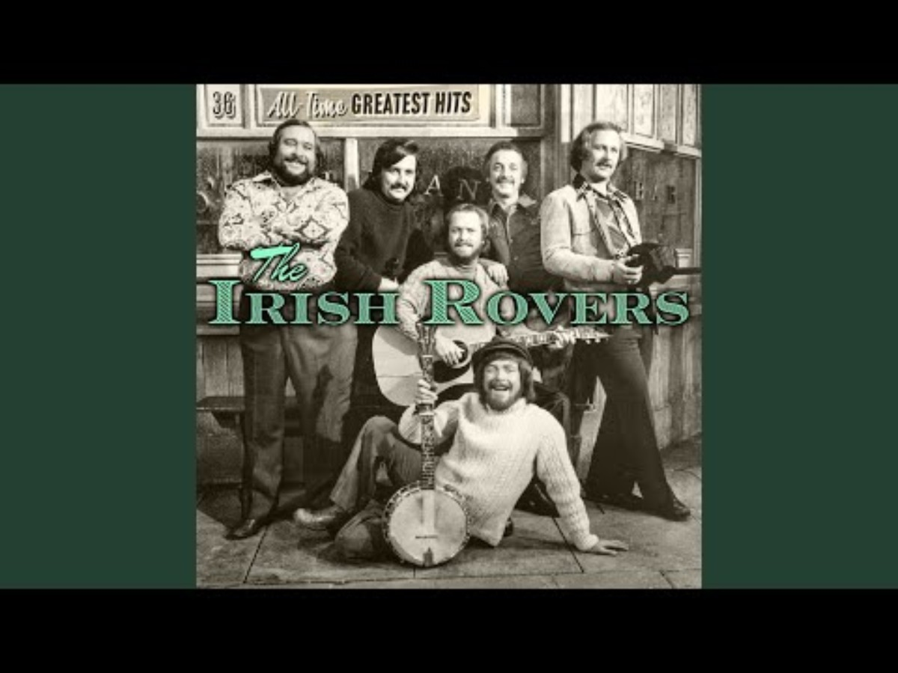
The Rattlin’ Bog

Slide 13


