Slide 1
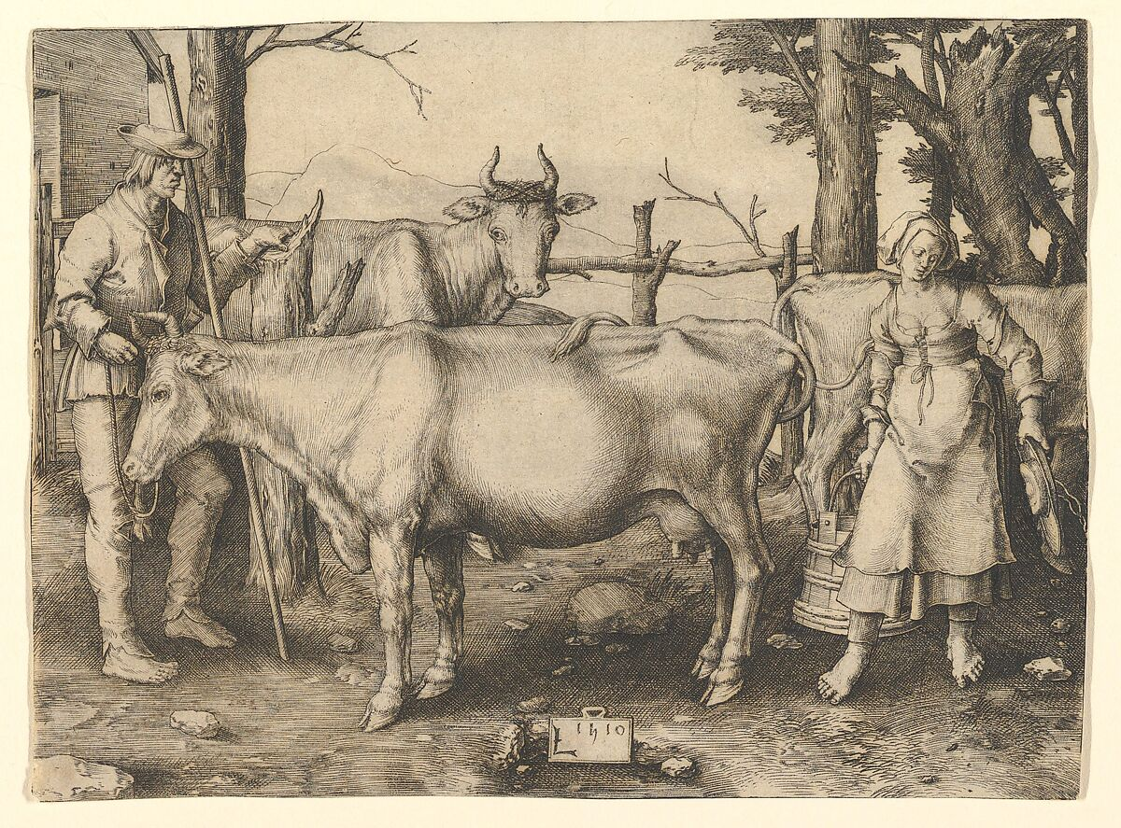
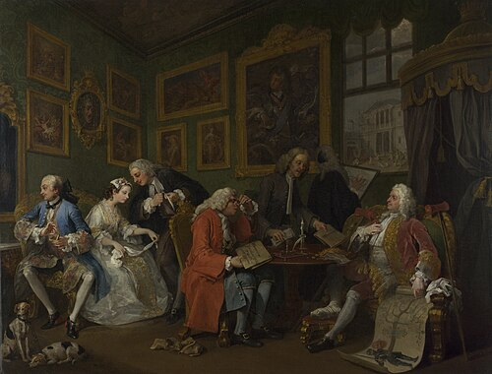
Songs of Love and Marriage
Lucas van Leyden 1510: The Milkmaid
William Hogarth 1743: The Marriage Settlement
https://www.nationalgallery.org.uk/paintings/william-hogarth-marriage-a-la-mode-1-the-marriage-settlement
https://www.metmuseum.org/art/collection/search/364745

Slide 2
Jennie Jenkins
Jenny Jenkins
Will you wear white, oh my dear, oh my dear?
Oh will you wear white, Jennie Jenkins?
I won't wear white,
For the color's too bright.
Chorus: I'll buy me a fol-de-roldy-tildy-toddy
seek-a-double, use-a-cause-a-roll-the-find-me
Roll, Jennie Jenkins, roll.
Will you wear blue, oh my dear, oh my dear?
Oh, will you wear blue, Jennie Jenkins?
I won't wear blue,
The color's too true.
Chorus
Will you wear red, oh my dear, oh my dear?
Oh will you wear red, Jennie Jenkins?
I won't wear red,
It's the color of my head.
Chrous
Will you wear black, oh my dear, oh my dear?
Oh will you wear black, Jennie Jenkins?
I won't wear black,
It's the color of my back.
Chorus
Will you wear purple, oh my dear, oh my dear?
Oh will you wear purple, Jennie Jenkins?
I won't wear purple,
It's the color of a turkle.
Chorus
Will you wear green, oh my dear, oh my dear?
Oh will you wear green, Jennie Jenkins?
I won't wear green,
For it's a shame to be seen.
Chorus
.
Will you wear yellow, oh my dear, oh my dear?
Oh will you wear yellow, Jennie Jenkins?
I won't wear yellow,
For the color's too shallow.
Chorus
Will you wear gold, oh my dear, oh my dear?
Oh will you wear gold, Jennie Jenkins?
I won't wear gold,
I'm not that old!
Chorus I'll buy me a fol-de-roldy-tildy-toddy
seek-a-double, use-a-cause-a-roll-the-find-me
Roll, Jennie Jenkins, roll.
What will you wear, oh my dear, oh my dear?
What will you wear, Jennie Jenkins?
I've nothing to wear,
So I'll just go bare.
I'll buy me a fol-de-roldy-tildy-toddy
seek-a-double, use-a-cause-a-roll-the-find-me
Roll, Jennie Jenkins, roll.

Slide 3
Histories of Love, Sex and Marriage
The long 18th century (1688-1815) frames our histories for Britain and America.
Pre-Industrial vs Industrial; Rural vs Urban; Religious vs Secular.
In England and Wales (but not Scotland), the Clandestine Marriage Act of 1753: required the posting of banns, a marriage license, and a formal ceremony with witnesses before an Anglican parish minister. Repealed in 1853, when civil marriage was introduced.
Historians debate the forces that shaped courtship, sexuality and marriage: economic necessity; patriarchal authority (consent and coercion); desire and sexual health.
Their sources include: marriage and birth registries; laws on marriage and inheritance; municipal laws on prostitution and public spaces; sermons and religious tracts; advice manuals; autobiographies; literature and fine art.
The effort to understand intimate histories of private lives focuses on birth rates, age of first marriage and illegitimacy.

Slide 4
An Old Man Came Courting Me (pre-1750)
Well an old man came courting me, hi-doo-a-darrity,
An old man came courting me, me being young
An old man came a-courting me, fain would he marry me
Maids when you’re young never wed an old man
Chorus (repeated after each verse):
For he’s got no falorum, faliddle-aye-orum
Got no falorum, faliddle-aye-ay
Got no falorum, and he’s lost his dingdorum
So maids when you’re young, never wed an old man
When that we went to church, hi-doo-a-darrity,
When we went to church, me being young
When that we went to church, he left me in the lurch
Maids when you’re young, never wed an old man
When that we went to tea, hi-doo-a-darrity,
When we went to tea, me being young
When that we went to tea, he started teasing me
Maids when you’re young never wed an old man
When that we went to bed, hi-doo-a-darrity,
When we went to bed, me being young
When that we went to bed, he neither done nor said
Maids when you’re young never wed an old man
When that he went to sleep, hi-doo-a-darrity,
When he went to sleep, me being young
When that he went to sleep, out of bed I did creep
Into the arms of a jolly young man
And I found his falorum, faliddle-aye-orum
I found his falorum, faliddle-aye-ay
I found his falorum and he’s got my dingdorum
So maids when you’re young never wed an old man
An old man came courting me, hi-doo-a-darrity,
An old man came courting me, me being young
An old man came a-courting me, fain would he marry me
Maids when you’re young never wed an old man
Eliza Carthy version

Slide 5
The Ploughboy (early 19th century)
’Twas of a brisk young ploughboy, come listen to this refrain
And join with me in chorus and sing the ploughboy’s praise.
My song is of the ploughboy’s praise and unto you I’ll relate the same,
He whistles and sings and drives his plough, the brave ploughboy.
So early in the morning the ploughboy he is seen
All hastening to the stable his horses for to clean.
Their manes and tails he does comb straight, with chaff and corn he will them bate
And he’ll endeavour to plough straight, the brave ploughboy.
When he goes out in the morning to harrow plough or sow
And with a gentle cast, my boys, he’ll give his corn a throw.
All this I’ll have you understand is just to fill the reaper’s hand,
Likewise I’ll have you understand, it comes from the ploughboy.
Now seedtime being over the fields look fresh and gay
There’s merry lads to mow the grass while damsels make the hay.
The small birds sing on every tree, the cuckoo joins sweet harmony,
All welcome here as you may see, the brave ploughboy.
Then haying being over and harvest does draw near,
Our Master he does welcome us with plenty of beef and beer.
We all sit round to drink our beer while Peace and Plenty fill the year
And we’ll be happy while we are here and drink to the ploughboy.
Now harvest being over we start the plough once more,
Our Master has invited us unlocks his cellar door.
With cake and ale we have our fill because we’ve done our work so well
And there’s no one can despise the skill of the brave ploughboy.

Slide 6
Blackbirds and Thrushes/Hares on the Mountain
If maidens could sing like blackbirds and thrushes, (×2)
How many young men’d go and hide in the bushes?
Chorus (after each verse):
Sing fal-de-ral, fal-de-ral, fal-de-ral day.
If maidens were to run like hares on the common, (×2)
How many young men’d take horse and ride hunting?
If maidens were to swim like fish in the water, (×2)
How many young men’d undress and dive after?
If maidens were to lie like sheep on the mountain, (×2)
How many young men’d go and lay down beside them?
But maidens they’re like the dew on the corn, (×2)
When a young man awakes they’re gone in the morn.
If maidens were to dance like rushes a-growing, (×2)
How many young men’d take scythes and go mowing?

Slide 7
Old Joe Clark: Square Dancing and Courtin’
Now I've got no money
Got no place to stay
I've got no place to lay my head
And the chickens a crowin' for day
Chorus:
Fare you well, old Joe Clark,
Fare you well I say
Fare you well, old Joe Clark,
I'm goin' away to stay.
I wish I had a nickel
I wish I had a dime
I wish I had a pretty little girl
To kiss her and call her mine.
I don't like that old Joe Clark
I'll tell you the reason why.
Ha goes about the country
A stealin' good men's wives.
I went down to old Joe Clark's
I did not mean no harm
He grabbed his old forty four
And shot me thru the arm.
Old Joe Clark's a mean old dog
I'll tell you the reason why
He tore down my old rail fence
So his cattle could eat my rye.
I went down to old Joe Clark's
I found old Joe in bed
I stuck my finger in old Joe's eye
And killed old Joe stone dead.
I wouldn't marry that old maid
I'll tell you the reason why
Her neck's so long and-stringy
I'm afraid she'll never die.
I went down to Dinah's house
She was standin' in the door
With her shoes and stocking in her hand
And her feet all over the floor.
Yonder sits a turtle dove
Sitting on yonder pine
You may weep for your true love
And I shall weep for mine.
Old Joe Clark's a mighty man
What will it take to please him
A good old bottle of apple jack
And Betty Brown to squeeze him.

Slide 8
Cindy: More Dancing and Courtin’
You ought to see my Cindy
She lives away down south
She's so sweet that honeybees
Swarm about her mouth.
cho: Get along home, Cindy Cindy
Get along home.
Get along home, Cindy Cindy
I'll marry you some day. (I'm a-gonna leave you now)
Cindy in the summertime
Cindy in the fall
If I can't have Cindy all the time
Have no one at all.
Cindy is a pretty girl
Cindy is a peach;
Threw her arms around my neck
Hung on like a leach.
Cindy got religion,
Tell you what she done:
Walked up to the minister
Chawed her chewin' gum.
Cindy got religion,
She had it once before
When she heered my old banjo
She's the first one on the floor.
Cindy got religion
She really went to town;
Got so full of glory, Lord,
Shook her stockin's down.
If I had a pretty gal
I'd put her on a shelf;
Ev'ry time she smiled at me,
I'd jump right up myself.
Cindy had one blue eye
She also had one brown
One eye looked in the country
The other one looked in town
Wish I was an apple
Hangin on a tree
An' every time my Cindy passed
She'd take a bite o' me
Wish I had a needle and thread
Wish that I could sew
I'd sew that gal to my coat tails
And down the road we'd go
alt chorus:
Git along home, Cindy
Git along home to stay
Git along home, Cindy
One more night 'n' day
alt cho: It's kiss me, gal
Kiss me once again.
Oh, it's kiss me, gal
All night long.

Slide 9
The Farmer’s Curst Wife/The Devil and the Farmer’s Wife
There was an old farmer lived under a hill,
Oh Daddy be gay
There was an old farmer lived under a hill,
If he ain’t moved away then he’s living there still.
Daddy be gay and eat candy
One day the old devil he come to his plough,
He says, “One of your family I have to have now.”
The old man cries out, “Then surely I’m done
For the devil has come for my eldest son.”
“It’s not your son or your daughter I crave,
But your old scolding wife that I must take away.”
“Then take her off with all of my heart
And I hope from hell she never will part.”
So the devil he hoisted her up on his back,
And like an old pedlar went packing his sack.
He set her down at the forks of the road,
And he says, “Old woman, you’re a hell of a load.”
He carried her off to the gates of hell,
He says, “Stoke up the coals, we’ll roast her well.”
Two little devils come rattling their chains,
She off with her slipper and out with their brains.
One little devil peeped over the wall
Says, “Take her back daddy, she’ll murder us all.”
The old man was peeking out of the crack,
When he seen the old devil a-wagging her back.
The old woman went whistling over the hill
“If the devil won’t have me I wonder who will!”
This proves that the women are better than men,
They can go down to hell and come straight back again.

Slide 10
Our Goodman/Four (Seven) Nights Drunk (pre-1760)
Now as I come home so drunk I couldn’t see, oh
There I saw a horse, no horse should be there
I says unto me wife, tell this to me, oh
How come the horse there, no horse should be there
You old fool, you silly fool, can’t you plainly see, oh
Nothing but a milk cow me mother sent to me, oh
Miles I have travelled a thousand miles and more, oh
Saddle on a milk cow I’ve never seen before
And as I come home so drunk I couldn’t see, oh
There I saw boots, no boots should be there
I says unto me wife, tell this to me, oh
How come the boots there, no boots should be there
You old fool, you silly fool, can’t you plainly see, oh
Nothing but a flower pot me mother sent to me, oh
Miles I have travelled a thousand miles and more, oh
Laces on a flower pot I’ve never seen before
And as I come home so drunk I couldn’t see, oh
There I saw a hat, no hat should be there
I says unto me wife, tell this to me, oh
How come the hat there, no hat should be there
You old fool, you silly fool, can’t you plainly see, oh
Nothing but a chamber pot me mother sent to me, oh
Miles I have travelled a thousand miles and more, oh
Sweat-band on a chamber pot I’ve never seen before
And as I come home so drunk I couldn’t see, oh
There I saw a man, no man should be there
I says unto me wife, tell this to me, oh
How come the man there, no man should be there
You old fool, you silly fool, can’t you plainly see, oh
Nothing but a baby me mother sent to me, oh
Miles I have travelled a thousand miles and more, oh
Whiskers on a baby I’ve never seen before
Steeleye Span version

