Slide 1
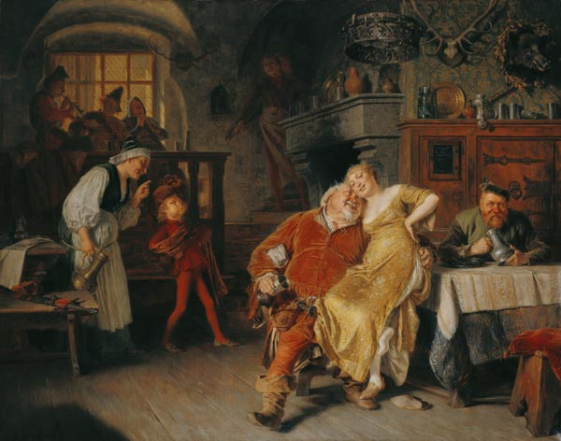
Funny Folk Songs in Traditional Music
Bawdy Songs
Wit and Mirth: Or Pills to Purge Melancholy (1698-1720). Songs written and collected by Thomas d’Urfey and published by Henry Playford.
The Merry Muses of Caledonia (1799). Songs collected and edited by Robert Burns.
Ozark Folksongs and Folklore (the unpublished volume (1990). Collected by Vance Randolph (1915-1955).
The Jelly Roll Morton Collection at the Library of Congress. Recorded by Alan Lomax in 1938.
Roll Your Leg Over: Bawdy Songs and Backroom Ballans, 1955-1958. Oscar Brand
Falstaff in the Tavern, Eduard Grǖtzner
https://www.art-prints-on-demand.com/a/gruetzner-eduard/falstaff-in-the-tavern-to.html

Slide 2
Why explore bawdy song traditions?
In Vance Randolph’s collection of Ozark folksongs and verses, 510 of 2,300 texts were “unprintable” about 22% of the total. In other words, bawdy songs and off-color poetry were inescapable elements of mountain popular culture. And that’s what most song-catchers since the 16th century have found.
Folklorists and historians are always looking for ways to understand the daily lives of people, especially ordinary people, and so these materials are intrinsically interesting. The fact that they have often been sung by women—by mothers (even grandmothers) and wives as well as by men-- has only added to their value.
Scholars do recognize the risk that the songs can reinforce stereotypes, especially misogynistic and racist stereotypes. And might also normalize behaviors, like sexual assault, that deserve condemnation.
Which is to say that not all of them are funny. When taken out of the social contexts in which they were performed, some just seem gratuitously vulgar. Or just plain mean-spirited.
Collections of these songs reflect the sensibilities of singers, collectors and publishers. And the sensibilities of the market—of readers and law-makers. And so their publication histories tell us something about social and political change in larger contexts,

Slide 3
Lavenders Green Dilly-Dilly
Lavender’s blue, diddle diddle
Lavender’s green,
When I am king, diddle diddle
You shall be queen.
Lavender’s green, diddle diddle
Lavender’s blue,
You must love me, diddle diddle
‘Cause I love you.
Down in the vale, diddle diddle
Where flowers grow,
And the birds sing, diddle diddle
All in a row.
A brisk young man, diddle diddle
Met with a maid,
And laid her down, diddle diddle
Under the shade.
There they did play, diddle diddle
And kiss and court.
All the fine day, diddle diddle
Making good sport.
I’ve heard them say, diddle diddle
Since I came hither
That you and I, diddle diddle
Might lie together.
Therefore be kind, diddle diddle
While here we lie,
And you will love, diddle diddle
My dog and I.
For you and I, diddle diddle
Now all are one,
And we will lie, diddle diddle
No more alone.
Lavender’s blue, diddle diddle
Lavender’s green,
Let me be king, diddle diddle
You be the queen.
Lavender’s green, diddle diddle
Lavender’s blue,
You must love me, diddle diddle
‘Cause I love you.

Slide 4
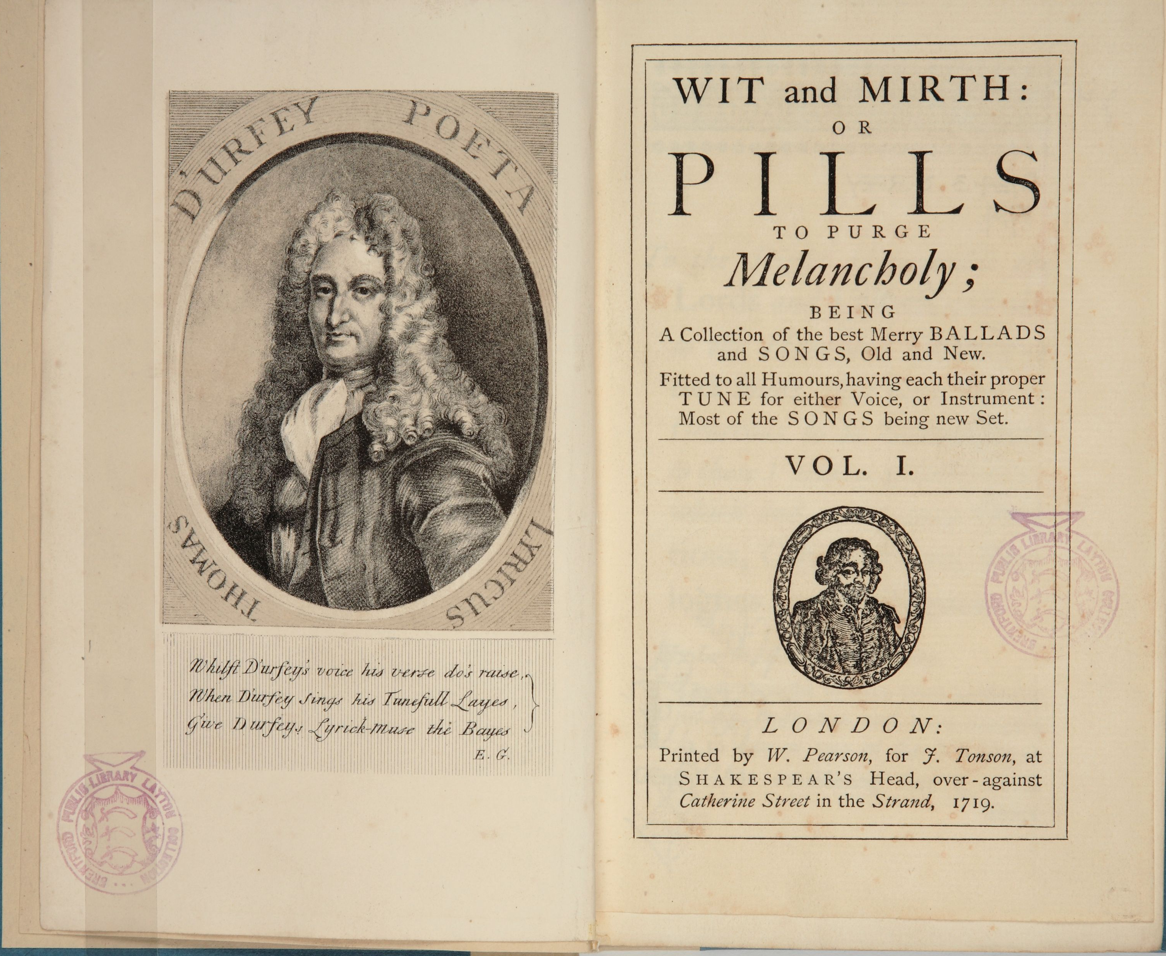
Wit and Mirth: Pills to Purge Melancholy
Come, sing me a bawdy song—make merry! Falstaff from Shakespeare’s Henry IV: Part I. 1597.
1698-1719, the playwright, Thomas d’Urfey, published, in six volumes, some 1000 songs and verses.
The 1719 editions included music notations of many songs that were later collected by Frances Childs and others.
A verse from The Traveling Tinker and the Country Ale-Wife reads:
A Comely Dame of Islington had got a leaky Copper
The Hole that let the Liquor run was wanting for a stopper
A Jolly Tinker undertook, and promised her most fairly
With a thump, thump, thump and knick knack knock
To do her Business rarely
https://thomaslayton.org.uk/wp-content/uploads/2018/05/2774-Durfey-Wit-Mirth-IMG_7896.jpg

Slide 5
The Lusty Young Smith
A lusty-young smith at his vice stood a-filing
His hammer laid by but his forge still a-glow
When to him a buxom young damsel came smiling
And asked if to work at her forge he would go.
With a jingle dang jingle dang, jingle dang jingle
With a jingle dang jingle dang jingle hi ho.
"I will" said the smith and they parted together
Along to the young damsel's forge they did go
They stripped to go to't, twas hot work and hot weather
She kindled a fire and soon made him blow
With a jingle dang jingle dang, jingle dang jingle
With a jingle dang jingle dang jingle hi ho.
Her husband she said no good work could afford her
His strength and his tool were worn out long ago
The smith said "Well mine are in very good order
And now I am ready my skill for to show"
With a jingle dang jingle dang, jingle dang jingle
With a jingle dang jingle dang jingle hi ho.
Red-hot grew his iron as both did desire
And he was too wise not to strike while twas so
Quoth she "What I get I get out of the fire
So prithee strike home and redouble the blow"
With a jingle dang jingle dang, jingle dang jingle
With a jingle dang jingle dang jingle hi ho.
Six times did his iron by vigorous heating
Grow soft in the forge in a minute or so
And though it was hardened at her fair entreating
The more it was softened it hardened more slow.
With a jingle dang jingle dang, jingle dang jingle
With a jingle dang jingle dang jingle hi ho.
The smith then would go: quoth the dame full of sorrow
"Oh what would I give could my husband do so!
Good lad with your hammer come hither tomorrow
But say, can't you use it once worn ere you go?"
With a jingle dang jingle dang, jingle dang jingle
With a jingle dang jingle dang jingle hi ho.

Slide 6
The Fair Maid of Islington
There was a fair maid of Islington as I have heard man tell
And she was a-going to London town her apples and pears to sell.
As she was a-going along the road a vintner did her spy.
“And what shall I give you, me lad, a night with you to lie?”
“If you would lie with me a night you must give to me five pounds.”
“A match, a match,” the vintner said, “and so let this go round.”
But when he’d lain with her all night her money she did crave,
“Oh no, oh no,” the vintner said, “the devil a penny you’ll have!”
This maid she made no more ado but to the justice went.
“This vintner’s hired a cellar of me and he will not pay the rent.”
And straight the justice for him sent and asked the reason why
That he would give this maid no rent to which he did reply:
“Although I hired a cellar of her and the possession was mine
I never put anything into it but one small pipe of wine.”
This fair maid being ripe of wit she straight replied again,
“There lay two oxes at the door why didn’t you roll them in?”
The justice laughed and told the vintner if he a tenant be
He must expect to pay the purse; he couldn’t sit rent free.
And when this maid her money got she put it in her purse
And clapped her hands on the cellar door and said it was none the worse.

Slide 7
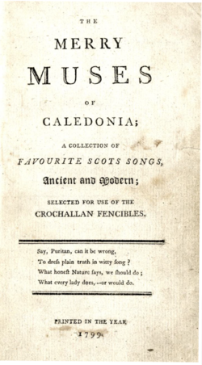
The Merry Muses of Caledonia
Robert Burns 1799
Published after Burns’ death, and in the first editions, without attribution.
For Burns scholars, the collection is supplemented by Burns’ correspondence.
A mix of traditional songs and verses composed by Burns himself.
One verse, The Fornicator, relates a true story, Burns’ reprimand in church for having impregnated Elizabeth Paton, a servant girl.
Look for records by Ewan MacColl and especially Jean Redpath that feature songs from the collection.
https://en.wikipedia.org/wiki/The_Merry_Muses_of_Caledonia

Slide 8
The Fornicator
Ye jovial boys who love the joys.
The blissful joys of Lovers;
Yet dare avow with dauntless brow,
When th' bony lass discovers;
Pray draw near and lend an ear,
And welcome in a Prater,
For I've lately been on quarantine,
A proven Fornicator.
Before the Congregation wide
I pass'd the muster fairly,
My handsome Betsey by my side,
We gat our ditty rarely;
But my downcast eye by chance did spy
What made my lips to water,
Those limbs so clean where I, between,
Commenc'd a Fornicator.
With rueful face and signs of grace
I pay'd the buttock-hire,
The night was dark and thro' the park
I could not but convoy her;
A parting kiss, what could I less,
My vows began to scatter,
My Betsey fell-lal de dal lal lal,
I am a Fornicator.
But for her sake this vow I make,
And solemnly I swear it,
That while I own a single crown,
She's welcome for to share it;
And my roguish boy his Mother's joy,
And the darling of his Pater,
For him I boast my pains and cost,
Although a Fornicator.
Ye wenching blades whose hireling jades
Have tipt you off blue-boram,
I tell ye plain, I do disdain
To rank you in the Quorum;
But a bony lass upon the grass
To teach her esse Mater,
And no reward but for regard,
O that's a Fornicator.
Your warlike Kings and Heros bold,
Great Captains and Commanders;
Your mighty Cesars fam'd of old,
And Conquering Alexanders;
fields they fought and laurels bought
And bulwarks strong did batter,
But still they grac'd our noble list
And ranked Fornicator!!!

Slide 9
The Ploughman
Then up wi't a', my ploughman lad,
And hey, my merry ploughman!
Of a' the trades that I do ken,
Commend me to the ploughman!
1.
The ploughman, he's a bonie lad,
His mind is ever true, jo!
His garters knit below his knee,
His bonnet it is blue, jo.
2.
I hae been east, I hae been west,
I hae been at St. Johnston;
The boniest sight that e'er I saw
Was the ploughman laddie dancin.
3.
Snaw-white stockings on his legs
And siller buckles glancin,
A guid blue bonnet on his head,
And O, but he was handsome!
4.
Commend me to the barn-yard
And the corn mou, man!
I never get my coggie fou
Till I met wi' the ploughman.
As I Came Over Cairney Mount
As I came o’er the Cairney mount,
And down amang the blooming heather,
The Highland laddie drew his dirk
And sheath’d it in my wanton leather.
Chorus (after each verse):
O my bonnie, bonnie Highland lad,
My handsome, charming Highland laddie;
When I am sick and like to die,
He’ll row me in his Highland plaidie.
With me he play’d his warlike pranks,
And on me boldly did adventure,
He did attack me on both flanks,
And pushed me fiercely in the centre.
A furious battle then began,
Wi’ equal courage and desire,
Altho’ he struck me three to one,
I stood my ground and receiv’d his fire.
But our ammunition being spent
And we quite out o’ breath an’ sweating,
We did agree with ae consent
To fight it out at the next meeting.

Slide 10
As I Came Over Cairney Mount
As I came o’er the Cairney mount,
And down amang the blooming heather,
The Highland laddie drew his dirk
And sheath’d it in my wanton leather.
Chorus (after each verse):
O my bonnie, bonnie Highland lad,
My handsome, charming Highland laddie;
When I am sick and like to die,
He’ll row me in his Highland plaidie.
With me he play’d his warlike pranks,
And on me boldly did adventure,
He did attack me on both flanks,
And pushed me fiercely in the centre.
A furious battle then began,
Wi’ equal courage and desire,
Altho’ he struck me three to one,
I stood my ground and receiv’d his fire.
But our ammunition being spent
And we quite out o’ breath an’ sweating,
We did agree with ae consent
To fight it out at the next meeting.

Slide 11
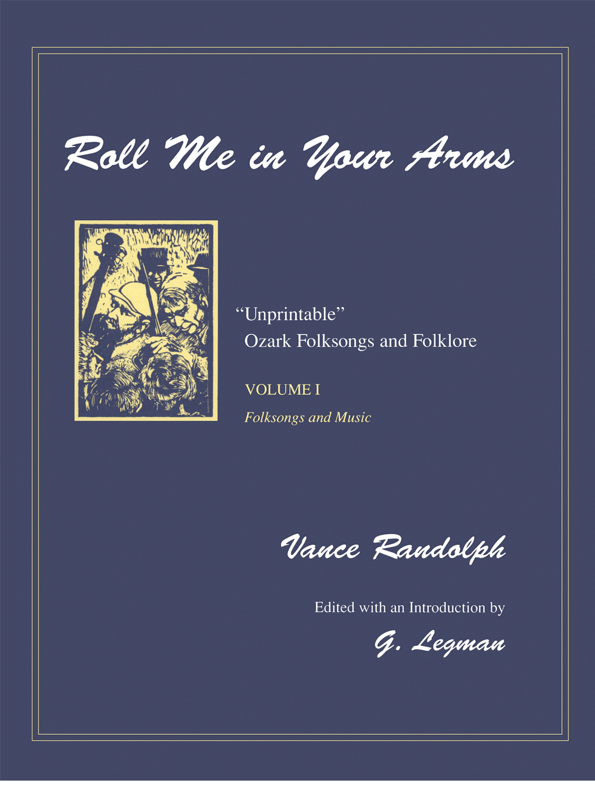
Vance Randolph and “Unprintable” Songs in the Ozark Tradition
A writer and folklorist who began to write on Ozark folklore in the 1920s.
The two-volume “unprintable songs” volumes were not published until 1990. Even as late as 1982, they had been cut from a manuscript Randolph submitted, Ozark Folksongs.
The collection includes verses of bawdy ballads that were in Pills to Purge Melancholy and also collected by Frances Childs in England and Cecil Sharpe and Maud Karpeles in Appalachia.
https://wordpressua.uark.edu/uapress-25/files/2016/02/randolph-rmiya.png

Slide 12
The Little Ball of Yarn
Mrs. Mary Ann Hayes version
Now, was in the month of May
When the boys were making hay,
I rolled around my old grandfather’s farm.
When I saw a dainty miss
And I asked her for a kiss.
Sure I didn’t intend to do her any harm.
Now I said, “My turtle-dove,
You’re the only girl I love.
Now, I’ll help to wind your little ball of yarn.”
O we took a steady walk
All behind some lonesome bush,
And there I had my true-love in my arms.
I heard the blackbird tell the thrush,
He said, “You are my turtle-dove.
Now, I have to twine your little ball of yarn.”
O six long months did pass
And the three it come at last,
She had a dainty babe all in her arms.
“O,” I said, “my little miss.
I did not expect this,
As I rolled you round my grandfather’s farm.”
“Now,” I say, “young girls of mine,
If you can work down on a farm,
Never trust a farmer as far as you can see.
O look at the damage he have done to me,
Now I’m cuddling up his little ball of

Slide 13
Blow the Candle Out
When I was apprenticed in London, I went to see my dear
The candles they were burning, the moon shone bright and clear
I knocked upon her window to ease her of her pain
She rose, she let me in, then she barred the door again
I like your well behaviour, and thus I often say
I won't rest contented, love, while you are far away
The roads they're so muddy we cannot gang about
Come roll me in your arms, love, and blow the candles out
My mother and my father in yonder room do lie
Hugging one another, so why not you and I?
A-hugging one another without no fear nor doubt
Come roll me in your arms, love, and blow the candles out
And if we prove successful, love, pray name it after me
Keep it neat and kiss it sweet and dap it on your knee
When my three years are ended, my time it will be out
I will double my indebted, love, by blowing the candles out

Slide 14
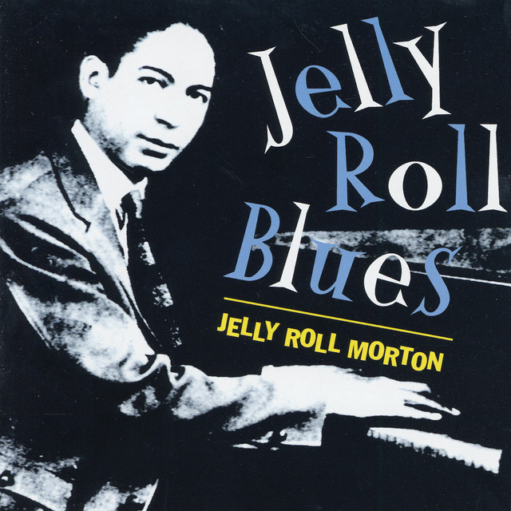
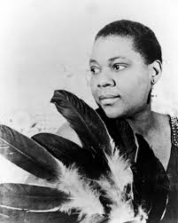
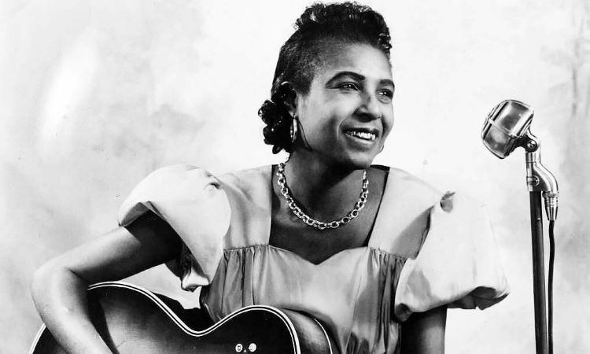
Dirty Blues: Juke Joints and Afterhours Clubs in the Jazz Age
In 1938, Alan Lomax recorded Jelly Roll Morton for the Library of Congress, 128 songs plus interviews.
The “dirty blues” were omitted from releases of the released recordings until 2005.
Subject of a new book by Elijah Wald, Jelly Roll Blues: Censored Songs and Hidden Histories.
Wald’s account highlights race relations under Jim Crow, the place of juke joints and afterhours clubs in the history jazz and blues.
https://i.scdn.co/image/ab67616d0000b2732ed1a9f2295e80f1080b7dba
https://aaregistry.org/story/bessie-smith-blues-empress/
https://folkalley.com/black-history-month-spotlight-on-memphis-minnie-2/

Slide 15
Hesitation Blues
Jelly Roll Morton version
If I was whiskey 'n' you was a duck,
I'd dive to the bottom and I'd never come up.
Oh, hooow long do I haaave to wait?
Can I get it nooow, do I have to hesitaaate?
If I had a woman, she was taaall,
She made me think about my parasoool. [Note:]
Oh, hooow long do I haaave to wait?
Can I get it nooow, do I have toooo hesitaaate?
'N old lady by the name of Jaaane,
I hit her, knocked her right off her caane.
Ooooh, how long do I have to waaaait?
Can IIII get it now, do I have to hesiiiitate?
Mama, mamaaa, look at sis,
She's out on th' levee doing the double twist.
Lord, how long do I haaave to wait?
Can IIII get you now, do I have to hesitaaaate?
She said, come in here
You dirty little sow, you try(ing) to be a bad girl, y'don't know how.
How long do I have to wait?
Can I get you now, do I have to hesitate?
She said touch my bonnet, touch my shawl,
Do not touch my waterfall.
Oh, how long do I have to wait?
Yes, if I get you now, won't have to hesitate?
There's a girl sitting on a stump,
I know, know she's on the stump.
Just how long (spoken: it's a [dirty little place]), ah, do I wait? (spoken: couldn't say that)
Can you (!) get you now, do I have to hesitate

Slide 16
The New Dirty Dozen
Memphis Minnie version
Come all you folks and start to walk, I'm fixing to start my dozen talk
What you're thinking about ain't on my mind, that stuff you got is the sorriest kind
Now you're a sorry mistreater, robber and a cheater
Slip you in the dozens, your papa and your cousin
I'se down in the henhouse on my knees
When I thought I heard ole Bruno sneeze
It was nuthin but the rooster sayin his prayers
Thankin the lord for the hens upstairs
Who broke the lock, I don't know
Who broke the lock on the henhouse door
I'll find out before I go
Who broke the lock on the henhouse door
Said the barnyard rooster to the barnyard hen
Ya told me a story and I know when
Ya told me that Sally made the cake so go
And don't mind the weather if the wind don't blow
chorus
Said the barnyard hen to the rooster out west
You know my dear I love you best
Said the barnyard rooster you're tellin me a lie
Cause I caught you a flirtin with a big Shanghai
chorus
Said the barnyard rooster to the barnyard hen
Well ya ain't laid an egg since I don't know when
Said the barnyard hen to the barnyard rooster
Well ya ain't been around fer somethin like ya used ta
Chorus
Your mama do the lordy lord
Come all of you women's outta be in the can, out on the corner stopping every man,
Hollering "Soap is a nickel and the towel is free, I'm pigmeat, pappy, now who wants me?"
You's a old mistreater, robber and a cheater
Slip you in the dozens, your papa and your cousin
Your mama do the lordy lord
Now the funniest thing I ever seen, tom cat jumping on a sewing machine
Sewing machine run so fast, took 99 stitches in his yas, yas, yas
Now he's a cruel mistreater, robber and a cheater
Slip you in the dozens, your papa and your cousin
Your mama do the lordy lord
Now I'm gonna tell you all about old man Bell, he can't see but he sure can smell
Fish-man passed here the other day, hollering "Hey, pretty mama, I'm going your way"
I know all about your pappy and your mammy,
your big fat sister and your little brother Sammy,
your auntie and your uncle and your ma's and pa's,
they all got drunk and showed their Santa Claus
Now they're all drunken mistreaters, robbers and a cheaters
Slip you in the dozens, your papa and your cousin
Your mama do the lordy lord

Slide 17
Need A Little Sugar in My Bowl
Bessie Smith Version
Tired of bein' lonely, tired of bein' blue
I wished I had some good man, to tell my troubles to
Seem like the whole world's wrong
Since my man's been gone
I need a little sugar in my bowl
I need a little hot dog on my roll
I can stand a bit of lovin', oh so bad
I feel so funny, I feel so sad
I need a little steam-heat on my floor
Maybe I can fix things up, so they'll go
What's the matter hard papa
Come on and save your mama's soul
'Cause I need a little sugar, in my bowl, doggone it
I need a some sugar in my bowl
I need a little sugar in my bowl
I need a little hot dog between my rolls
You gettin' different, I've been told
Move your finger, drop something in my bowl
I need a little steam-heat on my floor
Maybe I can fix things up, so they'll go
Get off your knees, I can't see what you're drivin' at
It's dark down there looks like a snake!
C'mon here and drop somethin' here in my bowl
Stop your foolin' and drop somethin' in my bowl

Slide 18
Who Broke the Lock
I'se down in the henhouse on my knees
When I thought I heard ole Bruno sneeze
It was nuthin but the rooster sayin his prayers
Thankin the lord for the hens upstairs
Chorus:Who broke the lock, I don't know
Who broke the lock on the henhouse door
I'll find out before I go
Who broke the lock on the henhouse door
Said the barnyard rooster to the barnyard hen
Ya told me a story and I know when
Ya told me that Sally made the cake so go
And don't mind the weather if the wind don't blow
chorus
Said the barnyard hen to the rooster out west
You know my dear I love you best
Said the barnyard rooster you're tellin me a lie
Cause I caught you a flirtin with a big Shanghai
chorus
Said the barnyard rooster to the barnyard hen
Well ya ain't laid an egg since I don't know when
Said the barnyard hen to the barnyard rooster
Well ya ain't been around fer somethin like ya used ta

Slide 19
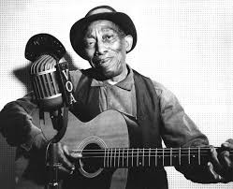
Candy Man
Mississippi John Hurt
Well all you ladies gather 'round
That good sweet candy man's in town
It's the candy man
It's the candy man
He likes a stick of candy just nine inch long
He sells as fast a hog can chew his corn
It's the candy man
It's the candy man
All heard what sister Johnson said
She always takes a candy stick to bed
It's the candy man
It's the candy man
Don't stand close to the candy man
He'll leave a big candy stick in your hand
It's the candy man
It's the candy man
He sold some candy to sister Bad
The very next day she took all he had
It's the candy man
It's the candy man
https://springfedrecords.com/mississippi-john-hurt

