Slide 1
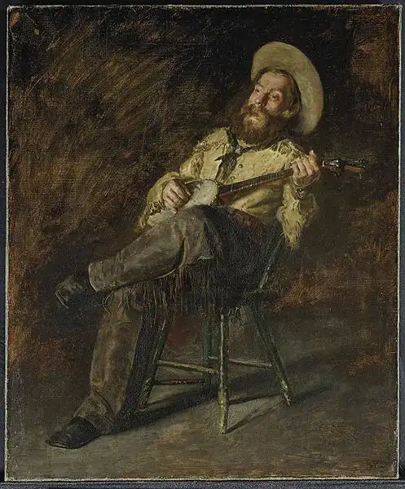
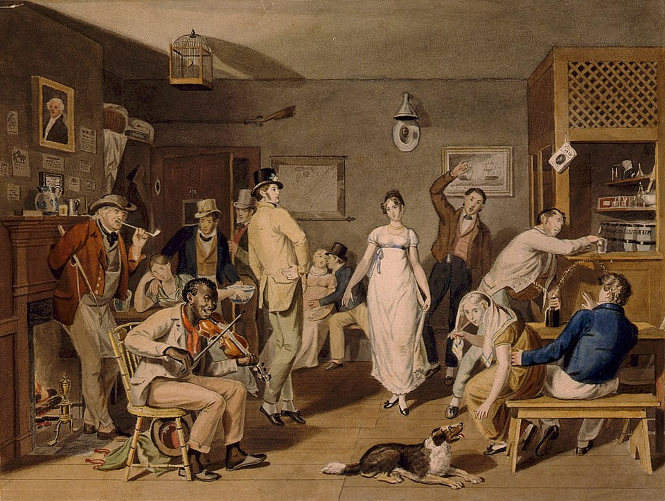
Funny Folks Songs in Traditional Music IV Songs of Work and Daily Life
Thomas Eakins, Singing Cowboy, 1892
John Lewis Krimmel, 1820, Philadelphia
https://discover.hubpages.com/entertainment/10-Songs-from-the-Old-West
https://en.wikipedia.org/wiki/Taverns_in_North_America#/media/File:Barroom_Dancing_by_John_Lewis_Krimmel.jpg

Slide 2
Some History
Playlist includes songs that entered the tradition in the late 1500s and songs written and published in the 1860s and later.
Big processes of economic change: conquest and colonization; enclosure and the commercialization of agriculture; the expansion of both African slavery and wage labor; the industrial revolution; new mining economies; urbanization; and accelerated technological change; boom-bust cycles of growth and expansion.
Big processes of social change: population growth; transoceanic migrations; urbanization; decline of the landed aristocracy and rise of merchant elites; emergence of working classes with gendered divisions of labor; deteriorating social conditions especially in the 19th century,
Big processes of political change: the Reformation; transcontinental warfare; centralization of monarchies and nation-states; nationalism; mobilization of new social classes; ideological polarization; Age of Revolution; Liberal Wars.
Some benchmarks for song traditions: the English Poor Laws; the Great Age of Sail; the Penal Transportation Acts; the American Civil War; American colonization of the West; impact of growing immigrant populations.

Slide 3
A Beggin’ We Will Go (pre-1641)
Of all the trades in England the beggin’ is the best
For when a beggar’s tired he can lay him down and rest
Chorus (repeated after each verse):
And a-beggin’ I will go
And a-beggin’ I will go
I’ve a pocket for my oatmeal and another for my salt
I’ve a pair of little crutches that should see how I can bolt
There’s patches on my fusty coat and a black patch on my eye
But when it comes to tuppenny ale I can see as well as thee
My britches they are no but holes but my heart is free of care
As long as I’ve my belly full my backside can go bare
I’ve been deaf at Duckinfield and I’ve been blind at Shaw
And many’s the right and willing lass I’ve bedded in the straw
There’s a bed for me where’er I lie and I don’t pay no rent
I’ve got no noisy looms to mind and I am right content
I can rest when I am tired and I heed no master’s bell
You men’d be daft to be a king when beggars live so well
(repeat first verse)
Martin Carthy version (one of three)

Slide 4
The Jolly Roving Tar/Get Up Jack, John Sit Down 18th Century
Well, ships may come and ships may go, just as long as the seas do run,
And a sailor lad, likewise his dad, he enjoys his pork and rum.
Now a lass ashore he do adore, one that is plump and round
But when your money’s all gone, it’s the same old song:
Chorus :
Get up Jack, John sit down.
Come along, come along, my jolly brave boys,
There’s plenty more grog in the jar,
We’ll plow the briny ocean with a jolly roving tar.
When Jack’s ashore, he’ll make his way to some old boarding house,
He’s welcomed in with rum end gin, likewise with pork and scouse,
And he’ll spend and he’ll spend, and he’ll never offend, until he lies drunk on the ground.
But when your money’s all gone, it’s the same old song, …
Jack then will slip aboard some ship bound for India or Japan,
For in Asia there, the ladies fair, they all love a sailor man,
And he’ll go ashore, and he won’t scorn to buy some maid a gown.
But when your money’s all gone, it’s the same old song, …
When Jack is old and weather-beat, too old to sail about,
They’ll let him stop in some grog shop till eight bells do ring out.
Then he’ll raise his hands high, and loud he’ll cry: “Great God! I’m homeward bound.”
But when your money’s all gone, it’s the same old song

Slide 5
Good Brown Ale and Tobacco/All For Me Grog
Chorus:
All for me grog, me jolly jolly grog
All for me beer and tobacco
For we spent all our tin with the lassies drinking gin
And across the western ocean we must wander
Where are me boots, me noggin’, noggin’ boots
All gone for beer and tobacco
And the heels they are worn out and the soles are knocked about
And me toes are looking out for better weather
Chorus:
I’m sick in the head for I haven’t been to bed
Since first I came ashore with me plunder
I see centipedes and snakes and I’m full of pains and aches
So I better make a push out over yonder.
Chorus:
Where is me shirt, me noggin’, noggin’ shirt
All gone for beer and tobacco
And the collar is wore out and the front is knocked about
And the tail is looking out for better weather

Slide 6
Six Jolly Miners (1830s)
It’s of six jolly miners, six miners you shall hear,
For they had been a-mining for many a long years.
They travelled England, Ireland and Scotland all around,
But of all their delight was a-working underground.
There was one came from Cornwall and two from Derby town,
The other three from Williamsbridge, young lads of high renown,
But of all their delight was to split those rocks in twine,
But of all their delight was a-working underground.
Sometimes we got money, boys, sometimes we’ve none at all,
But we can have good credit, my boys, when on it we do call.
We can call for liquors merrily and drink our healths all round,
Here’s a health to all my jolly miners that works all underground.
“Have you seen my miner?” so sweetly sang he,
“For of all the trades in England it’s the mining for me.”
(as sung by Victor Brown, 1957)

Slide 7
Barnyards of Delgaty (Scottish Bothy Ballad)
As I gaed up tae Turra Market,
Turra Market for tae fee
I met in wi’ a wealthy fairmer
By the Barnyards o’ Delgaty.
Chorus (after each verse):
Liltin adie toorin adie,
liltin adie toorin ae
O liltan louran louran louran,
The Barnyards o Delgaty.
He promised me the two best horse
That ever gaed on iron sheen
When I gaed to the Barnyards
There wis nothing there bit skin an’ bane
The aul’ grey meer lay on her hunkers,
The aul’ dun horse lay on her wime
An’ all that I could whup an’ cry,
They widna rise at yokin’ time.
Meg Lang Scott aye mak’s ma brose
An’ her an’ me can never ’gree
Here’s a mote an’ syne a k-not
An’ aye the ither splash o’ bree
Jean MacPherson mak’s ma bed,
Ye’Il see the marks upon ma shins
For she’s the coarse ull-tricket jaud,
She fills ma bed wi’ prickly wins
Barny’s milk it’s nae sae fine,
An’ Barny’s meal it is gey raw
If ye dinno bile the bree,
The brose they winna sup ava
Soir I vrocht, aye sair I’ve vrocht
An’ I hae won ma penny fee
I’ll gyang home by the gait I’ve cam’
An’ o better bairnie I will be

Slide 8
Little Brown Jug
Me and my wife lived all alone
In a little hut we called our home.
She loved gin and I loved rum,
I tell you what, we had some fun.
Chorus: Ha, ha, ha, you and me,
Little brown jug, don’t I love thee.
My and my wife and a bobtail dog,
Crossed the creek on a hickory log.
She fell in and I got wet,
Clung to the little brown jug, you bet.
(Chorus)
When I go toiling on my farm,
Take little brown jug on my arm.
Yes, she is so near my nose,
I tip her up, and down she goes.
(Chorus)
If I had a cow that’d give such milk,
I’d dress her in the finest silk.
I’d feed her on the finest hay,
Milk her forty times a day.

Slide 9
The Young Man Who Wouldn’t Sow Corn American 19th Century
I'll sing you a song and it's not very long
It's about a young man who wouldn't hoe corn
The reason why I cannot tell
For this young man was always well.
He planted his corn in the month of June
And by July it was knee-high
First of September there came a big frost
And all this young man's corn was lost.
He went down to the fence and he peeped therein
The weeds and the grass grew up to his chin
The weeds and the grass they grew so high
They caused this young man for to sigh.
So he went down to his neighbor's door
Where he had often been before,
Sayin', Pretty little miss, will you marry me?
Pretty little miss, what do you say?
Here you are, a-wantin' to be wed
And you cannot make your own cornbread,
Single I am and single I'll remain
A lazy man I'll not maintain.
You go down to that pretty little widder
And I hope by heck that you don't git 'er
She gave him the mitten as sure as you're born
And all because he wouldn't hoe corn.

Slide 10
Muirsheen Durkin (Irish, Late 1800s)
CHORUS
Goodbye Mrs. Durkin, I'm sick and tired of workin'
no longer I'll did praties, no longer I'll be fooled
as sure's my name is Carney I'll be off to Californy
instead of diggin praties I'll be diggin lumps of gold
In the days when I was courtin' I was never tired resortin'
from the ale house and the play house and many's the house beside
but I told me brother Seamus I'd grow off and be right famous
and the next time he would hear from me I'd roam the whole world wide CHORUS
Well I've courted girls in Balrney in Antrim and Killarney
in Passage and in Queenstown that is the Cobh of Cork
but I'm tired of all this pleasure so I'm off to take my leisure
and the next time that you'll hear from me in a letter from New York CHORUS
farewell to all the boys at home I'm sailing far across the foam
I'm off to find my fortune in far Amerikay
there's gold and money plenty for the poor and for the gentry
and when I will return again, I never more will say
When I landed in Amerikay I met a man named Burke
he told me if I stayed a while he'd surely find me work
But workin' didn't find me so ther's nothin' here to bind me
so I'm off to San Francisco in Californ I AY CHORUS
well I'm here in San Francisco and my fortune it is made
my pockets loaded down with gold I've trhown away my spade
I'll go back to being larin spend me fortune never carin'
I'll marry Queen Victory Mrs. Durkin for to spite CHORUS

Slide 11
Seeing the Elephant John A. Stone 1840s
When I left the States for gold,
Everything I had I sold:
A stove and a bed, a fat old sow,
Sixteen chickens and a cow.
Chorus: So leave, you miners, leave,
Leave, you miners, leave.
Take my advice, kill off your lice,
Or else go up into the mountains.
Oh, no, lots of dust,
I'm going to the city, get on a bust,
Oh, no, lots of dust,
I'm going to the city, get on a bust,
On the Platte we couldn't agree
Because I had the di-a-ree.
We there split up, I made a break,
With one old mule for the Great Salt Lake.
The Mormon girls were fat as hogs,
The chief production, cats and dogs.
Some had ten wives, others none,
Thirty-six had Brigham Young.
Being brave, I cut and carved;
On the desert nearly starved.
My old mule laid down and died;
I had no blanket, took his hide.
On I travelled through the pines,
At last I found the northern mines;
I stole a dog, got whipped like hell,
Then away I went to Marysville.
I mined a while, got lean and lank,
And lastly stole a monte bank;
Went to the city, got a gambler's name,
And lost my bank at the thimble game.
I fell in love with a California girl,
Her eyes were gray, her hair did curl;
Her nose turned up to get rid of her chin;
Says she, "You're a miner, you can't come in."
If I should make another raise,
In New York sure I'll spend my days.
I'll be a merchant, buy a saw,
So goodbye mines and Panama.

Slide 12
The Old Chisholm Trail (post-Civil War)
Come along boys and listen to my tale
And I'll tell you of my troubles on the old Chisholm Trail
Come a ki yi yippee yippee yi yippee yay
Come a ki yi yippee yippee yay
I woke up one morning on the Chisholm Trail
With a rope in my hand and a cow by the tail
Come a ki yi yippee yippee yi yippee yay
Come a ki yi yippee yippee yay
Well I went to the boss and the boss said, "Kill it,"
So I shot her in the rump with the handle of a skillet
Come a ki yi yippee yippee yi yippee yay
Come a ki yi yippee yippee yay
Started up the trail October twenty-third
I started up the trail with a U-boy herd
Come a ki yi yippee yippee yi yippee yay
Come a ki yi yippee yippee yay
With a ten dollar horse and a forty dollar saddle
I'm going to punch them Texas cattle
Come a ki yi yippee yippee yi yippee yay
Come a ki yi yippee yippee yay
I went to the boss and I hit him for my roll
And he figures me out nine dollars in the hole
Come a ki yi yippee yippee yi yippee yay
Come a ki yi yippee yippee yay
I seen a pretty girl and I offered her a quarter
She says, "Young man, I'm a gentleman's daughter."
Come a ki yi yippee yippee yi yippee yay
Come a ki yi yippee yippee yay
Well I held out the quarter and I put it in her hand
She says, "Young man, let's see it stand"
Come a ki yi yippee yippee yi yippee yay
Come a ki yi yippee yippee yay
With my feet in the stirrup and my hand on the horn
I'm the best danged cowboy ever was born
Come a ki yi yippee yippee yi yippee yay
Come a ki yi yippee yippee yay
Yeah my seat in the saddle and my head in the sky
I'm gonna quit punching cows in the sweet by and by
Come a ki yi yippee yippee yi yippee yay
Come a ki yi yippee yippee yay
Come a ki yi yippee yippee yi yippee yay
Come a ki yi yippee yippee yay
Come a ki yi yippee yippee yay..
Rambling Jack Elliott Version

Slide 13
The Old Chisholm Trail (Oscar Brand’s Bawdy Version
Well I reached in my pocket and I pulled out a penny
She says, "For that you won't get any."
Chorus:
So come and tie my root around a tree, 'round a tree
Come and tie my root around a tree.
I reached in my pocket and I pulled out a nickel
She says, "For that you won't even get a tickle."
I reached in my pocket and I pulled out a dime
She says, "For that you're wasting your time."
Well I reached in my pocket and I pulled out a quarter
She says, "Young man, I'm a minister's daughter."
And I reached in my pocket and I pulled out a half
She didn't even talk, just started to laugh.
And I reached in my pocket and I pulled out a dollar
She took my hand and she put it in her collar.
So I reached in my pocket and I pulled out a five
She says, "Come inside, we'll see if you're alive."
Well I rode her a-standin and I rode her a-lyin'
If I had wings I'd a-rode her flyin'.
And I went to the doctor 'cuz my gun was sore
"Good Lord," said the doctor, "it's the same damn whore."
You can put away your holster, put away your gun
your bough's been breached and your shootin's done.
Well the last time I seen her, I haven't seen her since
She was hustlin' a bull through a barbed-wire fence.

Slide 14
Starving to Death on a Government Claim/Greer County Bachelor Late 19th Century
My name it is Perkin, an old bachelor I am
You’ll find me out west on an elegant plan
You’ll find me out west in the county of fame
Starving to death on a government claim
Chorus:
Hurrah for Greer County, the land of the free
The home of the bedbug, grasshopper and flea
I’ll sing of its praises, I’ll tell of its fame
While starving to death on a government claim
My clothes are all ragged, my language is rough
My bread is corn dodger, my goodness how tough
Nothing to eat and nothing to wear
From nothing to nothing is the Greer County fare
My house it is built of the national soil
The walls are erected according to Hoyle
The roof has no pitch, but is level and plain
And you always get wet if it happens to rain
How happy am I when I go to bed
A rattlesnake rattles a tune at my head
A gay little centipede free from all care
Creeps out of my pillow and into my ear
Come all you claim-holders take warning by me
Don’t live with the bedbug, grasshopper and flea
I’ll travel east, I’ll marry me a wife
And quit these corndodgers the rest of my life.

Slide 15
Hallelujah Bum Again! (Harry McClintock (?) 1902
Oh, why don’t I work,
Like other men do?
How the hell can I work
When the skies are so blue?
Hallelujah, I’m a bum!
Hallelujah, bum again!
Hallelujah, give us a handout
And revive us again!
Oh, springtime has come
And I’m just out of jail,
Without any money,
Without any bail.
Hallelujah, I’m a bum!
Hallelujah, bum again!
Hallelujah, give us a handout
And I’ll buy a nip of gin!
I knock’d on a door
To beg a scrap of bread,
Then a lady came out and says
The baker is dead.
Hallelujah, I’m a bum!
Hallelujah, bum again!
Hallelujah, give us a handout
And revive us again!
I don’t give a damn
What good people think,
So long as I got plenty
Of hooch to drink.
Hallelujah, I’m a bum!
Hallelujah, bum again!
Hallelujah, give us a handout
And I’ll buy a nip of gin!
Hallelujah, I’m a bum!
Hallelujah, bum again!
Hallelujah, give us a handout
And revive us again!

Slide 16
The Big Rock Candy Mountain Harry McClintock, 1928
On a summer’s day in the month of May
A burly bum came hiking.
Down a shady lane with a sugar cane
He was lookin’ for his liking
As he strolled along he sang a song
Of a land of milk and honey
Where a bum can stay for many a day
And he don’t need any money.
Chorus (after each verse):
Oh, the buzzing of the bees in the cigarette trees,
The soda water fountains
Where the lemonade springs and the bluebird sings.
In the Big Rock Candy Mountains.
In the Big Rock Candy Mountains
The cops have wooden legs,
And the bulldogs all have rubber teeth
And the hens lay soft-boiled eggs.
The farmers’ trees are full of fruit,
The barns are full of hay.
Oj, I want to go where there ain’t no snow
Where the rain don’t fall and the wind don’t blow
In the Big Rock Candy Mountains.
In the Big Rock Candy Mountains
You never wash your socks
And the little streams of alcohol
Come trickling down the rocks.
There’s a lake of stew and whiskey too
And you paddle around in a big canoe,
Where they hung the turk who invented work,
In the Big Rock Candy Mountains.

