Slide 1
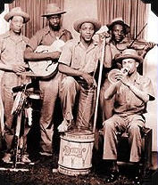
Funny Folk Songs in Traditional Music
20th Century to the Present
The Memphis Jug Band: 1927-1934
Topical Songs in the Tradition
Talking Blues: Woody Guthrie and Bob Dylan
Jug Band Music: Gus Cannon and the Memphis Jug Band; Jim Kweskin
Country music: Jimmie Rodgers, Tom Roger Miller and Loretta Lynn
Children’s Songs
The Funny Songs of John Prine
Some other favorites
https://www.nps.gov/locations/lowermsdeltaregion/memphis-jug-band.htm

Slide 2
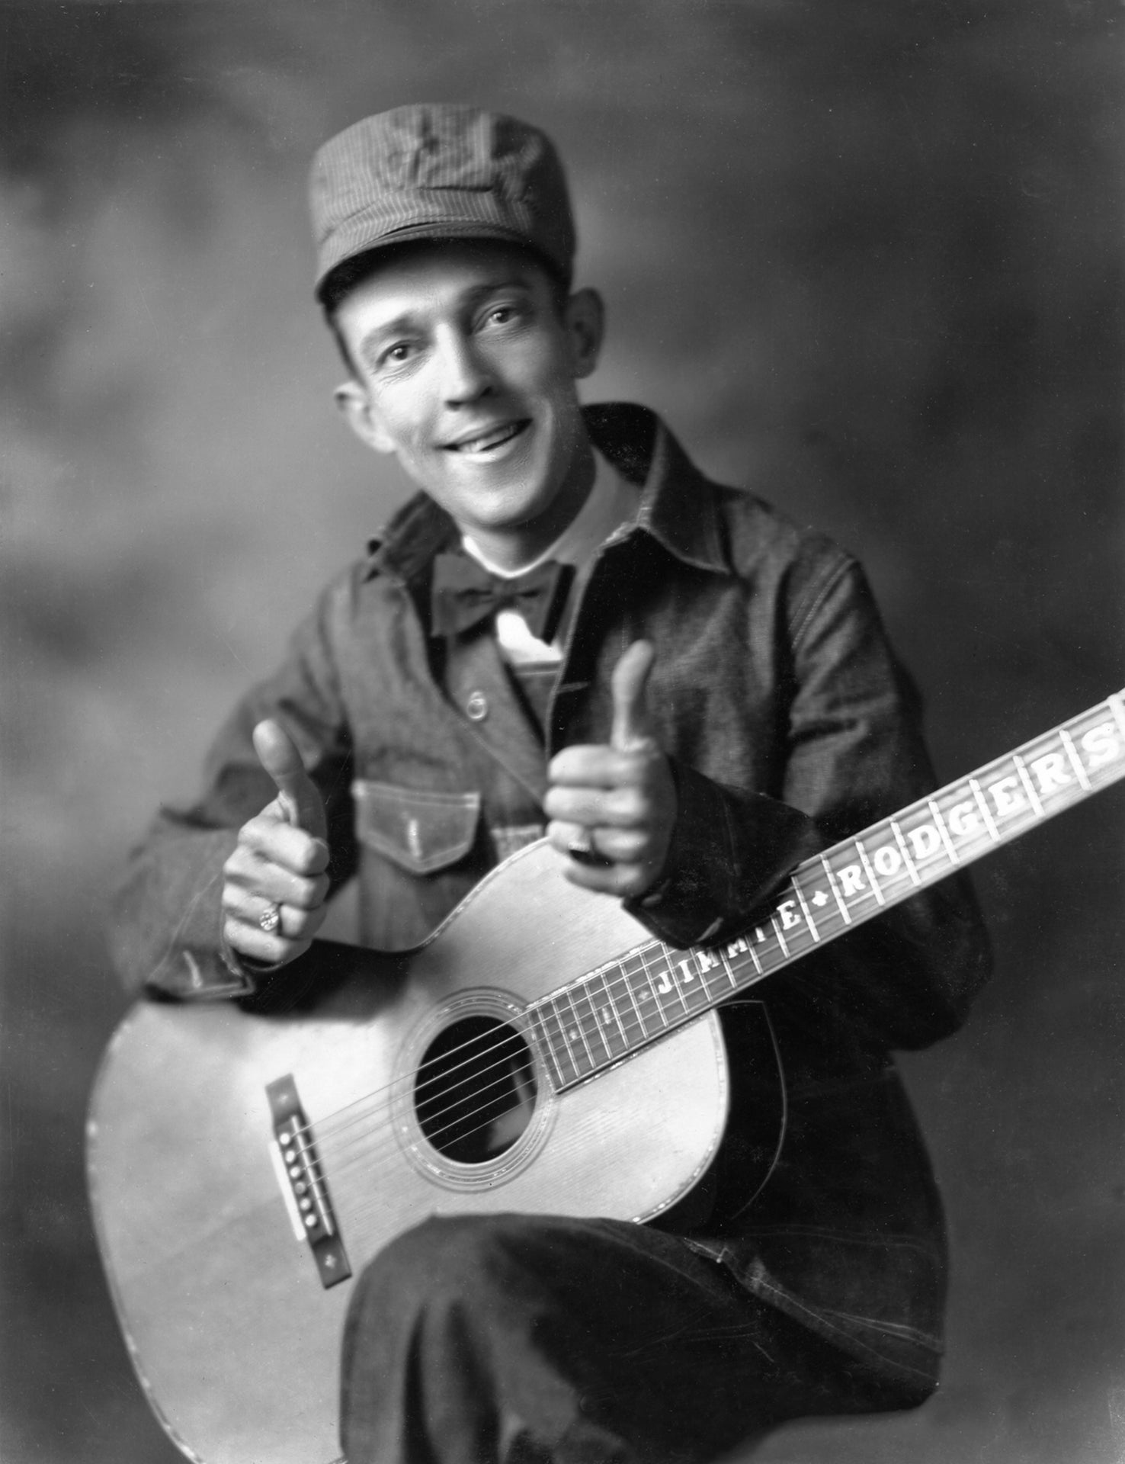
Country Music
Jimmie Rodgers (1897-1933)
A distinct genre by the 1920s that drew on traditional Appalachian, Cajun and Mexican traditions; cowboy songs; rural blues; vaudeville and jug band music.
Women were prominent from the beginning from Samantha Bumgarner and Eva Davis to the Carter sisters.
Humorous songs were popular, especially as Jimmie Rodgers became a national star.
Part of the repertoire of virtually every prominent artist. Think Johnny Cash’s “Boy Named Sue.”
https://en.wikipedia.org/wiki/Jimmie_Rodgers

Slide 3
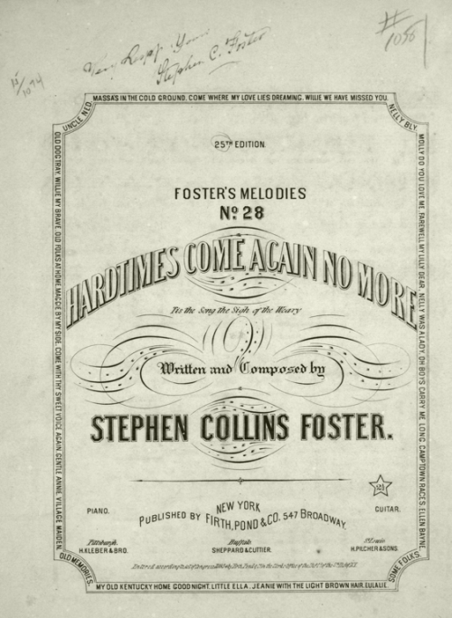
Topical Songs
A mainstay of traditional music.
Social and political commentary.
A story-telling form.
Vital to the social upheavals of the 19th century: abolitionism; the Civil War; temperance movements; union organizing; and the women’s suffrage movements.
Woody Guthrie, Pete Seeger, Molly Jackson, Malvina Reynolds nd others were models for the new singer-songwriters who came out of the folk revival of the 1950s.
https://en.wikipedia.org/wiki/Hard_Times_Come_Again_No_More

Slide 4
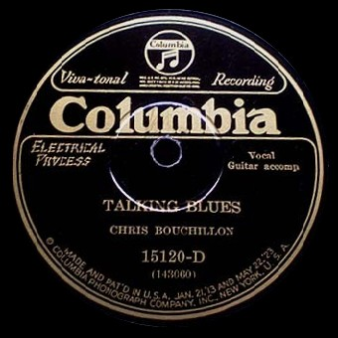
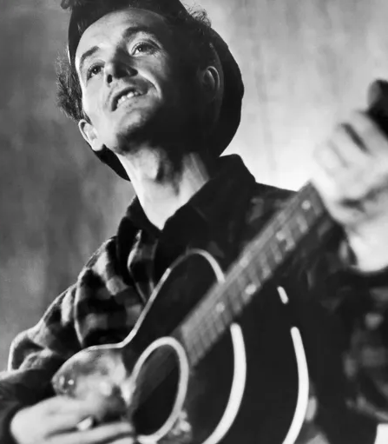
Talking Blues
Chris Bouchillon credited with recording the first talking blues in 1926.
A song form transcends genres from early blues and jazz to jug band music and country.
Woody Guthrie helped popularize the form, starting with “Mean Talking Blues” in 1945.
Bob Dylan included several on his early albums, like “Talking World War III Blues.”
Among other folk revival singers who recorded talking blues: Pete Seeger; Tom Paxton; Phil Oches; Dave Van Ronk; Flatt and Shruggs.
In 1974, Bob Marley titled a whole album “Talkin’ Blues.”
https://e.snmc.io/i/1200/s/a5da08bd5f9471ce9d40f10dd05929c7/4498852
https://www.rollingstone.com/music/music-news/waxahatchee-woody-guthrie-talking-dust-bowl-blues-1213592/

Slide 5
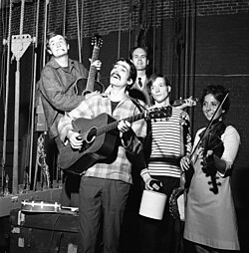
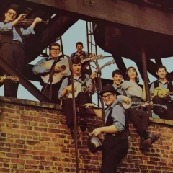
Jug Band Music
The Jim Kweskin Jug Band
Popular in the 1920s
Crazy mix of instruments, especially jugs, kazoos, washboards, and banjos.
Memphis was the capital of jug band music, the home of Gus Cannon and the Jug Stompers and Noah Lewis.
The form had a revival in the 1950s. Gus Cannon made new recordings and young revivalists like Jim Kweskin in Boston and the Even Dozen Jug Band in NY gained big audiences.
https://en.wikipedia.org/wiki/Jim_Kweskin
The Even Dozen Jug Band
https://secondhandsongs.com/artist/141562/all

Slide 6
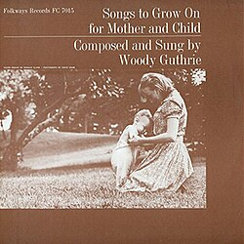
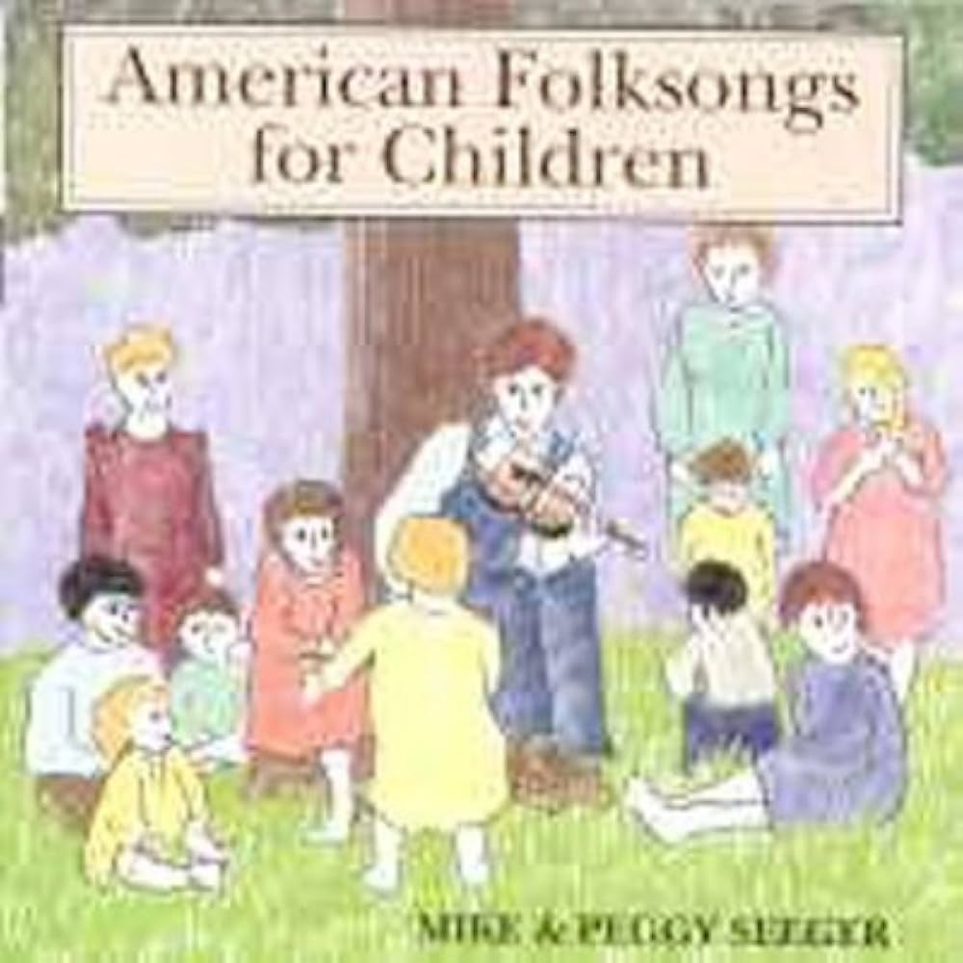
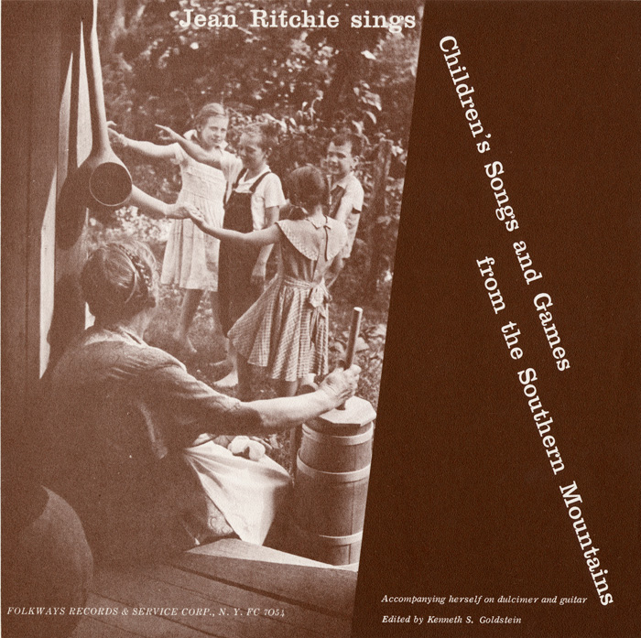
Children’s Songs
Woody Guthrie
Mike and Peggy Seeger
Jean Ritchie
https://m.media-amazon.com/images/I/51u26AgPTnL._UF1000,1000_QL80_.jpg
https://folkways.si.edu/jean-ritchie/childrens-songs-and-games-from-the-southern-mountains/music/album/smithsonian
https://en.wikipedia.org/wiki/Songs_to_Grow_on_for_Mother_and_Child

Slide 7
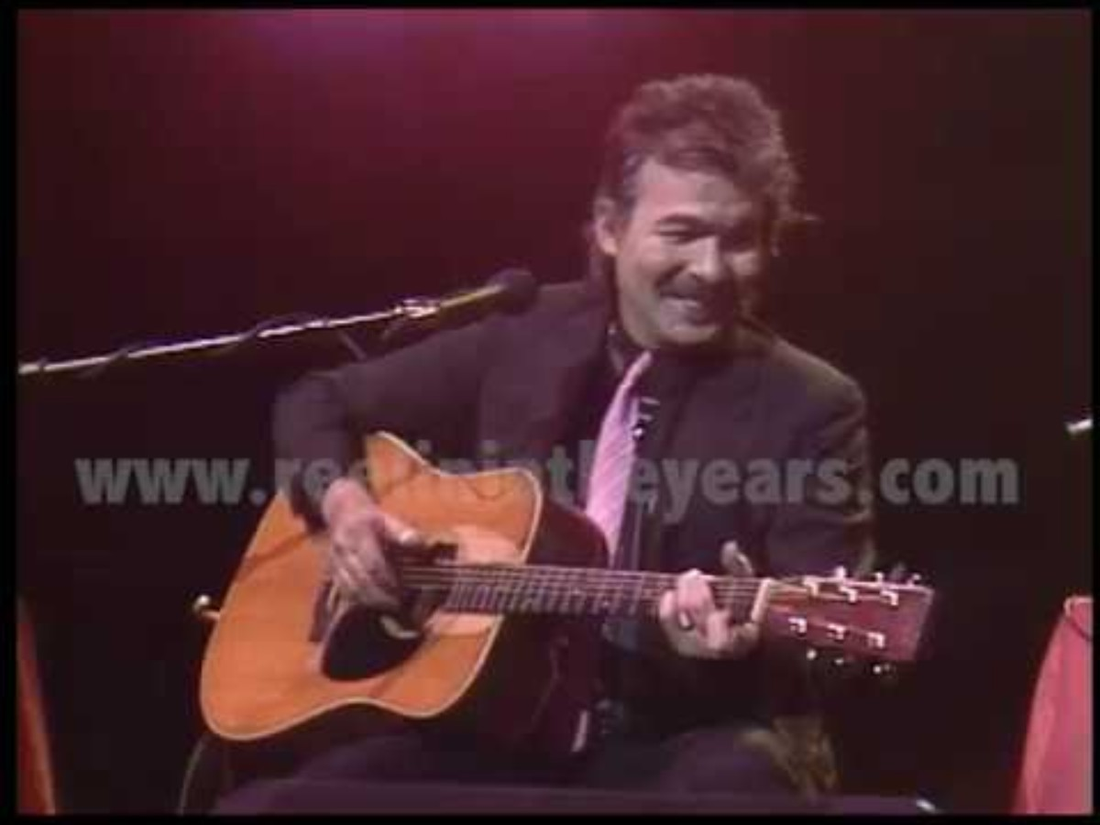
John Prine
Some Favorites:
Your Flag Decal won’t Get You Into Heaven Any More
Pretty Good
In Spite of Ourselves
Illegal Smile
The Sins of Memphisto
Jesus the Missing Year
Some Humans Ain’t Humans
When I Get to Heaven
Let’s Talk Dirty in Hawaiian

Slide 8
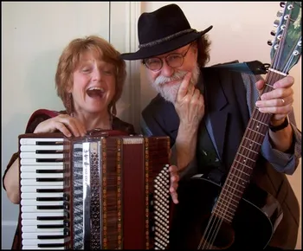
Lou and Peter Berryman
Some Favorites:
Chat With Your Mother (The F’ Word Song)
Dem Deer
Your State’s Name Here
Why Am I Painting in the Living Room?
Mr. and Mrs. Noah
https://www.louandpeter.com/photos

