Slide 1
We’re a Republic.
It’s Under Assault.

Slide 2
Week1 Review
First Amendment Rights
Separation of Powers
Due Process and The Rule of Law
Abuse of Executive Power

Slide 3
First Amendment​
Congress shall make no law respecting an establishment of religion or prohibiting the free exercise thereof; or abridging the freedom of speech, or of the press; or the right of the people peaceably to assemble, and to petition the Government for a redress of grievances.​

Slide 4
Actions not protected by the First Amendment include:
Speech that incites imminent lawless
action​
​
Threats ​
​
Obscenity​
​
Speech integral to illegal conduct

Slide 5
Relevant Judicial Decisions
Ray Epps, present at the Jan 6th Capitol events, claimed that Tucker Carlson falsely accused him of being a government provocateur. Epps argued that Carlson’s statements damaged his reputation and incited threats against him.
​
Secretary of State Marco Rubio personally approved the deportation of five student activists last year because of their participation in pro-Palestinian protests and their writings about the war in Gaza.​​
​
Notes:
James Ray Epps said that Tucker Carlson — who parted ways with the network in the wake of its massive settlement with Dominion Voting Systems in April 2023 — falsely implicated Epps as a government plant who "helped stage-manage" the melee. As a result of the publicity, Epps says, he and his wife faced online attacks and threats of violence so severe that they had to leave their home and live in their RV.
His suit against Carlson was dismissed in November of 2024
BOSTON (AP - 01/22/26) — A federal judge ruled on Thursday that the academics, who are party to a lawsuit alleging U.S. policy singles out noncitizens for detention or deportation over their pro-Palestinian activism on college campuses, can seek relief from the court if their immigration status is changed as retribution for taking part in the case.
The ruling from U.S. District Judge William Young comes in the wake of trial last year, in which he ruled the Trump administration violated the Constitution when it targeted non-U.S. citizens for deportation solely for supporting Palestinians and criticizing Israel. Young repeatedly chastised the administration for violating the First Amendment rights of the plaintiffs and, on Thursday, issued what he described as “remedial sanction to protect certain of the Plaintiffs’ noncitizen members from any retribution for the free exercise of their constitutional rights.”
Mahmoud Khalil: A Columbia University graduate student and lawful permanent resident. He was held in detention for over 100 days before a judge ordered his release.
Rümeysa Öztürk: A PhD student at Tufts University. She was detained for six weeks following the publication of an op-ed before a court ordered her release.
Mohsen Mahdawi: A student activist whose deportation was blocked by federal intervention.
Yunseo Chung: A Columbia University student who obtained a restraining order before ICE could execute an arrest.
Badar Khan Suri: A postdoctoral fellow at Georgetown University.

Slide 6
HOMEWORK (IF YOU WANT IT)​
​
Google the following on TED Talks:​
​
Let’s Get Real About Free Speech​
​
Greg Lukianoff

Slide 7
Week 2 - The Dismantling of Our Institutions
The Impact of DOGE on Governmental Agencies
The Impact on the Media
The Impact on Education
Notes:
After attacking law firms, the media, and Ivy League universities, the Trump administration’s latest target is nonprofits—particularly the public charities, philanthropies, and educational institutions known as 501(c)(3)s. Along with Vera, the administration has already directly attacked Harvard University, the American Bar Association, the United States Institute of Peace, the Chinese-American Planning Council, NeighborWorks, and more—and it is clearly not finished.

Slide 8

The Walking DOGE!
Notes:
The Department of Government Efficiency (DOGE) was officially declared as dead in May of last. But much like the antagonists in the popular series which began in 2010 it continues in, how shall I say, reruns and spinoffs

Slide 9
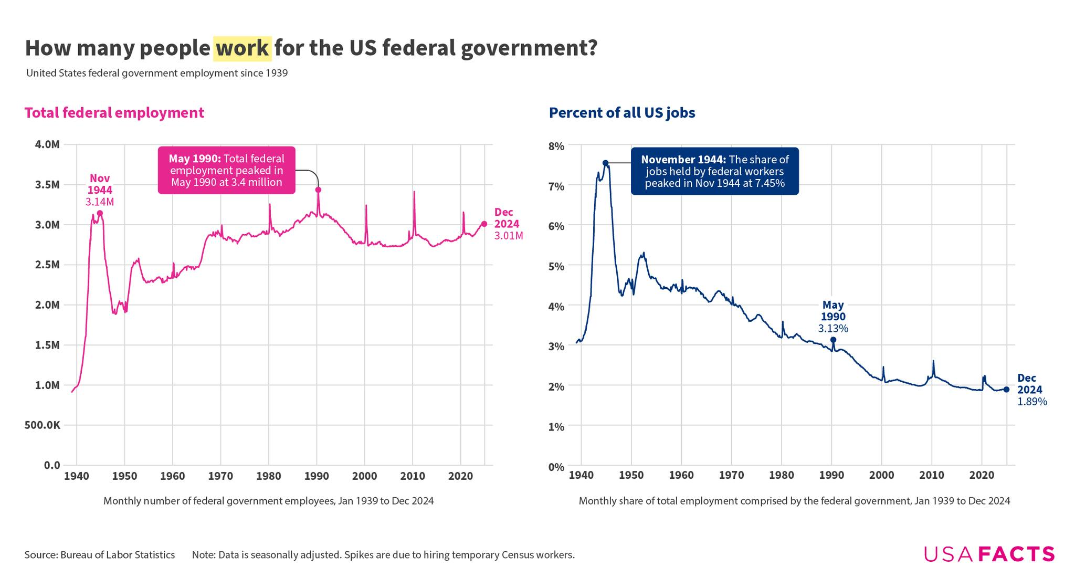
The Size of Government 1950 - 2024
Notes:
Ian Arthur Bremmer is an American political scientist, author, and entrepreneur focused on global political risk. He is the founder and president of Eurasia Group, a political risk research and consulting firm. He is also founder of GZERO Media, a digital media firm. Wikipedia
The larges number of Government employees was in WWII – 3. 4 million
Long-Term Stability: The total number of federal civilian employees has stayed roughly the same size since 1969.
Post-1950 Fluctuations: Following the Korean War, the workforce hovered around 2 million, hitting a post-war high of 2.3 million in 1969 during the Vietnam War.
Recent Data: As of December 2025, there were 2.14 million non-postal federal government workers, following a period of slight decline.
Relative Size: Although the absolute number of workers has remained stable, the federal workforce has decreased as a percentage of the total U.S. population.
Composition: Roughly 60% of these civilian employees work for the Departments of Defense, Veterans Affairs, and Homeland Security.
Historical Low: The lowest level of executive branch civilian employment since 1950 occurred in 2001, at 1.7 million employees.

Slide 10
The Impact of DOGE on Governmental Agencies
Department Eliminations
Workforce Reductions
Data Access & Security
DOGE Impacts Biosafety
Notes:
U.S. Agency for International Development (USAID): Almost entirely dismantled. As of mid-2025, only about 15 positions remained from an original workforce of over 10,000. Its remaining functions were transferred to the State Department.
Consumer Financial Protection Bureau (CFPB): Effectively shuttered after mass layoffs reduced its workforce from 1,700 to nearly zero. Its data and websites were briefly removed from the internet before court-ordered reinstatements began in early 2025.
Federal Mediation and Conciliation Service (FMCS): Reported as shuttered by DOGE in March 2025.
Department of Education: Targeted for total dismantling. It lost over 1,300 workers in early 2025, reducing its headquarters and regional operations significantly.
1. Massive Workforce Reductions
DOGE facilitated the largest peacetime federal workforce cut on record.
Total Job Losses: By November 2025, federal employment fell by 271,000, a 9% decline in less than ten months.
Targeted Layoffs: Reductions heavily impacted probationary employees—those with less than two years of service—at agencies like the IRS (6,700 fired), Department of Education (2,200), and VA (17,000).
Voluntary Departures: Large spikes in departures in late 2025 were driven by civil service buyout offers rather than normal attrition.
2. Spending and Contract Terminations
Despite claims of massive savings, DOGE's impact on total federal spending was limited as major budget drivers (Social Security and Medicare) remained mostly untouched.
Savings Accuracy: DOGE's "Wall of Receipts" claimed over $200 billion in savings by early 2026, but independent analyses found these figures were often inflated by double-counting or misclassifying "ceiling values" (maximum potential spending) as actual savings.
Agency Disruptions: The termination of more than 1,000 contracts and grants led to significant service disruptions. USAID was nearly dismantled, leading to estimates of hundreds of thousands of deaths globally due to halted humanitarian aid.
Technological Loss: DOGE eliminated units like 18F, which developed digital services like the IRS Direct File system.
3. Data Access and Security Concerns
DOGE operatives gained unprecedented "administrator-level" access to sensitive federal systems.
Sensitive Information: Staff accessed databases containing Social Security numbers, private health records (HHS), and financial data (Treasury, CFPB).
Privacy Breaches: Whistleblowers and lawsuits alleged that DOGE mishandled data, including uploading a database of 300 million Americans' information to an unsecured server.
Targeting DEI: Personnel used system access to identify and purge employees associated with Diversity, Equity, and Inclusion (DEI) initiatives.
4. Legal and Institutional Conflict
DOGE’s activities sparked a wave of litigation and institutional friction.
Court Battles: At least 16 lawsuits were filed. Judges issued preliminary injunctions to block DOGE from accessing Treasury payment systems and to prevent the dismantling of the Consumer Financial Protection Bureau (CFPB).
Agency Resignations: Senior career officials at the Treasury, Social Security Administration, and FEMA resigned or were fired after clashing with DOGE over data security and payment halts.
Dissolution: Elon Musk stepped back from his role in May 2025, calling the project "somewhat successful" but noting he would not do it again. By November 2025, reports indicated that DOGE as a distinct entity had effectively ceased to exist, with its functions moving under the Office of Management and Budget (OMB)
Click on the link at the bottom of the slide

Slide 11
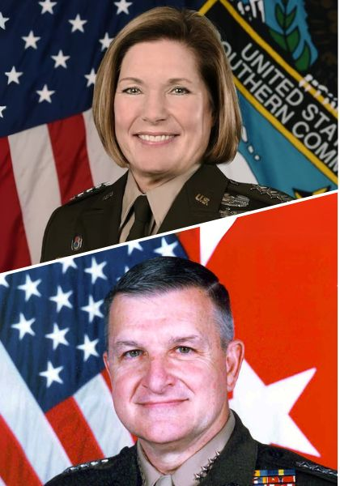
General Laura J. Richardson, USA (Ret.) and General Anthony C. Zinn USMC (Ret.)
https://www.usglc.org/resources/military-power-alone-is-not-enough-international-aid-is-vital-to-us-security-the-hill/
Notes:
In March 2025, a group of prominent retired military leaders, including high-ranking generals, urged members of the 119th Congress to support the U.S. Agency for International Development (USAID) amidst moves by the administration to dismantle the agency.
“Gutting U.S. international assistance infrastructure will not help the American people win the battle for the 21st century. Instead, we are seeing significant unintended damage from the abrupt and chaotic dismantling of programs, which will ultimately put America at a disadvantage to our rivals. These actions undermine Secretary of State Marco Rubio’s doctrine that every dollar we spend should make America safer, stronger and more prosperous. We need to play both offense and defense to advance a “peace through strength” agenda to outcompete rivals like China; prevent costly wars; and stop disease, drugs and terror from reaching our borders. Withdrawing from America’s leadership role on the global playing field risks leaving a void for our adversaries to fill.”

Slide 12

Micaela White
Senior Humanitarian Adviser – USAID 2009–2025
Notes:
In 2011, White traveled to Benghazi with the envoy J. Christopher Stevens, who was later murdered in a terrorist attack. On that mission, she survived a car bombing of her hotel. She also managed to hire boat captains willing to transport food into the starving eastern half of Libya. Her persistence occasionally irked her superiors back home, like the time she assumed control of the Syrian DART (Disaster Assistance Response Team) without telling them that she was pregnant.

Slide 13
Workforce Reductions
Approximately 271,000 workers were impacted
The CDC saw a 24% reduction in staff including their disease trackers and the entire Division of Healthy Start and Services
Personal information of millions of Americans may have been compromised
Notes:
Some of the agencies most impacted included FEMA, the National Weather Service, USAID, CFPB, SSA and the IRS
The United States ranks 14th in infant mortality among the top twenty nations as measured by GDP. It should be noted that the sole purpose of the Division of Healthy Start and Services is focused on developing pre and post-natal program services for woman and families near or below the poverty line.

Slide 14
Workforce Reductions
Approximately 271,000 workers were impacted
The CDC saw a 24% reduction in staff including their disease trackers and the entire Division of Healthy Start and Services
Personal information of millions of Americans was potentially compromised
Personal Information Breach
Notes:
Some of the agencies most impacted included FEMA, the National Weather Service, USAID, CFPB, SSA and the IRS
Some of the agencies most impacted included FEMA, the National Weather Service, USAID, CFPB, SSA and the IRS
The United States ranks 14th in infant mortality among the top twenty nations as measured by GDP. It should be noted that the sole purpose of the Division of Healthy Start and Services is focused on developing pre and post-natal program services for woman and families near or below the poverty line.
It also appears the DOCE employees have potentially compromised personal information on million of Americans, including SSN’s names and addresses. (Click on the link at the bottom of the sliden)

Slide 15
The Impact on the Media
Legal and Financial Action
  Defamation Lawsuits
  Public Broadcasting Cuts
  International Media Funding
The Administrative and Regulatory Pressures
  FCC Investigations
  Pentagon Access
  White House Restrictions:
  "Media Bias" List
Rhetoric and Intimidation
  Verbal Attacks
  DOJ Policy Shifts
  Social Media
Notes:
Legal and Financial Action
President Trump sued the Wall Street Journal for $10 billion over a reported lewd drawing. He pursued a $10 billion lawsuit against CBS, which Paramount eventually settled for $16 million.
On May 1, 2025, instructing the Corporation for Public Broadcasting (CPB) to cease all direct federal funding for NPR and PBS. This resulted in a $1.1 billion reduction in funds for these stations.
Cut funding for the U.S. Agency for Global Media, affecting outlets like Voice of America (VOA) and Radio Free Europe, leading to hundreds of layoffs.
Administrative and Regulatory Pressures
FCC launched at least eight probes into media organizations, including NPR and PBS and the broadcast licenses of networks like CBS, ABC, and NBC.
In 2025, the Department of Defense implemented new rules requiring reporters to agree not to use "unauthorized material," even if unclassified
The administration indefinitely banned Associated Press reporters from certain pool events for using the term "Gulf of Mexico" instead of "Gulf of America".
The White House launched a new website featuring a "Hall of Shame" that publicly listed journalists and outlets the administration considered "liars" or biased
Rhetoric and Intimidation
President Trump continued to label journalists as "the enemy of the people". During press briefings, he notably berated reporters, calling one female correspondent "piggy"
DOJ Policy Shifts: Attorney General Pam Bondi rescinded a memo that had previously protected journalists from being compelled to testify or provide records to identify anonymous sources of government leaks.
Social Media: As of late 2025, Trump had made over 200 anti-media posts on social media.

Slide 16
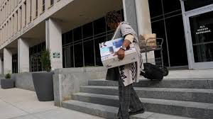
The Impact on Education
Worker Leaving the Department of Education Building
Notes:
Click on the link at the bottom of the Slide

Slide 17
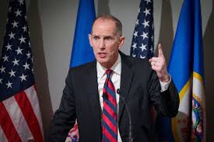
Minnesota Governor’s Race
Candidate Leaves The Race For Governor
Notes:
Chris Madel, a Republican candidate for governor of Minnesota and the lawyer representing the Immigration and Customs Enforcement (ICE) officer who fatally shot Renee Macklin Good, has dropped out of the state's gubernatorial race, saying he no longer stands for the immigration crackdown happening in Minneapolis.
"I cannot support the national Republicans' stated retribution on the citizens of our state, nor can I count myself a member of a party that would do so," Madel said in a nearly 11-minute video posted to X on Monday.
MSNOW only showed a short clip (48 seconds) from his 11 minute video. I think a view othe entire video is well worth your time.
Click on the Link at the bottom of the Slide

