Slide 1
We’re a Republic.
It’s Under Assault.

Slide 2
Week 2 Review
The Impact of DOGE on Governmental Agencies
The Impact on the Media
The Impact on Education
Notes:
USAID Current Operational Status
Official Shuttering: As of July 1, 2025, USAID officially ceased implementing foreign assistance.
Merger with State Department: New entities like the Office of Global Food Security have been created within State to handle transferred programs.
Personnel Reductions: Most of the agency's 10,000+ staff and contractors were separated from federal service by September 2, 2025.
Current Leadership: Russell Vought has served as the acting administrator since August 29, 2025, following the tenure of Marco Rubio.
Funding and Program Impact
Budget Cuts: For FY2026, the administration proposed a budget of roughly $16.5 billion, a sharp decline from the $63 billion budget in 2023 including an 83-86% reduction in foreign ais assistance .
Rescinded Awards: More than 5,300 project awards—representing billions in un-obligated funding—were cancelled. Including landmine clearance.
Global Health Disruption: PEPFAR saw 65% of their awards terminated, though active ones still comprise a majority of planned funding. Estimates suggest these cuts could lead to millions of preventable deaths from HIV/AIDS by 2030.
Legal and Legislative Standing
Legal Challenges: Several lawsuits have been filed to block the dismantling of USAID, arguing that only Congress has the power to abolish an agency it created. Congressional Action: Some members of Congress have introduced legislation to either formally abolish the agency (e.g., H.R. 1029) or protect it (e.g., H.R. 1196), but no definitive legislative resolution has superseded the executive branch's reorganization.

Slide 3

Indictment of Independent Journalist
Georgia Fort & Don Lemon
Notes:
In January 2026, two independent journalists, Don Lemon (formerly of CNN) and Georgia Fort, were indicted and arrested following their coverage of an anti-ICE protest at Cities Church in St. Paul, Minnesota.
Key Details of the Indictment
The Incident: On January 18, 2026, dozens of protesters interrupted a service at Cities Church, where a U.S. Immigration and Customs Enforcement (ICE) official serves as a pastor.
Charges: A federal grand jury indicted Lemon, Fort, and seven others. The primary charges include:
Conspiracy to deprive rights under an 1871 law originally used against the Ku Klux Klan.
Interfering with religious freedom by force or threat of force.
Violating the FACE Act (Freedom of Access to Clinic Entrances Act), which also protects places of religious worship.
The Prosecution's Argument: Prosecutors claim the journalists were not merely observers but were complicit in the "coordinated attack". The indictment alleges Lemon's livestream provided a timeline used to argue he was "complicit" with protesters.
Journalists' Defense: Both Lemon and Fort maintain they were present solely as members of the media. Lemon's attorney described the arrest as an "unprecedented attack on the First Amendment".
Current Status
Arrests and Release: Lemon was arrested in Los Angeles, while Fort was arrested by federal agents at her home in Minnesota. Both were released on bond following initial court appearances. Turns out not so much. Numerus other media sources reported that neither Fort nor Lemon were required to post bond. A specific AI request confirmed this.
Backlash: Media advocacy groups, including the National Association of Black Journalists, and organizations like Amnesty International have condemned the arrests as government overreach and a threat to press freedom.
Legal Action: A consortium of Minnesota news outlets, including the Star Tribune and MPR News, issued a joint statement defending the journalists' right to report on public events.

Slide 4

Liam Conejo Ramos and His Father Adrian
Case is being appealed by the DOJ
Notes:
U.S. District Judge Fred Biery, who sits in San Antonio and was appointed by former Democratic President Bill Clinton, said in his ruling that “the case has its genesis in the ill-conceived and incompetently-implemented government pursuit of daily deportation quotas, apparently even if it requires traumatizing children.”

Slide 5
Week 3 - Immigration
American Immigration History
The Worst of the Worst
This Border Is Closed
Casa de la Misericordia y de Todas las Naciones

Slide 6
American Immigration History
Naturalization Law of 1802
America Invades Mexico - 1846
Treaty of Guadalupe Hidalgo & Gadsden Purchase – 1848/54
14th Amendment - 1868
Immigration Act of 1924
Immigration & Naturalization Act - 1965
Notes:
Naturalization Law of 1802 - All immigrants can become citizens
“Report and Register” – 5 year wait
America Invades Mexico 1846
In
The Year of Decision: 1846
Bernard DeVoto analyzes the Mexican-American War as a deliberate political choice by President James K. Polk rather than an unavoidable necessity. While the term "war of choice" is a modern geopolitical label, DeVoto’s narrative highlights the following implications of Polk's decision to pursue conflict:
Manifest Destiny as a Driver: DeVoto argues that Polk was willing to risk war with both Mexico and Great Britain to secure California, New Mexico, and Oregon. The "decision" of 1846 was the commitment to continental expansion at any cost.
Provocation and Strategy: The book details how Polk intentionally ordered General Zachary Taylor into disputed territory on the Rio Grande to provoke a Mexican response, essentially choosing to force a military confrontation to settle territorial claims.
Political Fragmentation: The decision to go to war split the Democratic Party and led to the eventual collapse of the Whig Party, as the nation could no longer find common ground on whether the newly acquired lands should allow slavery.
The Inevitability of the Civil War: DeVoto’s central thesis is that the choice to wage war for new Western territories directly triggered the internal American crisis over slavery. He asserts that the expansion gained through the war broke the existing political compromises, leading directly to the Civil War fifteen years later.
Mexicans can opt to become U.S. citizens (Treaty of Guadalupe Hidalgo and Gadsden Purchase) 1848/54 –
14th Amendment – “all persons born or naturalized in the U.S are citizens” (African Americans) “jus soli” (right of the soil) not “jus sanguinis” (right of blood)
Immigration Act of 1924 – National Origins Quota (% of population) Visas required to enter the country. Native Americans born in the United States are citizens
Immigration Naturalization Act (Hart-Celler) – Family Pref. and Skills, Caps on Countries, Broadens Geography, Temp. Visas
Key Impact of the INA Act
Abolished Quotas: It replaced the National Origins Formula, which had heavily favored immigrants from Northern and Western Europe while restricting those from Asia, Africa, and Eastern Europe since the 1920s.
New Priorities: The system shifted focus to family reunification and skilled labor, which significantly altered the demographic makeup of the United States over the following decades.
Hemispheric Caps: For the first time, it established a limit on immigration from the Western Hemisphere while setting an annual ceiling for the Eastern Hemisphere.

Slide 7
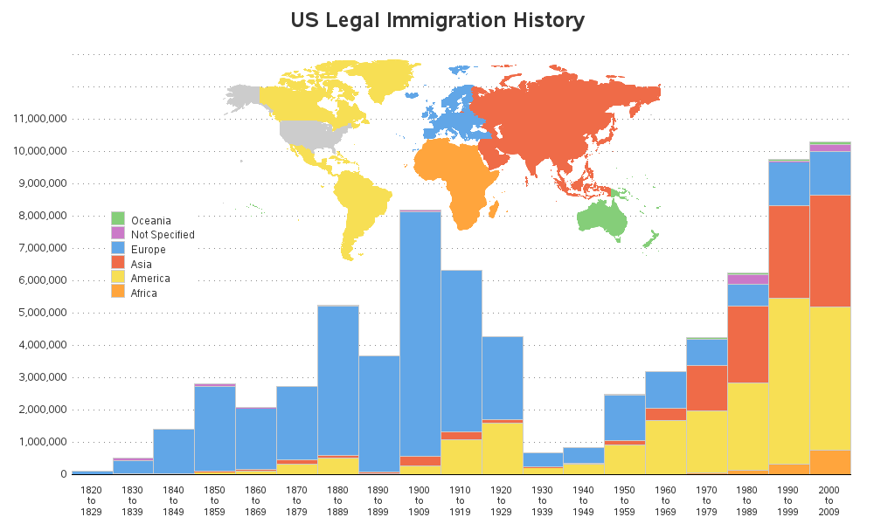

Slide 8
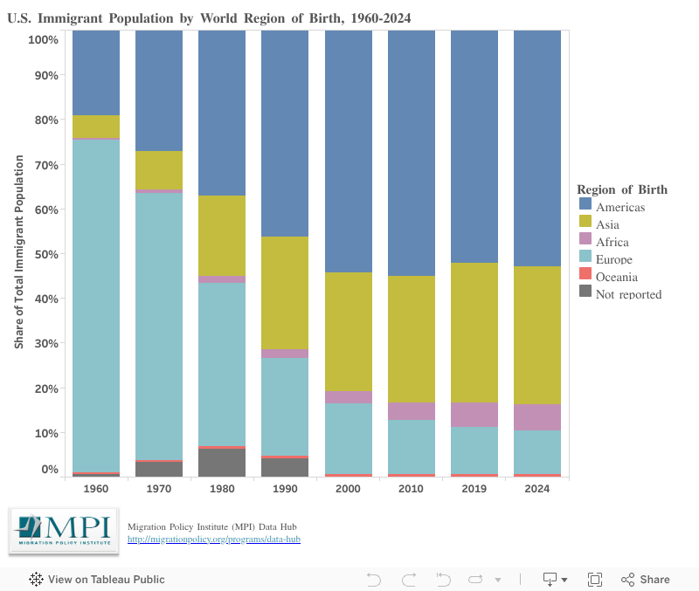
Immigration by World Region
Notes:
Since 2010, U.S. immigration has shifted from a Mexico-dominant flow to increased diversity, with Asia (India/China) becoming the top origin region, alongside rising South American (Venezuela) and African arrivals. While Mexican immigration declined by over 1 million (2010-2022), Asian, African, and South American populations grew significantly.

Slide 9
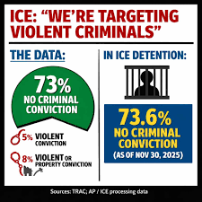
The Worst of the Worst
Cato Institute Study
Notes:
Cato Institute studies analyzing Texas Department of Public Safety data consistently find that immigrants, including those in the country illegally, are convicted of crimes and homicides at lower rates than native-born Americans. From 2013–2022, the homicide conviction rate in Texas was 2.2 per 100,000 for illegal immigrants, 1.2 for legal immigrants, and 3.0 for native-born citizens.
Key Findings on Crime in Texas (2013–2022 Data)
Homicide Rates: Native-born Americans were 26% more likely to be convicted of homicide than illegal immigrants and 61% more likely than legal immigrants.
Overall Criminal Convictions: Illegal immigrants had a 45% lower criminal conviction rate than native-born Americans in 2018.
Crime Types: The trend of lower criminality for immigrants holds across violent crimes, property crimes, and sexual offenses.
Long-Term Trends: Data from 2012–2018 showed that, compared to undocumented immigrants, US-born citizens were over 2 times more likely to be arrested for violent crimes, 2.5 times more likely for drug crimes, and 4 times more likely for property crimes.
Analysis by Nationality and Ethnicity
Broad Trends: The lower criminality of immigrants is consistent across all race and ethnic groups (Asian, Hispanic, Black, and White) compared to native-born white Americans.
Asian Immigrants: Asian illegal immigrants showed the lowest incarceration risks.
Victimization: Immigrants are also less likely to be victims of violent crime, suggesting that they are not, as sometimes argued, primarily victimizing their own communities.
Contextual Factors
Data Reliability: The study relies on unique data from the Texas Department of Public Safety, which tracks the legal status of individuals at the time of arrest.
Debate on Undercounting: While some critics, such as the Center for Immigration Studies, argue that,the Cato studies undercount illegal immigrant criminals, the Cato Institute maintains that their analysis of state-level data properly accounts for these populations.
Fear of Deportation: The studies suggest that the fear of deportation and legal repercussions contributes to lower crime rates among immigrant populations.

Slide 10
The United States Border Is Closed
Administrative Justification
Constitutional Authority - We’re Being Invaded
National Security - INA 212(f) Security & Crime
Deterrence - Discouraging Future “Waves”
Public Safety - Lack Authoritative Information
Major Lawsuits and Legal Challanges
Raices v. Noem - Asylum Shutdown
Al Otro Lado v. Trump - Asylum Application Cancelation
W.M.M v. Trump - Alien Enemies Act
Trump v. Barbara - Birthright Citizenship
Notes:
Administration Justifications
The administration defended its border closures and asylum bans using several key arguments:
Constitutional Authority: Invoking presidential powers to override federal immigration law, claiming migrants are engaged in an "invasion" that justifies immediate suspension of entry.
National Security: Citing Section 212(f) of the Immigration and Nationality Act to restrict entry of foreign nationals based on national security risks and criminal activity.
Deterrence: Arguing that sweeping restrictions are necessary to "discourage future waves" of irregular migration.
Public Safety: Stating that lack of authoritative criminal information from certain countries makes it difficult for vetting authorities to assess admissibility.
Major Lawsuits and Legal Challenges
Advocacy groups including the ACLU, National Immigrant Justice Center, and RAICES filed numerous suits to overturn these orders.
RAICES v. Noem: Challenged the proclamation aimed at completely shutting down asylum. In July 2025, a federal court blocked the effort, ruling that the administration could not use the "invasion" claim to override asylum laws set by Congress.
Al Otro Lado v. Trump: Filed in June 2025 after the administration suspended access to asylum at ports of entry and canceled roughly 30,000 CBP One appointments.
W.M.M. v. Trump: A decisive battle over the Alien Enemies Act, an 18th-century law used to deport certain immigrants. An appeals court panel rejected the administration’s "invasion" claim in September 2025.
Trump v. Barbara: Challenged an executive order attempting to end birthright citizenship. While lower courts blocked the order, the Supreme Court limited the scope of nationwide injunctions in June 2025.
By January 2026, over 230 legal actions had been taken against the administration's immigration agenda, with 64% resulting in some level of delay or defeat for the policies.

Slide 11
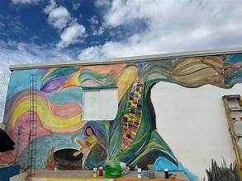
"House of Mercy and of All Nations".
Notes:
I first became aware of "House of Mercy and of All Nations". Through our church, The Good Shepherd UCC in Sahuarita, and in particular our pastor, Randy Mayer.
The organization, often referred to as CMTN, is a prominent migrant and refugee shelter located in Nogales, Sonora, Mexico. It primarily serves as a sanctuary for women, children, and families seeking asylum in the United States, providing them with housing, food, and various support services.
Key details about the organization:
Mission: To offer a safe, dignified, and nurturing space for vulnerable individuals during their asylum journey.
Impact: It has assisted thousands of people in navigating the legal entry process into the U.S. and offers educational programs, job training, and therapy.
Leadership: The shelter is led by executive director Sister Lika Macías (also known as Alma Angélica Macías Mejía).
Partnerships: It collaborates with various international organizations and religious groups, such as the Grand Canyon Synod and the Green Valley-Sahuarita Samaritans.

Slide 12
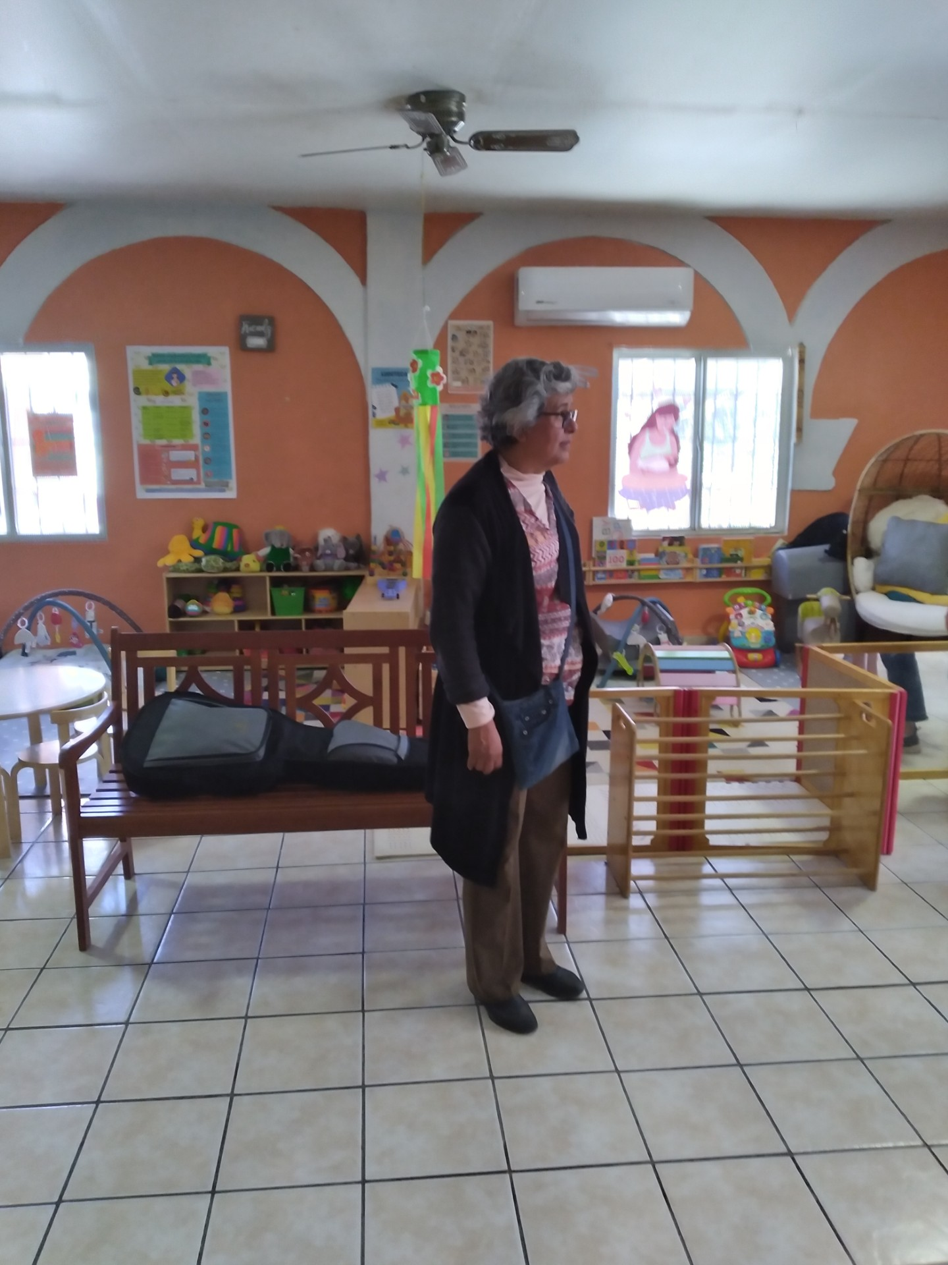
Sister Lika Macia
Notes:
In English, the name translates to "House of Mercy and of All Nations".
The organization, often referred to as CMTN, is a prominent migrant and refugee shelter located in Nogales, Sonora, Mexico. It primarily serves as a sanctuary for women, children, and families seeking asylum in the United States, providing them with housing, food, and various support services.
Key details about the organization:
Mission: To offer a safe, dignified, and nurturing space for vulnerable individuals during their asylum journey.
Impact: It has assisted thousands of people in navigating the legal entry process into the U.S. and offers educational programs, job training, and therapy.
Leadership: The shelter is led by executive director Sister Lika Macías (also known as Alma Angélica Macías Mejía).
Partnerships: It collaborates with various international organizations and religious groups, such as the Grand Canyon Synod and the Green Valley-Sahuarita Samaritans.

Slide 13
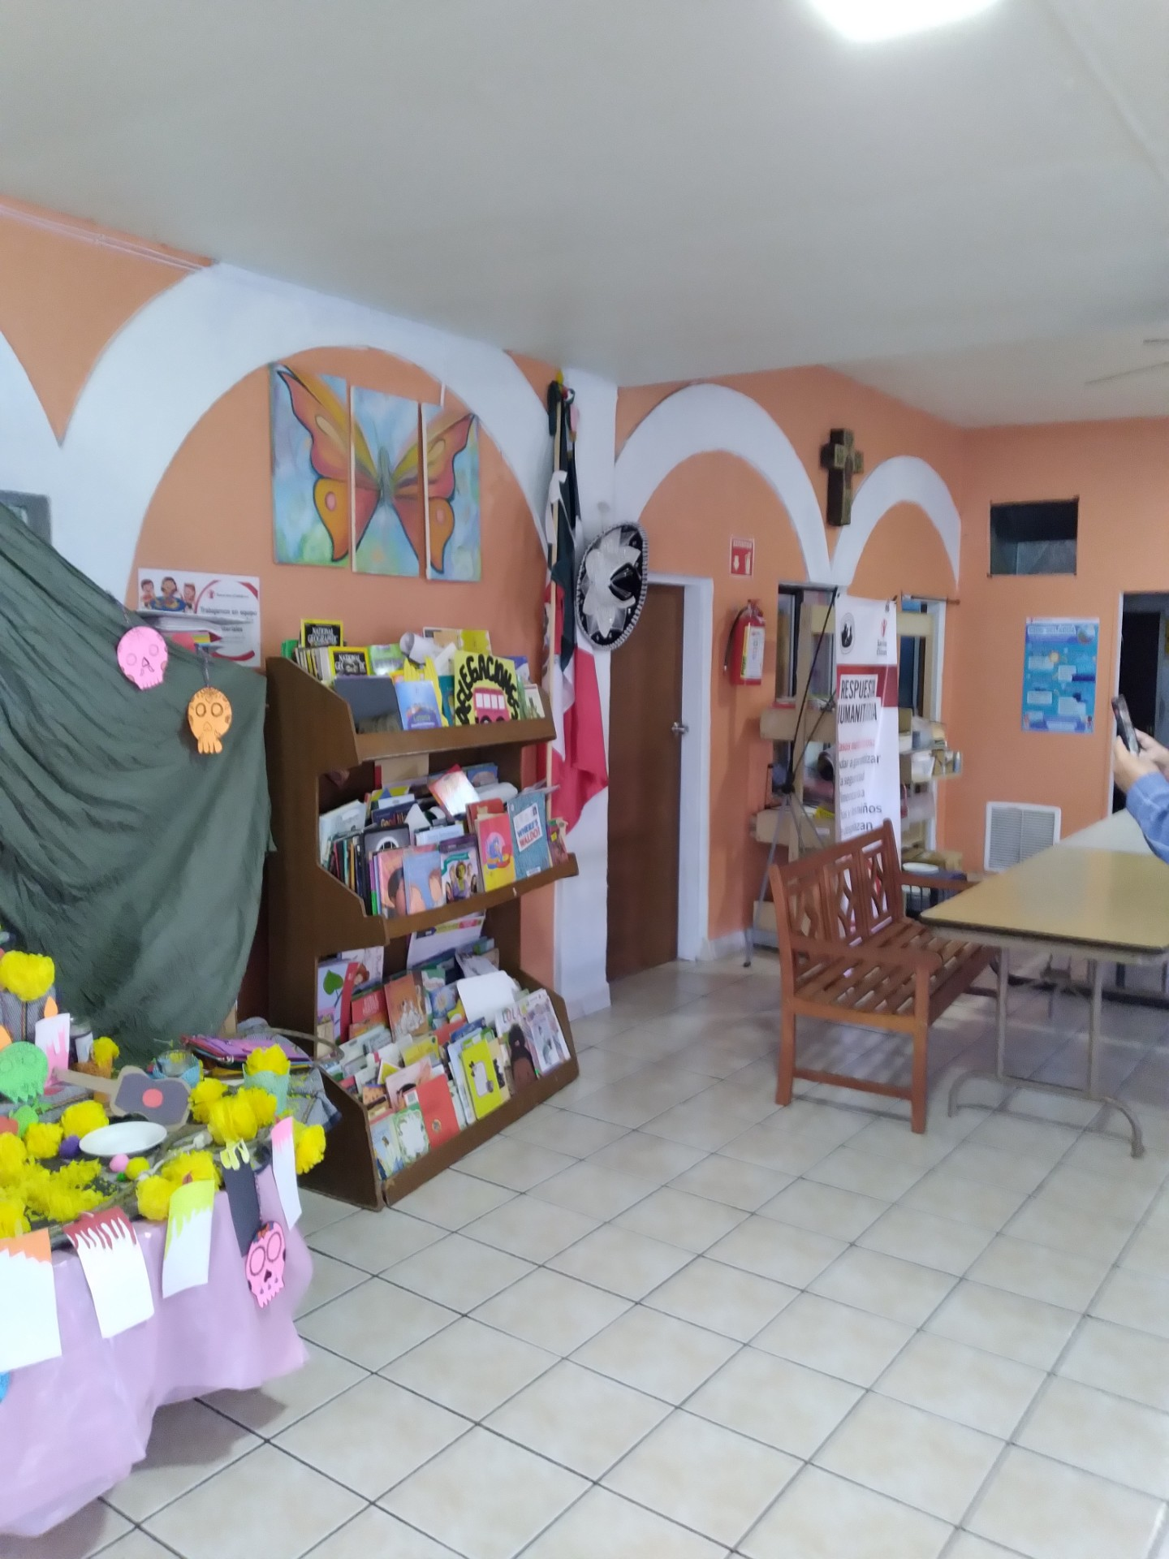
"House of Mercy and of All Nations".
Main Lobby
Notes:
Entrance to the main office

Slide 14
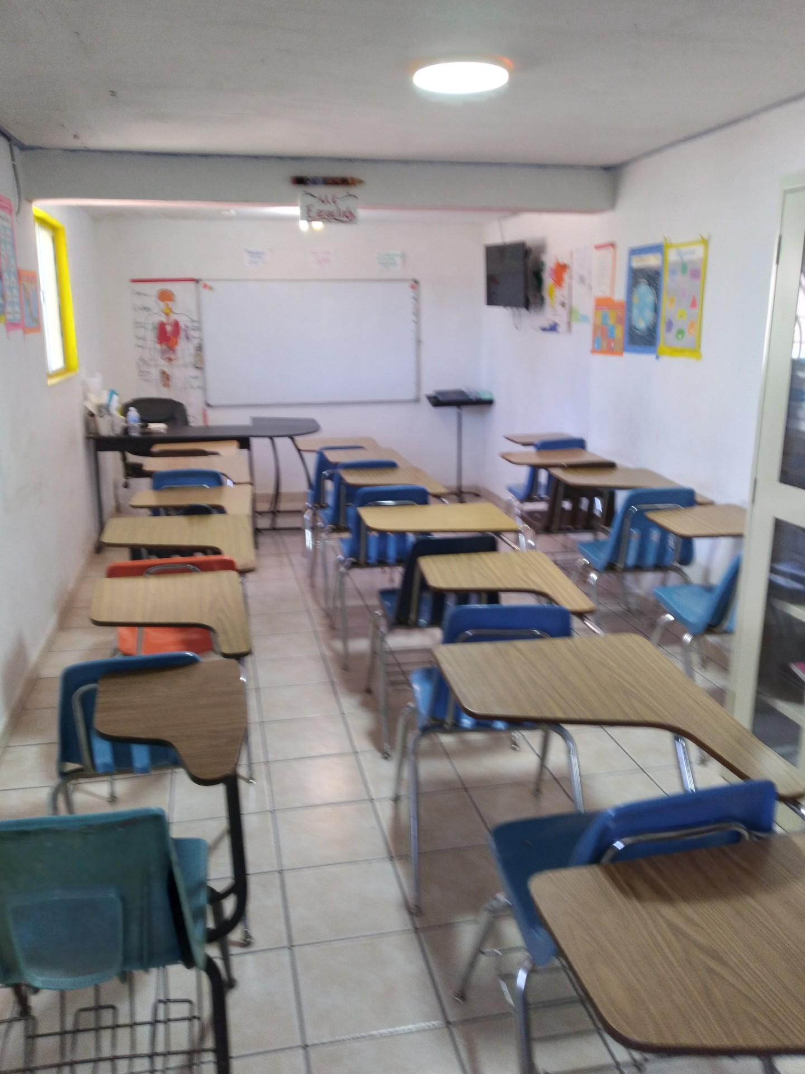
"House of Mercy and of All Nations".
One of Two Classroom – October 2022
Notes:
One of the classrooms
90 students graduate with a highschool diploma in 2023. That number dropped to 20 in 2024.

Slide 15

"House of Mercy and of All Nations".
The Kitchen Crew – October 2022
Notes:
The Kitchen Crew
Sister Lika, her sister and one other woman manage the shelter. The residents do all the cooking, cleaning and maintenance.

