Slide 1
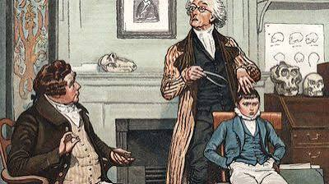
What Causes Crime
Notes:
NOTES
In

Slide 2
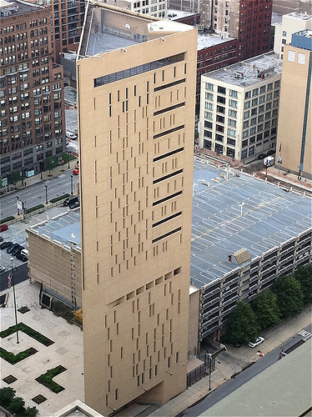
Outline
Welcome/Housekeeping
Historic Theories
A Scientific Approach
  Algorithms
  Criminogenic Factors
  Reducing Recidivism
Breakout Groups
Discussion/Wrap up
Notes:
Notes
A chair sits in the execution chamber at the Utah State Prison on June 18, 2010, after Ronnie Lee Gardner was executed by firing squad in Draper, Utah.

Slide 3
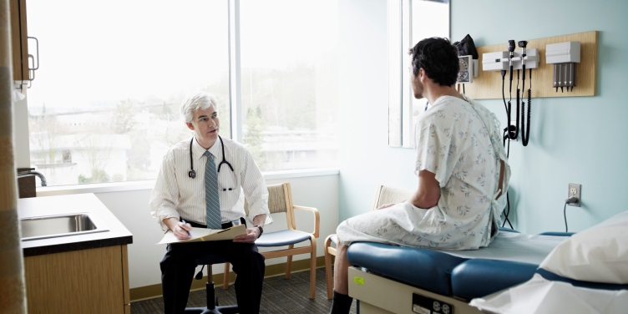

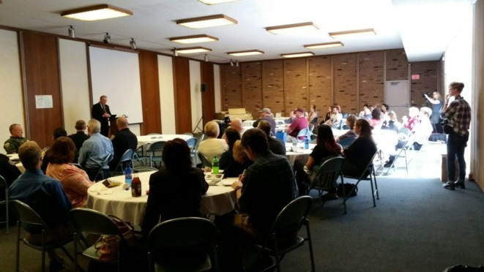
Medicine
Criminal Justice
Mid-1800’s
  Concern about effectiveness
  Application of scientific study
    Scientific methods
    Statistical analysis
1990’s
  Less than 20% of procedures studied were proven to work
  Campaign of rigorous study
  100,000 Lives Campaign
  122,342 deaths prevented
Possessed by the Devil
Phrenology
Medical Model
Robert Martinson
  Wrote a book in 1970’s
  “Nothing Works”
Scramble to Show Results
  Began applying research design
  Meta analysis became common

Slide 4
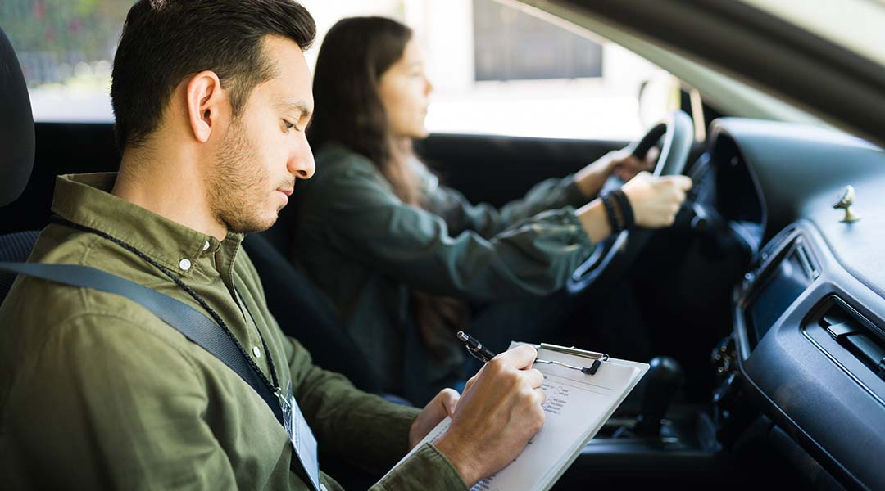
An algorithm is a set of finite, well-defined steps or instructions designed to solve a problem or perform a computation.

Slide 5
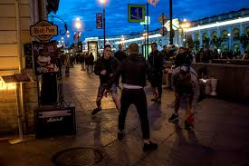
Risk
Need
Risk
Factors that can help measure or predict the likelihood of re-offending
Need
Personal traits and life circumstances linked to the cause of an individual's criminal behavior

Slide 6
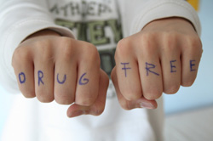
Key Terms
Risk
  Likelihood of further criminal activities – low, medium, & high
  Structure is used to control short term behavior
Need
  Criminogenic needs that lead to criminal behavior
  Programming is applied while under structure
Receptivity
  The willingness to address areas of need
  Begin where the client is willing to start
Dosage
  Medium risk – 100 hours
  High risk – 200 hours+
Notes:
WHERE TO FOCUS
Good classification instruments today focus on risk and need. These are critical to decision making about offenders.
Review definitions shown on slide.

Slide 7
Evidence-based Practices
Criminogenic Factors
The Big Four
The Moderate Four
Antisocial History/Lifestyle
Antisocial Personality
  Impulsive
  Aggressive
Antisocial Cognition
  Attitudes
  Values & beliefs
Antisocial Associates
Family/Marital
  Relationships
  Stability
School/Work
  Skills & strengths
  Relationships
Leisure/Recreation
Substance Abuse
Source: Psychology of Criminal Conduct, 2010

Slide 8
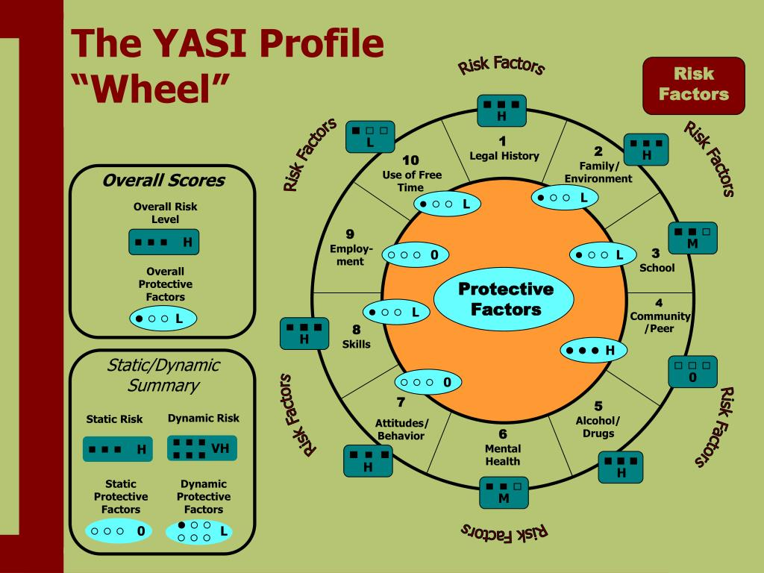

Slide 9
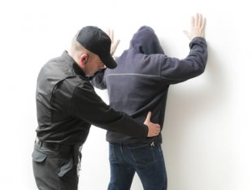


Target
Interventions
Manage Risk
Address Needs
Anti-social cognition
Anti-social associates
Leisure/recreation
Substance abuse
Receptivity
Start where the offender is ready to start
Dosage
Medium risk – 100 hours
High risk – 200 hours+
supervision, electronic home monitoring, halfway house, in-patient, incarceration

Slide 10
Targeted Interventions
Evidence-based Practices
Risk & Need
Manage the Risk
Address the Needs
Informal Supervision
Low
Intensity
Outpatient Groups
Formal Supervision
Day Centers
Community Centers
Group Homes
Inpatient Facilities
Secure Incarceration
High
Intensity
Therapeutic Communities

Slide 11



Breakout Groups
Computer will Place in Random Groups
  Take a minute and get acquainted
  Appoint a recorder/spokesperson
  Review handout and content covered in lecture
Subject Matter
  Discuss, in general, what has been covered today
  List questions that people have about the content
  List concerns about this approach or methodology
Report Outs
  A group will be asked for their conclusions
  Main points will be summarized

Slide 12
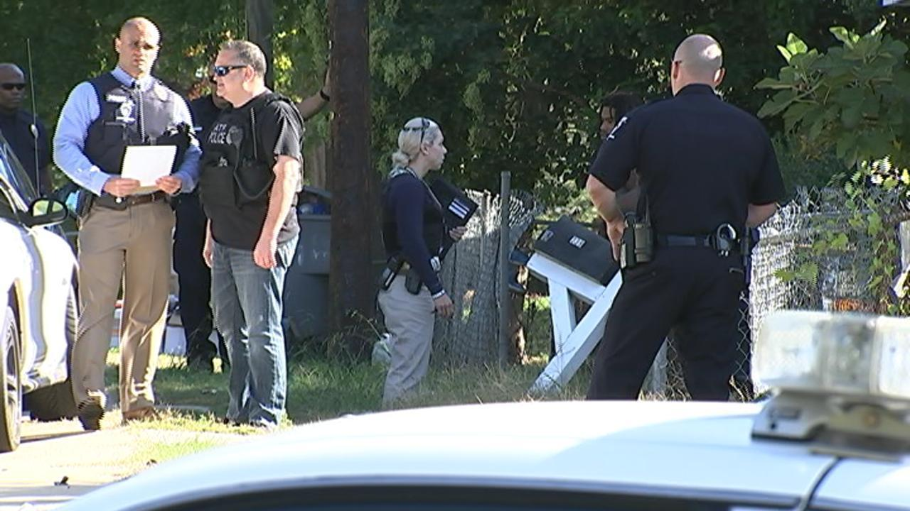
Summary
Reliance on Science
Past Practice Ineffective
Major Focus
  Harm reduction
  Reduced recidivism
Positive Results

Slide 13
Questions
Notes:
Notes

Slide 14
Programming High/Low Risk Offenders
Percent reduction in recidivism
Source: Latessa, Listwan & Koetzle, 2014
Notes:
Notes
Ohio Facilities
37 halfway houses & 15 community-based correctional facilities
Slide shows sample – about every third one
Offenders
Total of 13,221
Included both direct sentence and releases from prison
Tracked
2 year follow up
Recidivism – new arrests and re-incarcerations
Comparison group – released directly to supervision
Risk Level
Low risk – rated as having a 18% chance of recidivating
High risk – rated as having a 50% chance of recidivating

Slide 15
Ratio – Rewards to Sanctions
Sanctions | Rewards
Verbal reprimand Written assignment Modified curfew hours Community service hours Restrict visitation Program extension Electronic monitoring (EM) Inpatient treatment Detention time | Verbal praise, reinforcement Removal from EM Level advancement Increased personal time Approved special activiity Fees reduced Extended special visits
Probability of ISP Success
Source: Latessa, Listwan & Koetzle, 2014

Slide 16
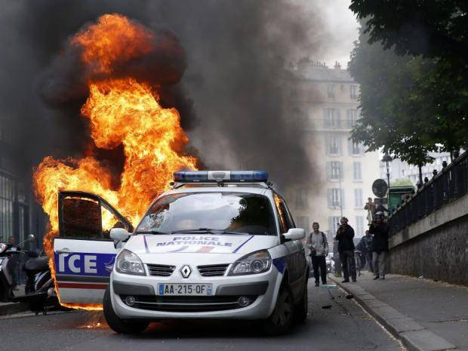
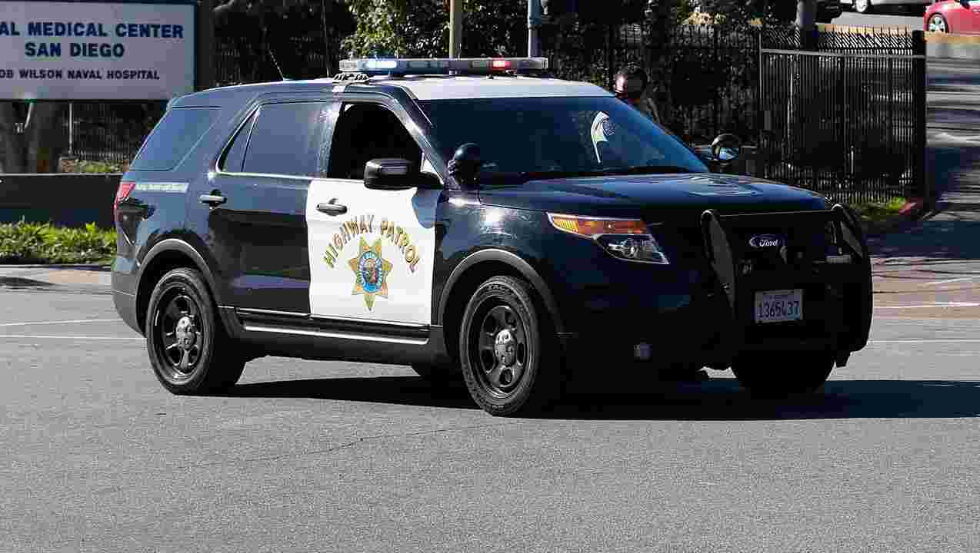
Can Make a Difference
Place-based or hot spots policing
Individual-focused strategies
  Juveniles
  Domestic violence
Neighborhood/ jurisdiction interventions
Some technology:
  Crime analysis
  License plate readers
  Body worn cameras
What has Little Impact
Fast response times did not increase arrests
Fast response times did not prevent crimes
No correlation between arrest & crime rates
Increased patrols did not deter crime
Arrests of some groups increased crime
  Juveniles
  Mentally ill

Slide 17
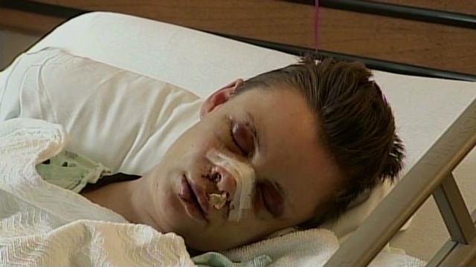
Harm Reduction
Decreases in the ill effects of crime experienced by:
Communities
  Resources allocated to the justice system that could otherwise be directed to alternative public priorities
  Unsafe streets
  Abandoned businesses
Victims
  Fear of reprisal or re-victimization
  Financial losses
Citizens
  Lack of confidence in community protection efforts
  Generalized fears of victimization
Families of offenders
  Loss of wages by a family member who is justice-system involved
  Inability of incarcerated fathers/mothers to fulfill their parenting roles
Offenders
  Homelessness
  Unemployment

Slide 18


From a Focus on How
Patrol zones
Report writing
Response times
Clearance rates
Conviction rates
Number of escapes
Caseload size
To a Focus on Outcomes
Increased public safety
Reduced harm to victims
Improved community wellness
Fewer drug/alcohol related traffic accidents
Satisfaction with CJ system
Fewer child welfare interventions
Reduced costs of CJ interventions

